Slide 1
DB Structure of DPI Project
Presented By
Pawan Kumar Chhangani
Raghvendra Kaushik

Slide 2
INDEX
Master Tables
Transaction Tables
Procedures
Versioning Tables
User Defined Table Types
Functions
- Table-valued Functions
- Scalar-valued Functions
Reports

Slide 3
Application working on 3 main Components
Masters
Transactions
Reports

Slide 4
Naming convention of Tables ,Stored Procedures & functions.
Table Name Should be in Pascal Case( Ex : SchoolRegistration)
Master Table Should be (prefix + Table Name)
- Ex(Mst + State=MstState)
Transaction Table Should be (prefix + Table Name)
- Ex(Trn + StudentRegistration=TrnStudentRegistration)
Stored Procedure should be
1. For Insertion (prefix + underscore + Table Name + underscore + Event name)
- Ex(USP_MstState_Insert)
2. For Updation (prefix + underscore + Table Name + underscore + Event name)
- Ex(USP_MstState_Update)
3. For Soft Delete (prefix + underscore + Table Name + underscore + Event name)
- Ex(USP_MstState_SoftDelete)
4. For Getting all Data in Grid after insertion(prefix + underscore + Table Name + underscore + Event name)
- Ex(USP_MstState_GetAll)
5. For Reporting (prefix + underscore + suffix + underscore + ReportName)
- Ex. (USP_Rpt_SchoolDetails)

Slide 5
Naming convention of Tables, user Defined Table Types ,Stored Procedures & functions.
User Defined Table Types (prefix + underscore + Suffix + Table Name)
- Ex(type_MstState=type_MstState)
Functions
- Table-Valued-Functions(Function Name)
- Ex(GetSchoolSetupForHS)
- Scaler-valued-Functions(Function Name)
- Ex(GetPolicyAmtFrequencyWise)
Temp Table Should be (prefix + Table Name)
- Ex(temp + GramPanchayatList=GramPanchayatList)
Triggers Should be (prefix +operation + working)
- Ex(trg + operation +working=trgUpdateLeaveDetails)
Jobs Should be (jb+operation)
- Ex(trg + operation=jbscheduleLeaveCalculation)

Slide 6
Total No. of Tables Count In Database
Total Masters Table : 79
Total Transaction Table :16

Slide 7
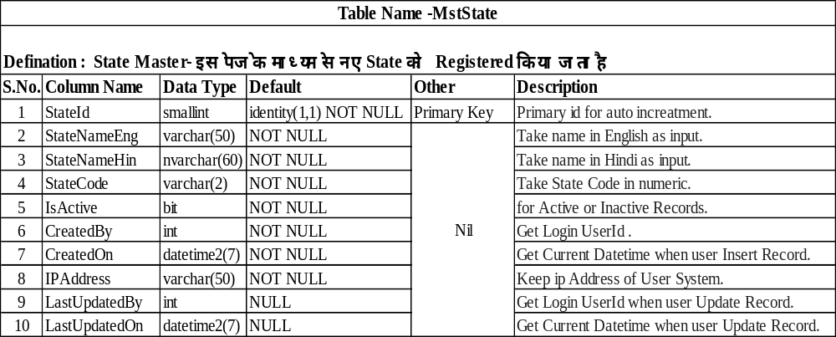
1. Master Tables
State Master

Slide 8
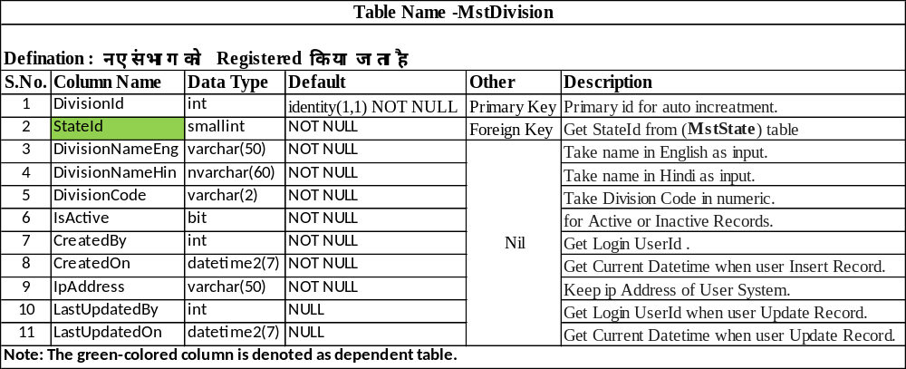
Division Master

Slide 9
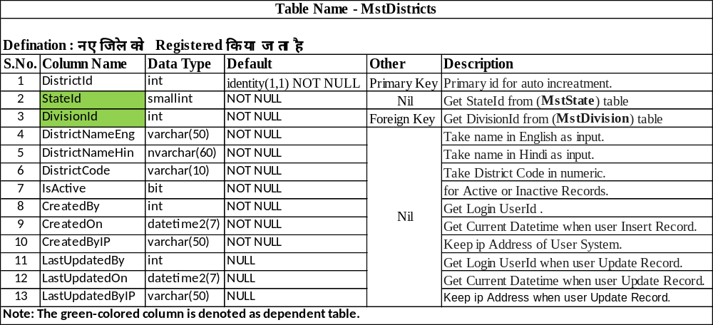
District Master

Slide 10
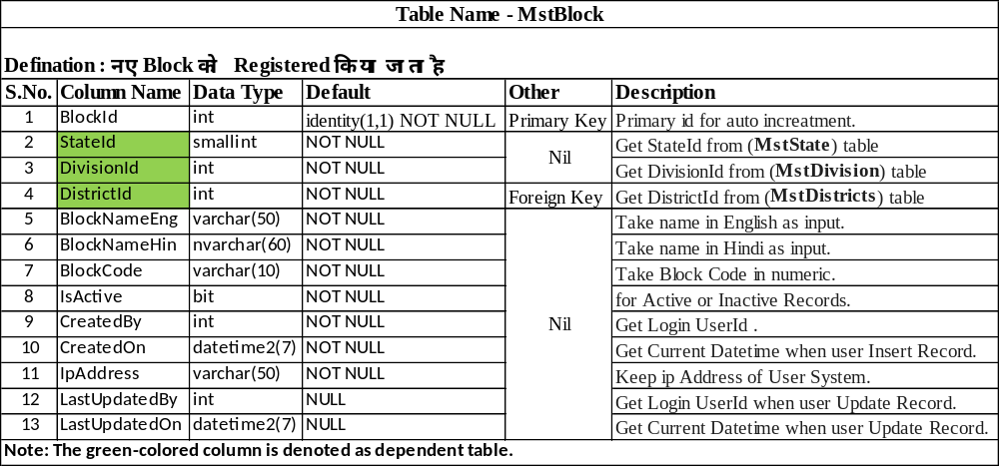
Block Master

Slide 11
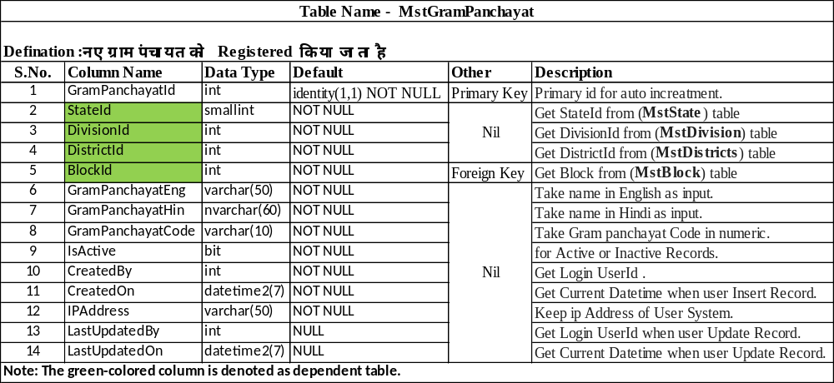
Gram Panchayat Master

Slide 12
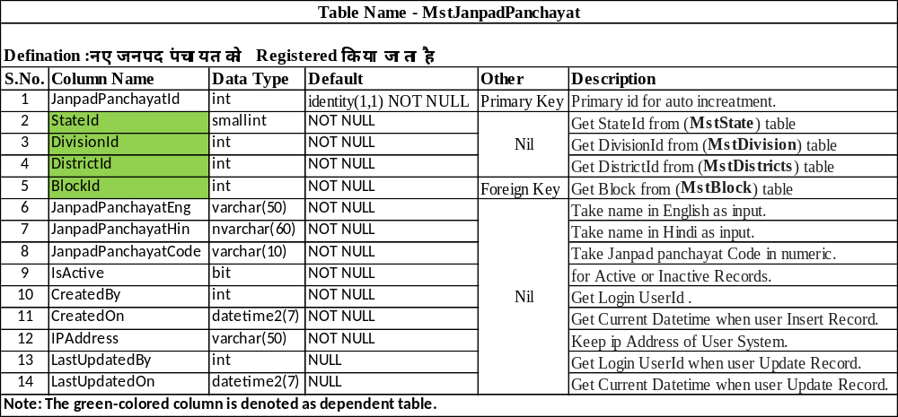
Janpad Panchayat Master

Slide 13
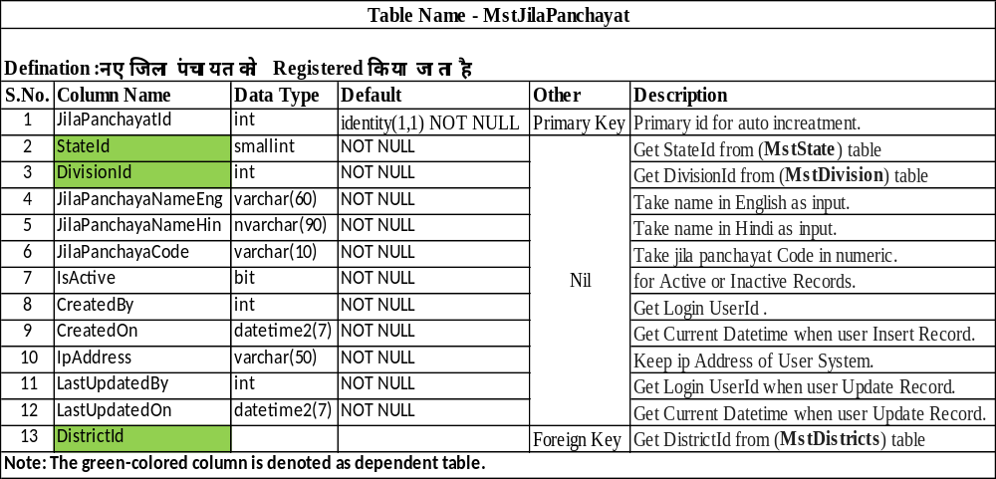
Jila Panchayat Master

Slide 14
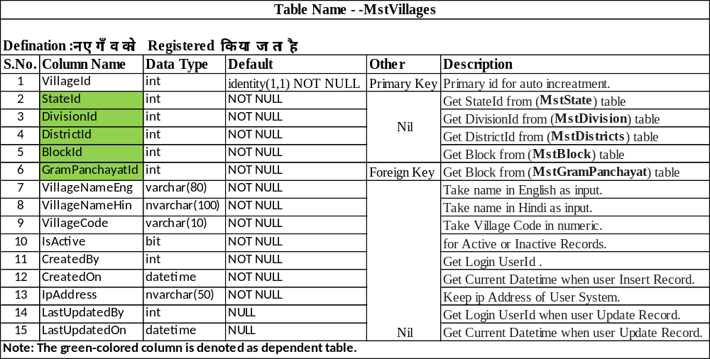
Village Master

Slide 15
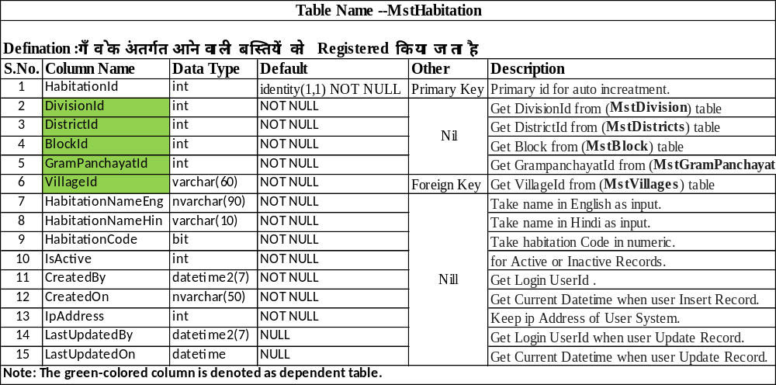
Habitation Master

Slide 16
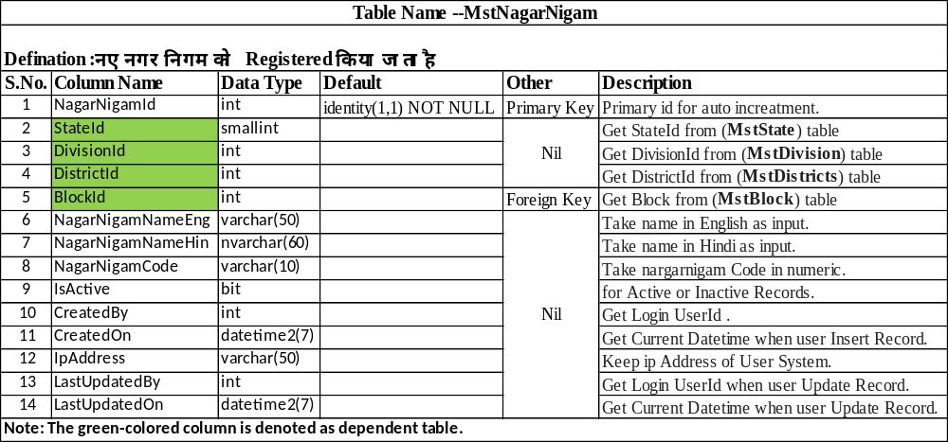
Nagar Nigam Master

Slide 17
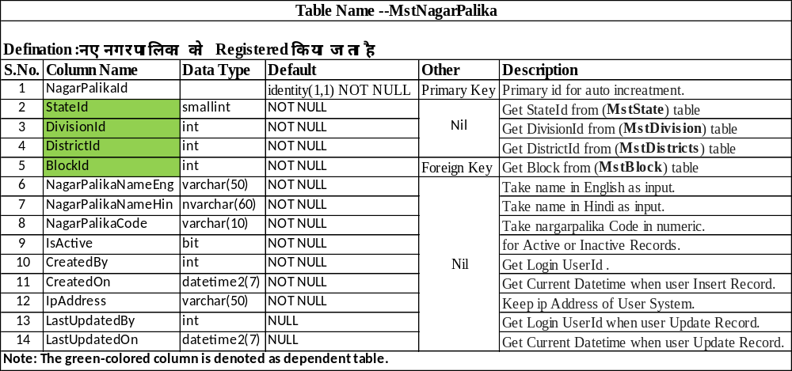
Nagar Palika Master

Slide 18
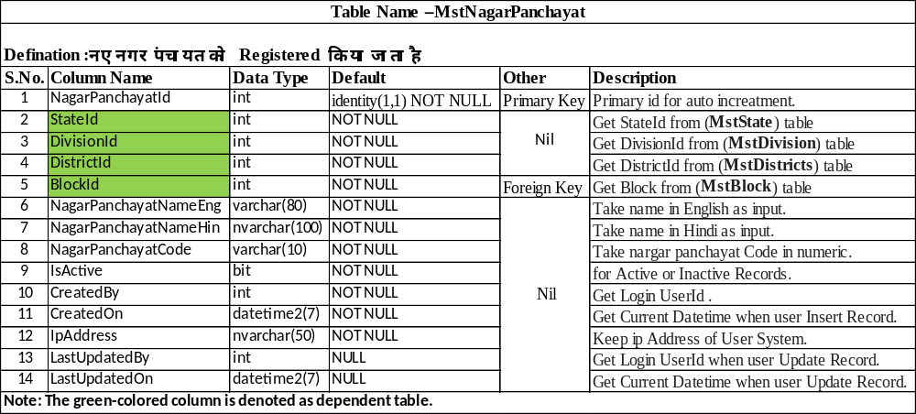
Nagar Panchayat Master

Slide 19
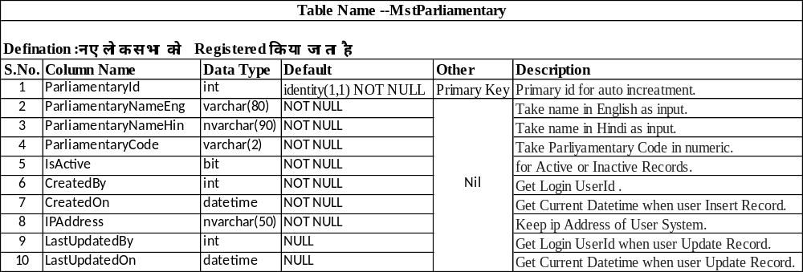
Parliamentary Master

Slide 20
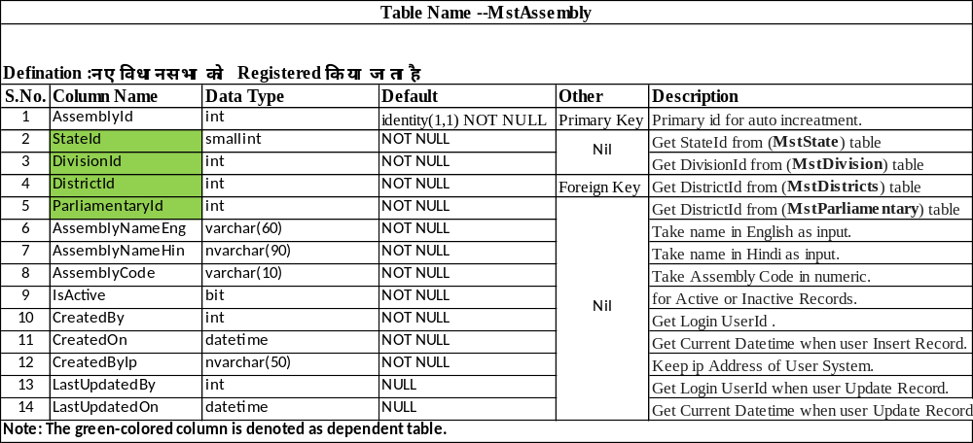
Assembly Master

Slide 21
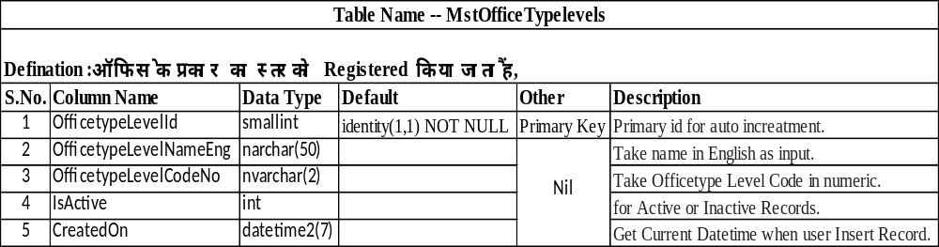
Office Type level Master

Slide 22
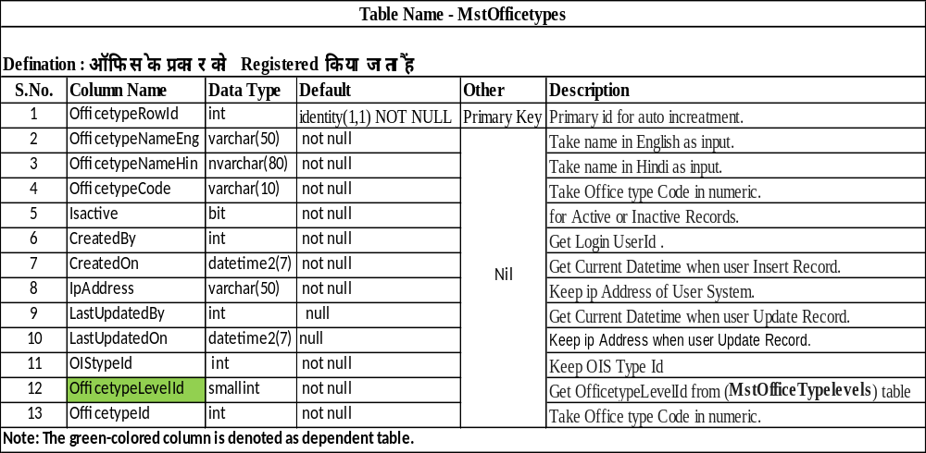
Office Type Master

Slide 23
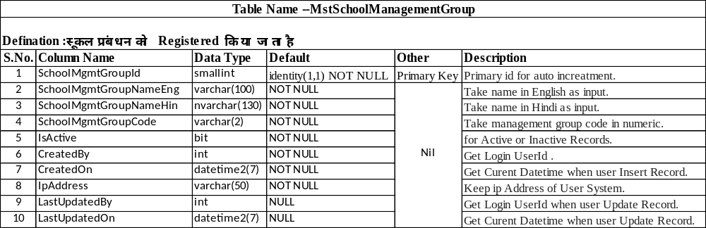
School Management Group Master

Slide 24
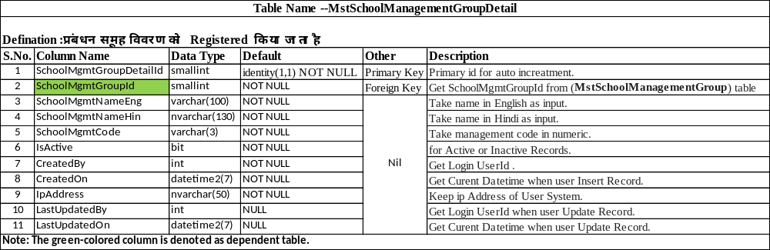
Management Group Details Master

Slide 25
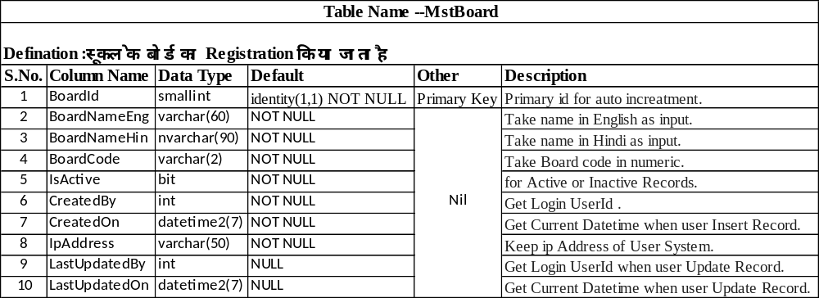
School Board Master

Slide 26
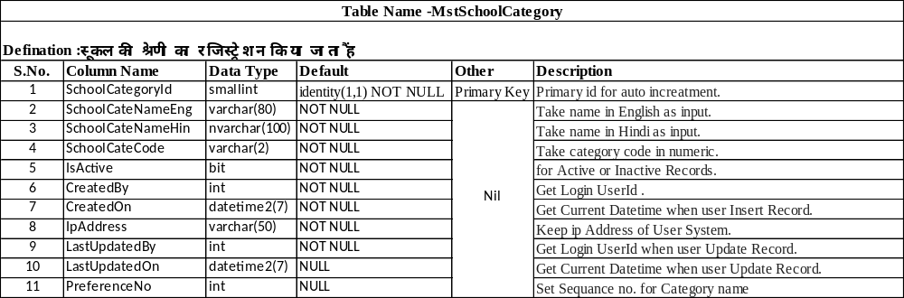
School Category Master

Slide 27
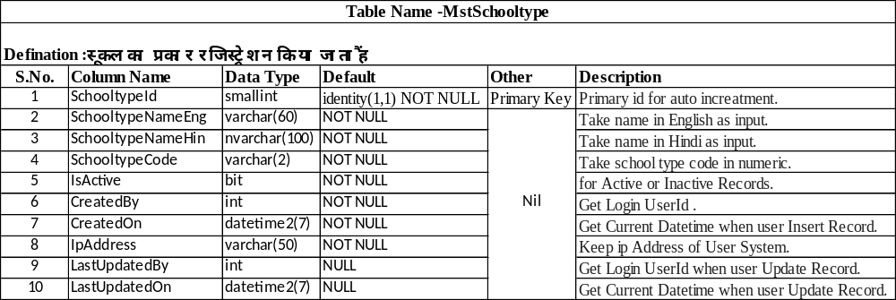
School Type Master

Slide 28
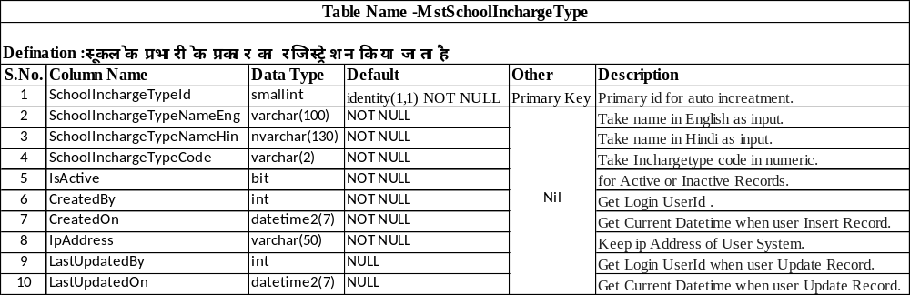
School Incharge Type Master

Slide 29
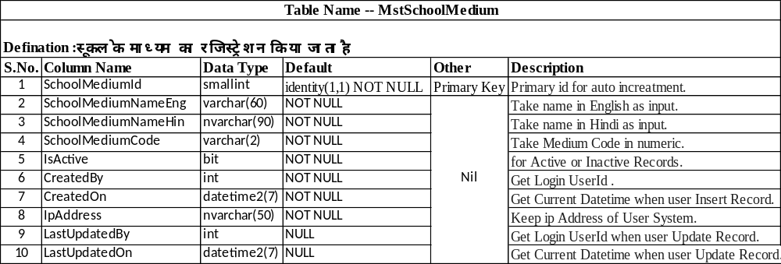
School Medium Master

Slide 30
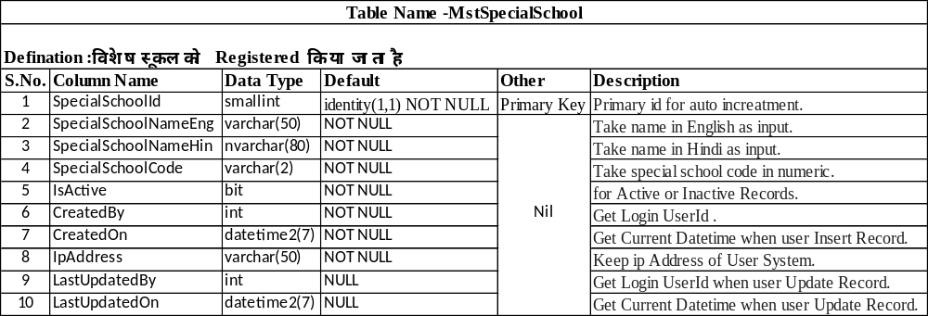
Special School Master

Slide 31
School Type Master

Slide 32
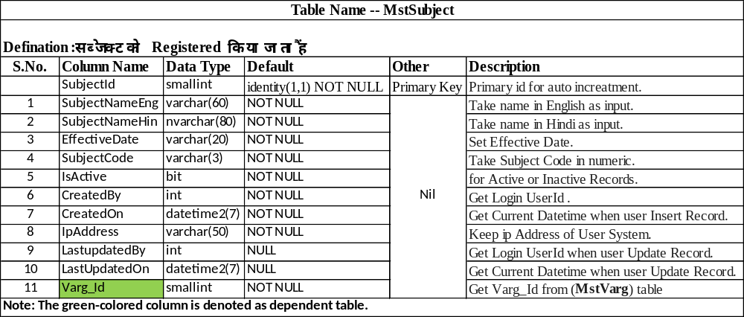
Subject Master

Slide 33
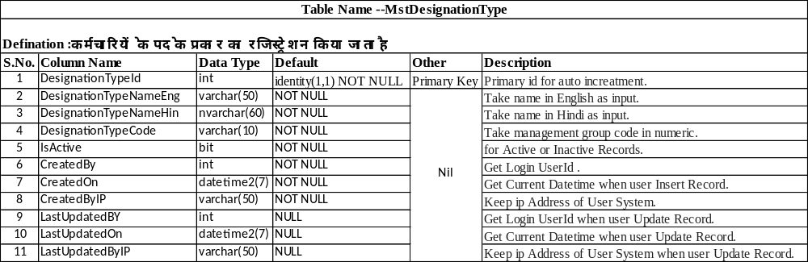
Designation Type Master

Slide 34
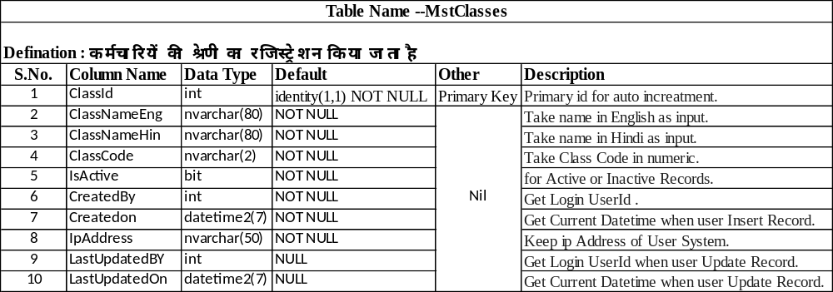
Employee Class Master

Slide 35
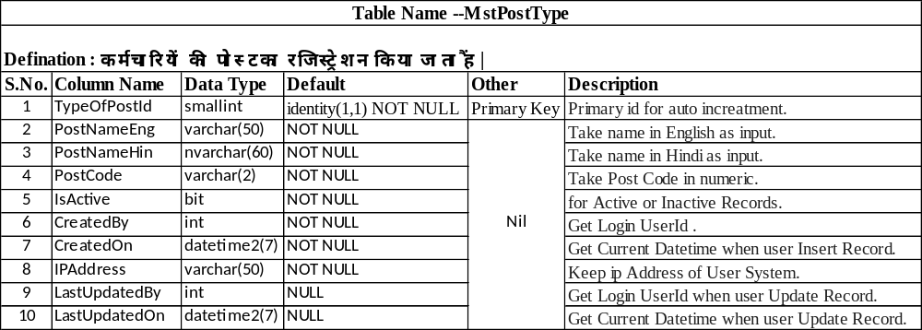
Post Type Master

Slide 36
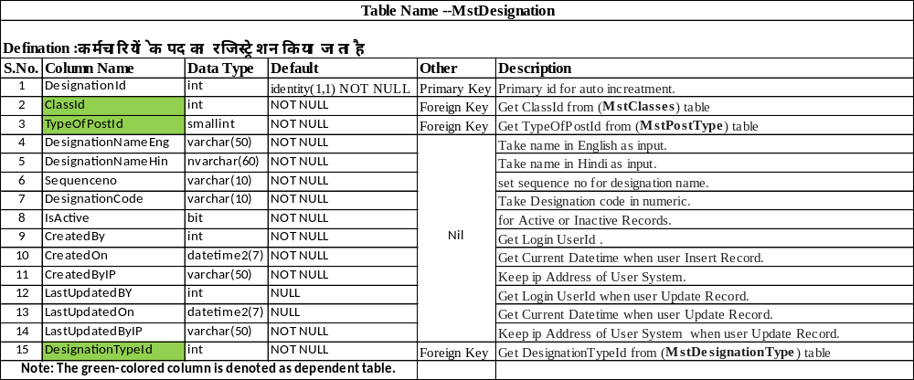
Designation Master

Slide 37
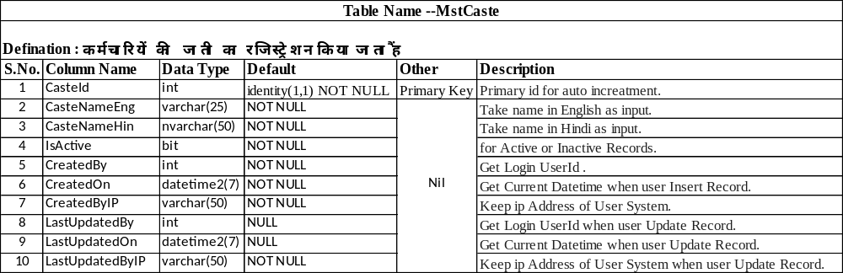
Caste Master

Slide 38
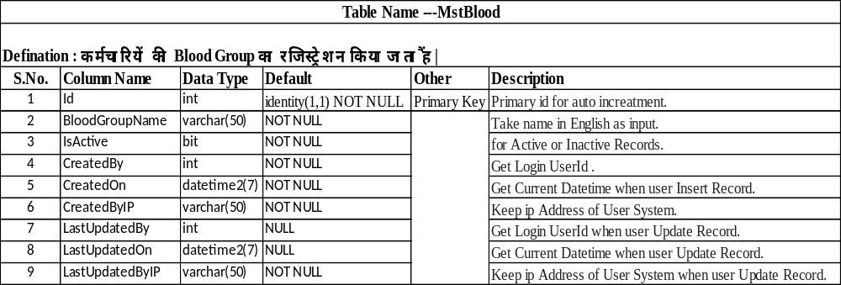
Blood Master

Slide 39
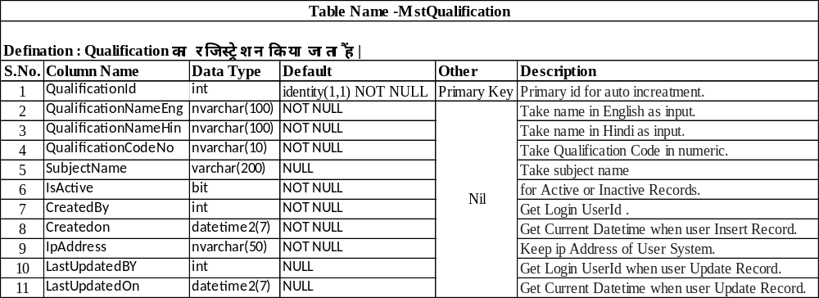
Qualification Master

Slide 40
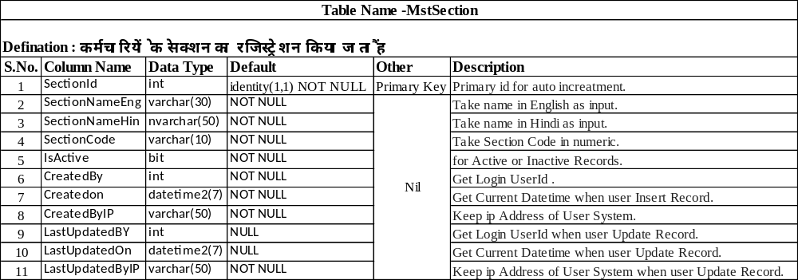
Section Master

Slide 41
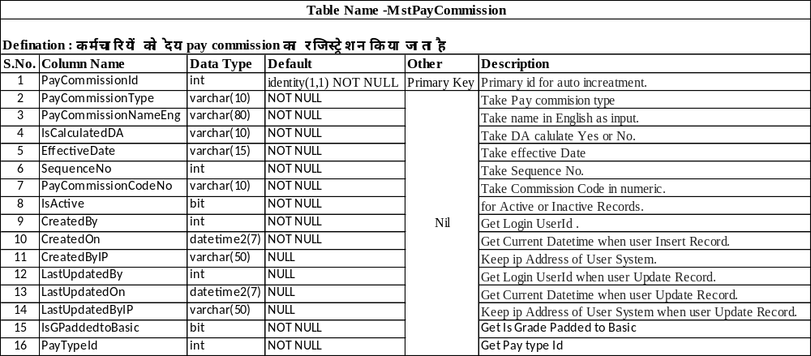
Pay Commission Master

Slide 42
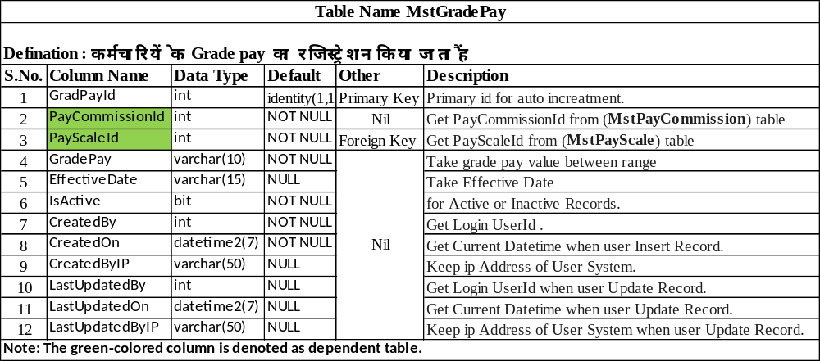
Grade Pay Master

Slide 43
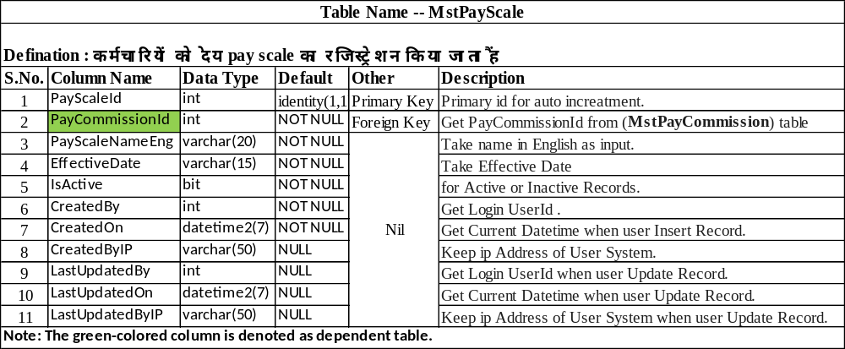
Pay Scale Master

Slide 44
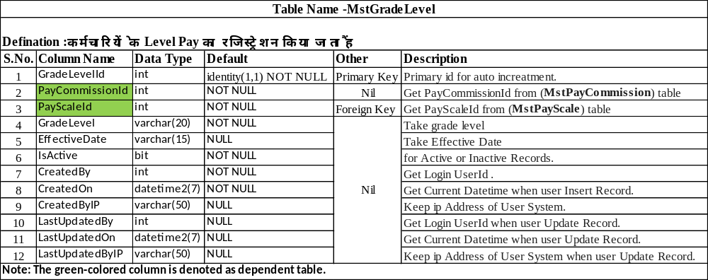
Grade Level Master

Slide 45
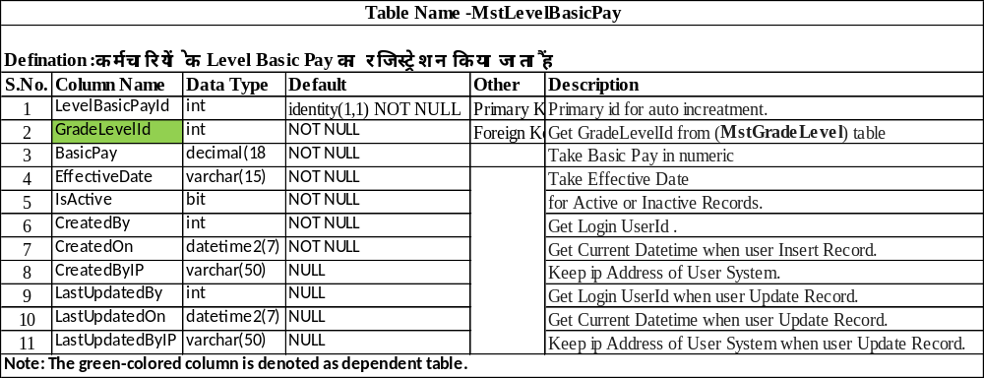
Level Basic Pay Master

Slide 46
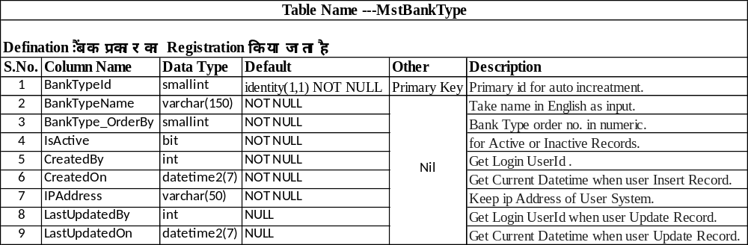
Bank Type Master

Slide 47
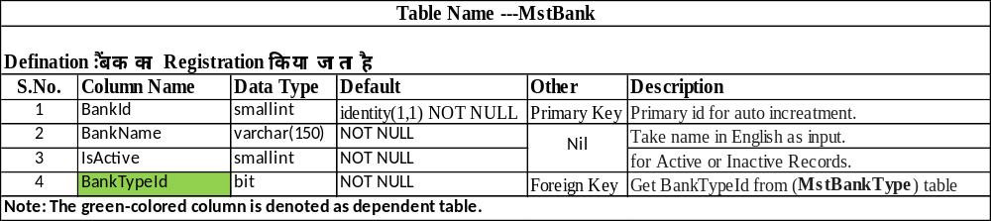
Bank Master

Slide 48
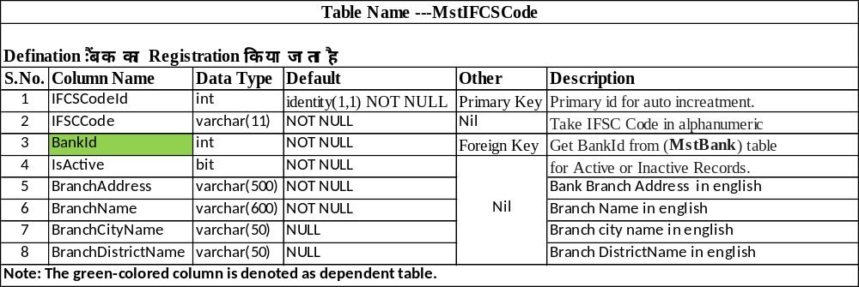
IFSC Code Master

Slide 49
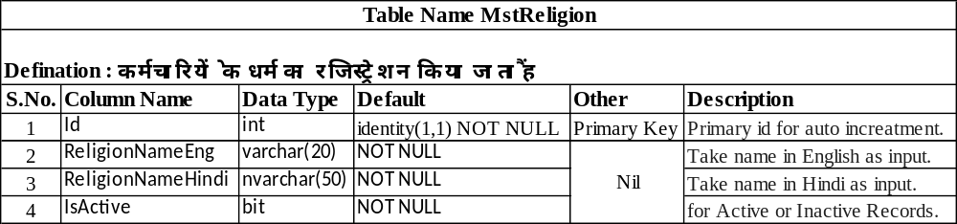
Religion Master

Slide 50
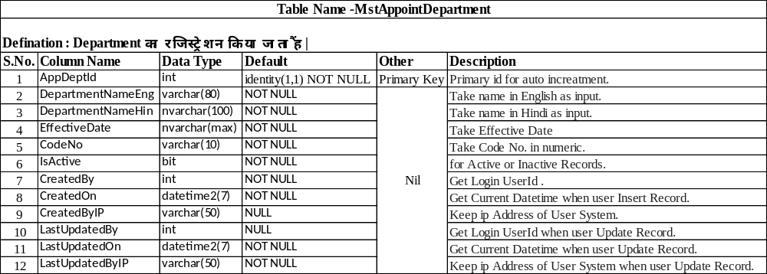
Appointment Department Master

Slide 51
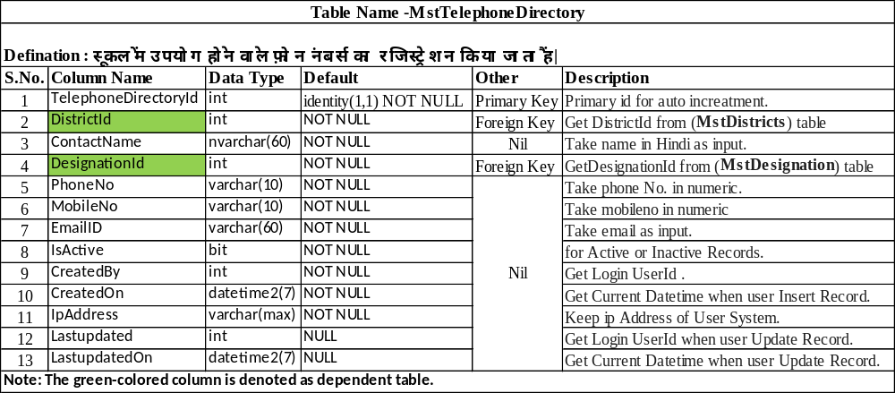
Telephone Directory Master

Slide 52
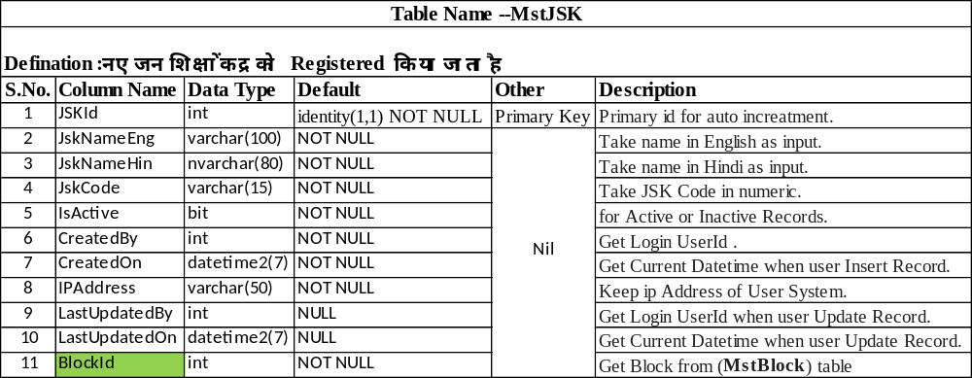
JSK Master

Slide 53
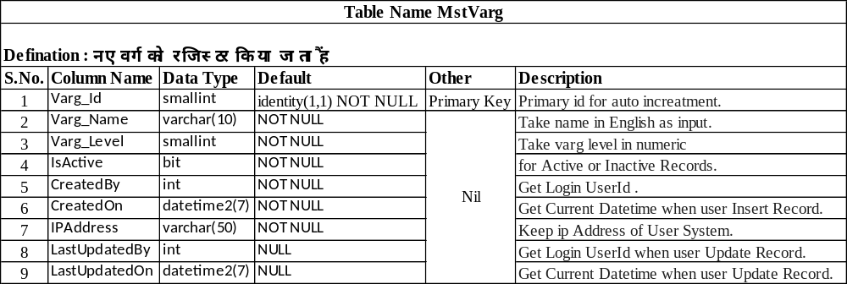
Varg Master

Slide 54
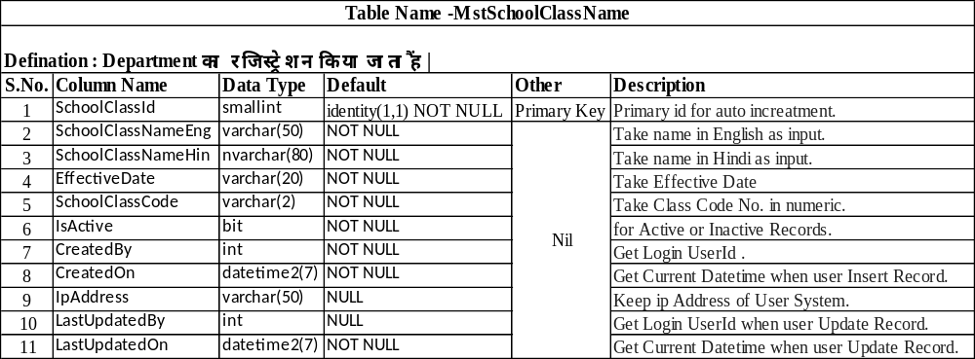
School Class Master

Slide 55
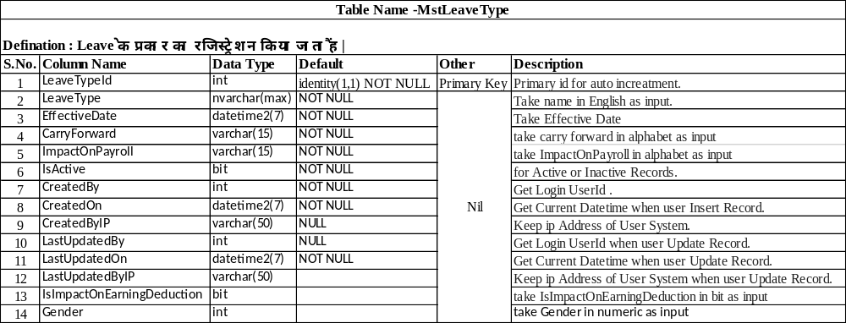
Leave Type Master

Slide 56
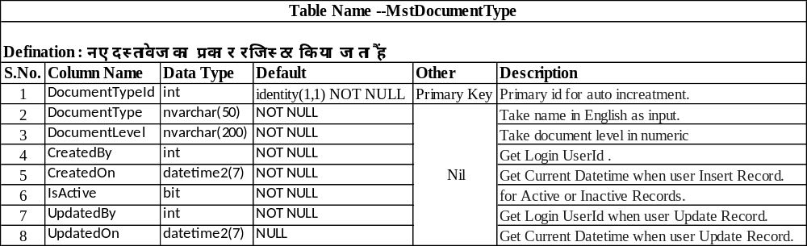
Document Type Master

Slide 57
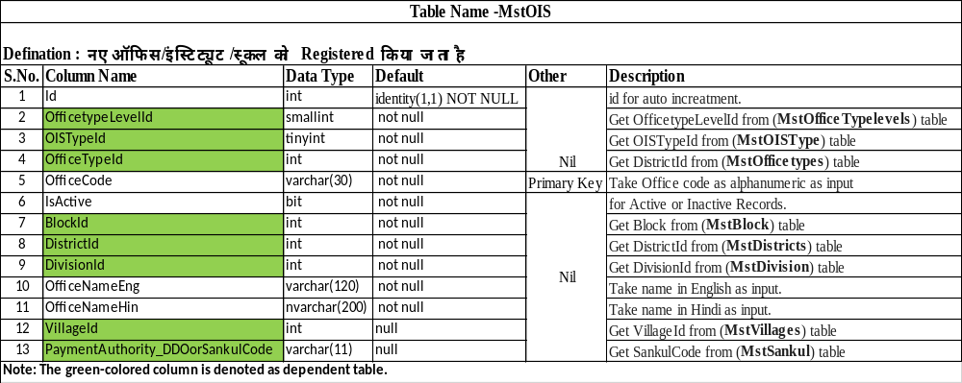
OIS Master

Slide 58

Criticalillness Type Master

Slide 59

Authority Objection Type Master

Slide 60

Class To Subject Type Master

Slide 61

Compassion Document Type Master

Slide 62

Complaint Topics Type Master

Slide 63

Complaint Type Master

Slide 64

Institute Registration Type Master-Part 01

Slide 65

Institute Registration Type Master-Part 02

Slide 66

Month Master

Slide 67

Panel Master

Slide 68

Panel Designation Mapping Master

Slide 69

Panel Group Master

Slide 70

Priority Master

Slide 71

Scheme Master

Slide 72

School Registration Master –Part 01

Slide 73

School Registration Master-Part 02

Slide 74

Student Registration Master-Part 01

Slide 75

Student Registration Master-Part 02

Slide 76

Apply Leave Master-Part 01

Slide 77

Apply Leave Master-Part 02

Slide 78

Varg Designation Mapping Master

Slide 79

Varg School Sub Category Mapping Master

Slide 80

Varg Subject Mapping Master

Slide 81

OIS Transfer Process-Part 01

Slide 82

OIS Transfer Process-Part 02

Slide 83

Office Setup

Slide 84

Post Code

Slide 85

Institute Setup

Slide 86

Employee Transfer Approval

Slide 87

Employee Transfer Location

Slide 88

Leave Allocation Type

Slide 89

Annual Confidential Report Master

Slide 90

Applicant Marital Stetus Master

Slide 91

Primary Teacher Degree Master

Slide 92

Relation With Prev Employee Master

Slide 93

Office Registration Master

Slide 94

Student Admission

Slide 95

Document Store

Slide 96

Handicapped Percentage Master

Slide 97

Sankul To School Mapping

Slide 98

Handicapped Type Master

Slide 99

School Close Process

Slide 100

School Merge Request

Slide 101

School Verification Process

Slide 102

Category Master

Slide 103

UnMapp School From Sankul

Slide 104

School Setup

Slide 105

Sankul Master

Slide 106

School UnMerge Request

Slide 107
HRMS-AppLogs
Table Name -AppLogs
Defination :
S.No. | Column Name | Data Type | Default | Other | Description
1 | Id | int | IDENTITY (1,1) | PRIMARY KEY | Primary id for auto increatment.
2 | Message | nvarchar(MAX) | NOT NULL |  | Take Message as String.
3 | MessageTemplate | nvarchar(MAX) | NOT NULL |  | Take MessageTemplate as String.
4 | Level | nvarchar(256) | NOT NULL |  | Take Level as String.
5 | TimeStamp | datetime2 | NOT NULL |  | Take input as date
6 | Exception | nvarchar(MAX) | NULL |  | Take Exception as String.
7 | LogEvent | nvarchar(MAX) | NOT NULL |  | Take LogEvent as String.
8 | RequestId | nvarchar(MAX) | NULL |  | Take RequestId as String.
9 | RequestPath | nvarchar(MAX) | NULL |  | Take RequestPath as String.
10 | UserId | int | NULL |  | Get Login UserId .
11 | Username | nvarchar(MAX) | NULL |  | Take Username as String.
12 | MachineName | nvarchar(1000) | NULL |  | Take MachineName as String.
13 | ClientIp | nvarchar(200) | NULL |  | Keep IP Address of User System.

Slide 108
HRMS- Child_TrnApplyTour
Table Name - Child_TrnApplyTour
Defination :
S.No. | Column Name | Data Type | Default | Other | Description
1 | ChildTourId | int | IDENTITY (1,1) | PRIMARY KEY | Primary id for auto increatment.
2 | TourId | int | NULL |  | Get TourId (TrnApplyTour) in Numaric
3 | DestinationDistrictId | varchar(MAX) | NULL |  | Take DestinationDistrictId as String.

Slide 109
HRMS- EmpDocuments
Table Name - EmpDocuments
Defination :
S.No. | Column Name | Data Type | Default | Other | Description
1 | EmpDocumentId | int | IDENTITY (1,1) | PRIMARY KEY | Primary id for auto increatment.
2 | EmpUniqueId | varchar(30) | NOT NULL |  | Get EmpUniqueId (MstEmployeeRegistration) in Numaric
3 | DocTypeId | smallint | NOT NULL
4 | DocName | nvarchar(MAX) | NOT NULL |  | Take DocName as String.
5 | IsActive | bit | NOT NULL |  | Keep IP Address of User System.
6 | CreatedBy | int | NOT NULL |  | Get Login UserId .
7 | CreatedOn | datetime2 | NOT NULL |  | Get Current Datetime when user Insert Record.
8 | CreatedByIP | varchar(30) | NOT NULL |  | Keep IP Address of User System.
9 | UpdatedBy | int | NULL |  | Get Login UserId .
10 | UpdatedOn | datetime2 | NULL |  | Get Current Datetime when user Insert Record.
11 | UpdatedByIP | varchar(30) | NULL |  | Keep IP Address of User System.
Note : The Colored column denoted as dependent Table

Slide 110
HRMS- EmployeeVerificationProcess
Table Name -EmployeeVerificationProcess
Defination :
S.No. | Column Name | Data Type | Default | Other | Description
1 | EmpVerificationProcessId | int | IDENTITY (1,1) | PRIMARY KEY | Primary id for auto increatment.
2 | EmpRegId | int | NOT NULL |  | Get EmpRegId (MstEmployeeRegistration) in Numaric
3 | EmpUniqueId | varchar(30) | NULL |  | Get EmpUniqueId (MstEmployeeRegistration) in Numaric
4 | ReqNo | varchar(30) | NULL |  | Take ReqNo as String.
5 | ReqDate | datetime2 | NULL |  | Take input as date
6 | ReqRemarks | nvarchar(400) | NULL |  | Take ReqRemarks as String.
7 | VerificationRequestBy | int | NOT NULL |  | Get Login UserId .
8 | VerificationRequestOn | datetime2 | NULL |  | Get Current Datetime when user Insert Record.
9 | VerificationRequestByIP | varchar(50) | NULL |  | Keep IP Address of User System.
10 | VerifyOrRejectBy | int | NOT NULL |  | Get Login UserId .
11 | VerifyOrRejectOn | datetime2 | NULL |  | Get Current Datetime when user Insert Record.
12 | VerifyOrRejectByIP | varchar(50) | NULL |  | Keep IP Address of User System.
13 | VerifyOrRejectRemarks | nvarchar(400) | NULL |  | Take VerifyOrRejectRemarks as String.
14 | Status | int | NULL |  | Take Status as Int.
15 | PeriodEnd | datetime2 | NOT NULL |  | Take input as date
16 | PeriodStart | datetime2 | NOT NULL |  | Take input as date
Note : The Colored column denoted as dependent Table

Slide 111
HRMS- EmpQualificationDetails
Table Name -EmpQualificationDetails
Defination :
S.No. | Column Name | Data Type | Default | Other | Description
1 | QualificationuniqueId | int | NOT NULL | PRIMARY KEY | Primary id for auto increatment.
2 | EmpUniqueId | varchar(15) | NULL |  | Get EmpUniqueId (MstEmployeeRegistration) in Numaric
3 | QualificationId | varchar(MAX) | NULL |  | Take QualificationId as String.
4 | Subject | varchar(MAX) | NULL |  | Take Subject as String.
5 | UnivercityName | varchar(MAX) | NULL |  | Take UnivercityName as String.
6 | PassingYear | varchar(MAX) | NULL |  | Take PassingYear as String.
7 | Percentage | varchar(MAX) | NULL |  | Take Percentage as String.
8 | CreatedBy | int | NULL |  | Get Login UserId .
9 | CreatedOn | datetime2 | NOT NULL |  | Get Current Datetime when user Insert Record.
10 | IPAddress | varchar(MAX) | NULL |  | Keep IP Address of User System.
11 | LastUpdatedBy | int | NULL |  | Get Login UserId .
12 | LastUpdatedOn | datetime2 | NULL |  | Get Current Datetime when user Insert Record.
Note : The Colored column denoted as dependent Table

Slide 112
HRMS- MstAddEmployeeACR
Table Name - MstAddEmployeeACR
Defination :
S.No. | Column Name | Data Type | Default | Other | Description
1 | AcrId | int | IDENTITY (1,1) | PRIMARY KEY | Primary id for auto increatment.
2 | FinancialYear | int | NULL |  | Take FinancialYear as Int.
3 | EmployeeId | int | NULL |  | Get EmployeeId (MstEmployeeRegistration) in Numaric
4 | DesignationId | int | NULL |  | Get DesignationId (MstDesignation) in Numaric
5 | EmpUniqueId | nvarchar(12) | NULL |  | Get EmpUniqueId (MstEmployeeRegistration) in Numaric
6 | DOB | datetime2 | NULL |  | Take input as date
7 | BlockId | int | NULL |  | Get BlockId (MstBlock) in Numaric
8 | OfficeNameandCode | nvarchar(100) | NULL |  | Take OfficeNameandCode as String.
9 | PostingDate | datetime2 | NULL |  | Take input as date
10 | PromotionDate | datetime2 | NULL |  | Take input as date
11 | AnnualPropertyReturnDate | datetime2 | NULL |  | Take input as date
12 | ReportingOfficerId | nvarchar(12) | NULL |  | Take ReportingOfficerId as String.
13 | RejectingOfficerComment | nvarchar(200) | NULL |  | Take RejectingOfficerComment as String.
14 | ForwardingReportingOfficerId | nvarchar(12) | NULL |  | Take ForwardingReportingOfficerId as String.
15 | ReasonForNotComplete | nvarchar(200) | NULL |  | Take ReasonForNotComplete as String.
16 | ReasonForNotCompleteTargetSyllabusSectionWise | nvarchar(200) | NULL |  | Take ReasonForNotCompleteTargetSyllabusSectionWise as String.
17 | Status | int | NULL |  | Take Status as Int.
18 | CreatedBy | int | NOT NULL |  | Get Login UserId .
19 | CreatedOn | datetime2 | NOT NULL |  | Get Current Datetime when user Insert Record.
20 | CreatedByIP | nvarchar(100) | NOT NULL |  | Keep IP Address of User System.
21 | LastUpdatedBy | int | NULL |  | Get Login UserId .
22 | LastUpdatedOn | datetime2 | NULL |  | Get Current Datetime when user Insert Record.
23 | LastUpdatedByIP | nvarchar(100) | NOT NULL |  | Keep IP Address of User System.
24 | PeriodEnd | datetime2 | NOT NULL |  | Take input as date
25 | PeriodStart | datetime2 | NOT NULL |  | Take input as date
Note : The Colored column denoted as dependent Table

Slide 113
HRMS- MstCivilDocumentType
Table Name - MstCivilDocumentType
Defination :
S.No. | Column Name | Data Type | Default | Other | Description
1 | DocTypeId | bigint | IDENTITY (1,1) | PRIMARY KEY | Primary id for auto increatment.
2 | DocTypeNameEng | varchar(60) | NULL |  | Take DocTypeNameEng as String.
3 | DocTypeNameHin | nvarchar(240) | NULL |  | Take DocTypeNameHin as String.
4 | IsMandatory | bit | NOT NULL |  | For active or inactive record.
5 | FormName | varchar(70) | NULL |  | Take FormName as String.

Slide 114
HRMS- MstCMSContactUs
Table Name - MstCMSContactUs
Defination :
S.No. | Column Name | Data Type | Default | Other | Description
1 | ContactUsId | int | IDENTITY (1,1) | PRIMARY KEY | Primary id for auto increatment.
2 | UseInHinAndEng | bit | NOT NULL |  | For UseInHinAndEng Check.
3 | Name | nvarchar(300) | NULL |  | Take Name as String.
4 | Adderess | nvarchar(500) | NULL |  | Take Adderess as String.
5 | ContactNo | varchar(15) | NULL |  | Take ContactNo as String.
6 | EmailID | nvarchar(300) | NULL |  | Take EmailID as String.
7 | IsActive | bit | NOT NULL |  | For active or inactive record.
8 | CreatedBy | int | NULL |  | Get Login UserId .
9 | CreatedOn | datetime2 | NULL |  | Get Current Datetime when user Insert Record.
10 | CreatedByIP | varchar(50) | NULL |  | Keep IP Address of User System.
11 | LastUpdatedBY | int | NULL |  | Get Login UserId .
12 | LastUpdatedOn | datetime2 | NULL |  | Get Current Datetime when user Insert Record.
13 | LastUpdatedByIP | varchar(50) | NULL |  | Keep IP Address of User System.

Slide 115
HRMS- MstCMSFooter
Table Name - MstCMSFooter
Defination :
S.No. | Column Name | Data Type | Default | Other | Description
1 | FooterID | int | IDENTITY (1,1) | PRIMARY KEY | Primary id for auto increatment.
2 | UseInHinAndEng | bit | NOT NULL |  | For UseInHinAndEng Check.
3 | Name | nvarchar(300) | NULL |  | Take Name as String.
4 | Adderess | nvarchar(500) | NULL |  | Take Adderess as String.
5 | ContactNo | varchar(15) | NULL |  | Take ContactNo as String.
6 | EmailID | nvarchar(300) | NULL |  | Take EmailID as String.
7 | FooterAbout | nvarchar(500) | NULL |  | Take FooterAbout as String.
8 | IsActive | bit | NOT NULL |  | For active or inactive record.
9 | CreatedBy | int | NULL |  | Get Login UserId .
10 | CreatedOn | datetime2 | NULL |  | Get Current Datetime when user Insert Record.
11 | CreatedByIP | varchar(50) | NULL |  | Keep IP Address of User System.
12 | LastUpdatedBY | int | NULL |  | Get Login UserId .
13 | LastUpdatedOn | datetime2 | NULL |  | Get Current Datetime when user Insert Record.
14 | LastUpdatedByIP | varchar(50) | NULL |  | Keep IP Address of User System.

Slide 116
HRMS- MstCMSFooterQuickLink
Table Name - MstCMSFooterQuickLink
Defination :
S.No. | Column Name | Data Type | Default | Other | Description
1 | FooterQuickLinkID | int | IDENTITY (1,1) | PRIMARY KEY | Primary id for auto increatment.
2 | UseInHinAndEng | bit | NOT NULL |  | For UseInHinAndEng Check.
3 | Title | nvarchar(200) | NULL |  | Take Title as String.
4 | LinkTypeId | int | NULL |  | Take LinkTypeId as Int.
5 | DocUpload | nvarchar(300) | NULL |  | Take ImagePath as String.
6 | Url | nvarchar(300) | NULL |  | Take Url as String.
7 | SliderSequenceNo | varchar(50) | NULL |  | Take SliderSequenceNo as String.
8 | IsActive | bit | NOT NULL |  | For active or inactive record.
9 | CreatedBy | int | NULL |  | Get Login UserId .
10 | CreatedOn | datetime2 | NULL |  | Get Current Datetime when user Insert Record.
11 | CreatedByIP | varchar(50) | NULL |  | Keep IP Address of User System.
12 | LastUpdatedBY | int | NULL |  | Get Login UserId .
13 | LastUpdatedOn | datetime2 | NULL |  | Get Current Datetime when user Insert Record.
14 | LastUpdatedByIP | varchar(50) | NULL |  | Keep IP Address of User System.

Slide 117
HRMS- MstCMSHomeSlider
Table Name -MstCMSHomeSlider
Defination :
S.No. | Column Name | Data Type | Default | Other | Description
1 | HomeSliderID | int | NOT NULL | PRIMARY KEY | Primary id for auto increatment.
2 | UseInHinAndEng | bit | NOT NULL |  | For UseInHinAndEng Check.
3 | SliderImg | nvarchar(200) | NULL |  | Take ImagePath as String.
4 | SliderSequenceNo | varchar(50) | NULL |  | Take SliderSequenceNo as String.
5 | IsActive | bit | NOT NULL |  | For active or inactive record.
6 | CreatedBy | int | NULL |  | Get Login UserId .
7 | OfficeId | int | NULL |  | Get OfficeId (MstOIS) in Numaric
8 | CreatedOn | datetime2 | NULL |  | Get Current Datetime when user Insert Record.
9 | CreatedByIP | varchar(50) | NULL |  | Keep IP Address of User System.
10 | LastUpdatedBY | int | NULL |  | Get Login UserId .
11 | LastUpdatedOn | datetime2 | NULL |  | Get Current Datetime when user Insert Record.
12 | LastUpdatedByIP | varchar(50) | NULL |  | Keep IP Address of User System.
13 | HomeSliderTitle | varchar(50) | NULL |  | Take HomeSliderTitle as String.
Note : The Colored column denoted as dependent Table

Slide 118
HRMS- MstCMSLinkType
Table Name - MstCMSLinkType
Defination :
S.No. | Column Name | Data Type | Default | Other | Description
1 | LinkTypeId | int | IDENTITY (1,1) | PRIMARY KEY | Primary id for auto increatment.
2 | LinkType | varchar(50) | NULL |  | Take LinkType as String.

Slide 119
HRMS- MstCMSMainMenu
Table Name - MstCMSMainMenu
Defination :
S.No. | Column Name | Data Type | Default | Other | Description
1 | MainID | int | IDENTITY (1,1) | PRIMARY KEY | Primary id for auto increatment.
2 | MainMenuName | nvarchar(200) | NULL |  | Take MainMenuName as String.
3 | MenuSequenceNo | varchar(50) | NULL |  | Take MenuSequenceNo as String.
4 | IsActive | bit | NOT NULL |  | For active or inactive record.
5 | CreatedBy | int | NULL |  | Get Login UserId .
6 | OfficeId | int | NULL |  | Get OfficeId (MstOIS) in Numaric
7 | CreatedOn | datetime2 | NULL |  | Get Current Datetime when user Insert Record.
8 | CreatedByIP | varchar(50) | NULL |  | Keep IP Address of User System.
9 | LastUpdatedBY | int | NULL |  | Get Login UserId .
10 | LastUpdatedOn | datetime2 | NULL |  | Get Current Datetime when user Insert Record.
11 | LastUpdatedByIP | varchar(50) | NULL |  | Keep IP Address of User System.
12 | MenuUrl | nvarchar(300) | NULL |  | Take MenuUrl as String.
13 | MenuUsedforId | int | NULL |  | Take MenuUsedforId as Int.
14 | UseInHinAndEng | bit | NOT NULL |  | For UseInHinAndEng Check.
Note : The Colored column denoted as dependent Table

Slide 120
HRMS- MstCMSMenuSubMenuDescription
Table Name - MstCMSMenuSubMenuDescription
Defination :
S.No. | Column Name | Data Type | Default | Other | Description
1 | MenuSubMenuDescriptionID | int | IDENTITY (1,1) | PRIMARY KEY | Primary id for auto increatment.
2 | MainID | smallint | NOT NULL |  | Get MainID (MstCMSMainMenu) in Numaric
3 | SubMenuId | smallint | NULL |  | Get SubMenuId (MstCMSSubManuMaster) in Numaric
4 | Description | nvarchar(MAX) | NOT NULL |  | Take MainMenuName as String.
5 | IsActive | bit | NOT NULL |  | For active or inactive record.
6 | CreatedBy | int | NOT NULL |  | Get Login UserId .
7 | CreatedOn | datetime2 | NOT NULL |  | Get Current Datetime when user Insert Record.
8 | CreatedByIP | varchar(40) | NOT NULL |  | Keep IP Address of User System.
9 | UpdatedBy | int | NULL |  | Get Login UserId .
10 | UpdatedOn | datetime2 | NULL |  | Get Current Datetime when user Insert Record.
11 | UpdatedByIP | varchar(40) | NULL |  | Keep IP Address of User System.
Note : The Colored column denoted as dependent Table

Slide 121
HRMS- MstCMSSubManuMaster
Table Name - MstCMSSubManuMaster
Defination :
S.No. | Column Name | Data Type | Default | Other | Description
1 | SubMenuId | int | IDENTITY (1,1) | PRIMARY KEY | Primary id for auto increatment.
2 | MainID | int | NOT NULL |  | Get MainID (MstCMSMainMenu) in Numaric
3 | SubMenuName | nvarchar(200) | NULL |  | Take SubMenuName as String.
4 | SubMenuSequenceNo | varchar(50) | NULL |  | Take SubMenuSequenceNo as String.
5 | IsActive | bit | NOT NULL |  | For active or inactive record.
6 | CreatedBy | int | NULL |  | Get Login UserId .
7 | OfficeId | int | NULL |  | Get OfficeId (MstOIS) in Numaric
8 | CreatedOn | datetime2 | NULL |  | Get Current Datetime when user Insert Record.
9 | CreatedByIP | varchar(50) | NULL |  | Keep IP Address of User System.
10 | LastUpdatedBY | int | NULL |  | Get Login UserId .
11 | LastUpdatedOn | datetime2 | NULL |  | Get Current Datetime when user Insert Record.
12 | LastUpdatedByIP | varchar(50) | NULL |  | Keep IP Address of User System.
13 | UseInHinAndEng | bit | NOT NULL |  | For UseInHinAndEng Check.
Note : The Colored column denoted as dependent Table

Slide 122
HRMS- MstCMSSuvichar
Table Name - MstCMSSuvichar
Defination :
S.No. | Column Name | Data Type | Default | Other | Description
1 | SuvicharID | int | IDENTITY (1,1) | PRIMARY KEY | Primary id for auto increatment.
2 | Suvichar | nvarchar(200) | NULL |  | Take SubMenuName as String.
3 | UseInHinAndEng | bit | NOT NULL |  | For UseInHinAndEng Check.
4 | SuvicharDate | datetime2 | NOT NULL |  | Take input as date
5 | IsActive | bit | NOT NULL |  | For active or inactive record.
6 | CreatedBy | int | NULL |  | Get Login UserId .
7 | OfficeId | int | NULL |  | Get OfficeId (MstOIS) in Numaric
8 | CreatedOn | datetime2 | NULL |  | Get Current Datetime when user Insert Record.
9 | CreatedByIP | varchar(50) | NULL |  | Keep IP Address of User System.
10 | LastUpdatedBY | int | NULL |  | Get Login UserId .
11 | LastUpdatedOn | datetime2 | NULL |  | Get Current Datetime when user Insert Record.
12 | LastUpdatedByIP | varchar(50) | NULL |  | Keep IP Address of User System.
Note : The Colored column denoted as dependent Table

Slide 123
HRMS- MstCMSTelephoneDirectory
Table Name - MstCMSTelephoneDirectory
Defination :
S.No. | Column Name | Data Type | Default | Other | Description
1 | TelephoneDirectoryID | int | NOT NULL | PRIMARY KEY | Primary id for auto increatment.
2 | Name | nvarchar(300) | NULL |  | Take Name as String.
3 | Department | nvarchar(100) | NULL |  | Take Department as String.
4 | Designation | nvarchar(100) | NULL |  | Take Designation as String.
5 | MobileNo | varchar(15) | NULL |  | Take MobileNo as String.
6 | TelephoneNo | varchar(15) | NULL |  | Take TelephoneNo as String.
7 | EmailID | nvarchar(200) | NULL |  | Take EmailID as String.
8 | SequenceNo | varchar(50) | NULL |  | Take SequenceNo as String.
9 | IsActive | bit | NOT NULL |  | For active or inactive record.
10 | CreatedBy | int | NULL |  | Get Login UserId .
11 | CreatedOn | datetime2 | NULL |  | Get Current Datetime when user Insert Record.
12 | CreatedByIP | varchar(50) | NULL |  | Keep IP Address of User System.
13 | LastUpdatedBY | int | NULL |  | Get Login UserId .
14 | LastUpdatedOn | datetime2 | NULL |  | Get Current Datetime when user Insert Record.
15 | LastUpdatedByIP | varchar(50) | NULL |  | Keep IP Address of User System.
16 | UseInHinAndEng | bit | NOT NULL |  | For UseInHinAndEng Check.

Slide 124
HRMS- MstCompassionAuthFinalDecisiontypes
Table Name - MstCompassionAuthFinalDecisiontypes
Defination :
S.No. | Column Name | Data Type | Default | Other | Description
1 | DecisiontypeId | int | IDENTITY (1,1) | PRIMARY KEY | Primary id for auto increatment.
2 | DecisiontypeNameEng | varchar(80) | NOT NULL |  | Take DecisiontypeNameEng as String.
3 | DecisiontypeNameHin | nvarchar(200) | NOT NULL |  | Take DecisiontypeNameHin as String.

Slide 125
        HRMS- MstCompassionJobStatusforNoc
Table Name - MstCompassionJobStatusforNoc
Defination :
S.No. | Column Name | Data Type | Default | Other | Description
1 | JobStatusId | int | IDENTITY (1,1) | PRIMARY KEY | Primary id for auto increatment.
2 | JobStatusNameEng | varchar(60) | NOT NULL |  | Take JobStatusNameEng as String.
3 | JobStatusNameHin | nvarchar(160) | NOT NULL |  | Take JobStatusNameHin as String.
4 | IsActive | bit | NOT NULL |  | For active or inactive record.

Slide 126
        HRMS- MstCompassionQualification
Table Name - MstCompassionQualification
Defination :
S.No. | Column Name | Data Type | Default | Other | Description
1 | QualificationId | int | IDENTITY (1,1) | PRIMARY KEY | Primary id for auto increatment.
2 | QualificationNameEng | varchar(50) | NOT NULL |  | Take QualificationNameEng as String.
3 | QualificationNameHin | nvarchar(160) | NOT NULL |  | Take QualificationNameHin as String.

Slide 127
        HRMS- MstEmpImportEnorllData
Table Name - MstEmpImportEnorllData
Defination :
S.No. | Column Name | Data Type | Default | Other | Description
1 | EmpEnrollIdByRollNo | int | IDENTITY (1,1) | PRIMARY KEY | Primary id for auto increatment.
2 | ApplicationNo | nvarchar(40) | NOT NULL |  | Take ApplicationNo as String.
3 | RollNo | nvarchar(40) | NOT NULL |  | Take RollNo as String.
4 | ConsRank | varchar(15) | NOT NULL |  | Take ConsRank as String.
5 | FirstName | nvarchar(100) | NOT NULL |  | Take FirstName as String.
6 | MiddleName | nvarchar(100) | NOT NULL |  | Take MiddleName as String.
7 | LastName | nvarchar(100) | NOT NULL |  | Take LastName as String.
8 | DOB | nvarchar(30) | NOT NULL |  | Take DOB as String.
9 | Gender | nvarchar(20) | NOT NULL |  | Take Gender as String.
10 | CastCode | int | NOT NULL |  | Take CastCode as Int.
11 | ClassCode | int | NOT NULL |  | Take ClassCode as Int.
12 | DomicileStatus | bit | NOT NULL |  | For DomicileStatus Check.
13 | SubjectCode | nvarchar(6) | NOT NULL |  | Take OfficeAddress as String.
14 | DesignationCode | nvarchar(20) | NOT NULL |  | Take OfficeAddress as String.
15 | SchoolMgmtDetailCode | nvarchar(6) | NOT NULL |  | Take OfficeAddress as String.
16 | IsActive | bit | NOT NULL |  | For active or inactive record.
17 | CreatedByIP | nvarchar(MAX) | NOT NULL |  | Get Login UserId .
18 | CreatedBy | nvarchar(MAX) | NOT NULL |  | Get Current Datetime when user Insert Record.
19 | CreateDate | datetime2 | NULL |  | Keep IP Address of User System.
20 | FatherName | nvarchar(200) | NOT NULL |  | Take OfficeAddress as String.

Slide 128
        HRMS- MstEmployeeAcademicandExtraCurricularActivityPerformanceSheet
Table Name - MstEmployeeAcademicandExtraCurricularActivityPerformanceSheet
Defination :
S.No. | Column Name | Data Type | Default | Other | Description
1 | ExtraCurricularActivityId | int | IDENTITY (1,1) | PRIMARY KEY | Primary id for auto increatment.
2 | FinancialYear | int | NULL |  | Take FinancialYear as Int.
3 | EmployeeId | int | NULL |  | Get EmployeeId (MstEmployeeRegistration) in Numaric
4 | UseOfLearningAid | nvarchar(MAX) | NULL |  | Take UseOfLearningAid as String.
5 | UseOfLessonPlan | nvarchar(MAX) | NULL |  | Take UseOfLessonPlan as String.
6 | InnovationandImpact | nvarchar(MAX) | NULL |  | Take InnovationandImpact as String.
7 | NotebookChecking | nvarchar(MAX) | NULL |  | Take NotebookChecking as String.
8 | RemedialTeaching | nvarchar(MAX) | NULL |  | Take RemedialTeaching as String.
9 | ExtraClasses | nvarchar(MAX) | NULL |  | Take ExtraClasses as String.
10 | SportsLiteraryCulturalActivity | nvarchar(MAX) | NULL |  | Take SportsLiteraryCulturalActivity as String.
11 | ExtraOrdiaryHygeneWork | nvarchar(MAX) | NULL |  | Take ExtraOrdiaryHygeneWork as String.
12 | UseofICTTeachingLearning | nvarchar(MAX) | NULL |  | Take UseofICTTeachingLearning as String.
13 | OtherContributions | nvarchar(MAX) | NULL |  | Take OtherContributions as String.
14 | CreatedBy | int | NULL |  | Get Login UserId .
15 | CreatedOn | datetime2 | NULL |  | Get Current Datetime when user Insert Record.
16 | CreatedByIP | nvarchar(100) | NULL |  | Keep IP Address of User System.
17 | LastUpdatedBy | int | NULL |  | Get Login UserId .
18 | LastUpdatedOn | datetime2 | NULL |  | Get Current Datetime when user Insert Record.
19 | LastUpdatedByIP | nvarchar(100) | NULL |  | Keep IP Address of User System.
20 | PeriodEnd | datetime2 | NOT NULL |  | Take input as date
21 | PeriodStart | datetime2 | NOT NULL |  | Take input as date
22 | Gvid | nvarchar(MAX) | NULL |  | Take Gvid as String.
Note : The Colored column denoted as dependent Table

Slide 129
        HRMS- MstEmployeeAccountInfo
Table Name - MstEmployeeAccountInfo
Defination :
S.No. | Column Name | Data Type | Default | Other | Description
1 | EmpBankId | int | IDENTITY (1,1) | PRIMARY KEY | Primary id for auto increatment.
2 | EmpRegId | int | NOT NULL |  | Get EmployeeId (MstEmployeeRegistration) in Numaric
3 | IFCSCodeId | int | NOT NULL |  | Get IFCSCodeId (MstIFCSCode) in Numaric
4 | Account_Type | int | NOT NULL |  | Take Account_Type as Int.
5 | AccountNumber | nvarchar(MAX) | NOT NULL |  | Take AccountNumber as String.
6 | IsActive | bit | NOT NULL |  | For active or inactive record.
7 | CreatedDate | datetime2 | NOT NULL |  | Get Login UserId .
8 | CreatedBy | nvarchar(MAX) | NOT NULL |  | Get Current Datetime when user Insert Record.
9 | CreatedByIp | nvarchar(MAX) | NOT NULL |  | Keep IP Address of User System.
Note : The Colored column denoted as dependent Table

Slide 130
        HRMS- MstEmployeeAPRMS
Table Name - MstEmployeeAPRMS
Defination :
S.No. | Column Name | Data Type | Default | Other | Description
1 | APRMSId | int | IDENTITY (1,1) | PRIMARY KEY | Primary id for auto increatment.
2 | AcademicYear | int | NULL |  | Take AcademicYear as String.
3 | EmpId | int | NULL |  | Get EmpId (MstEmployeeRegistration) in Numaric
4 | DesignationId | int | NULL |  | Get DesignationId (MstDesignation) in Numaric
5 | EmpUniqueId | nvarchar(12) | NULL |  | Get EmpUniqueId (MstEmployeeRegistration) in Numaric
6 | Salary | decimal(18,2) | NULL |  | Take Salary as Decimal.
7 | IncrementDate | datetime2 | NULL |  | Take input as date
8 | DivisionId | int | NULL |  | Get DivisionId (MstDivision) in Numaric
9 | DistrictId | int | NULL |  | Get DistrictId (MstDistricts) in Numaric
10 | BlockId | int | NULL |  | Get BlockId (MstBlock) in Numaric
11 | GramPanchayatId | int | NULL |  | Get GramPanchayatId (MstGramPanchayat) in Numaric
12 | VillageId | int | NULL |  | Get VillageId (MstVillages) in Numaric
13 | PropertyId | int | NULL |  | Take PropertyId as Int.
14 | PropertyValue | decimal(18,2) | NULL |  | Take PropertyValue as Decimal.
15 | PropertyAreaSqft | decimal(18,2) | NULL |  | Take PropertyAreaSqft as Decimal.
16 | PropertyAreahctr | decimal(18,2) | NULL |  | Take PropertyAreahctr as Decimal.
17 | PropertyOwnerId | int | NULL |  | Take PropertyOwnerId as Int.
18 | PropertyOwnerName | nvarchar(MAX) | NULL |  | Take PropertyOwnerName as String.
19 | OwnerName | nvarchar(MAX) | NULL |  | Take OwnerName as String.
20 | PropertySourceId | int | NULL |  | Take PropertySourceId as Int.
21 | PurchaseDate | datetime2 | NULL |  | Take input as date
22 | MobileNumber | nvarchar(MAX) | NULL |  | Take MobileNumber as String.
23 | SellerAddress | nvarchar(MAX) | NULL |  | Take SellerAddress as String.
24 | AnnualIncomeofProperty | decimal(18,2) | NULL |  | Take AnnualIncomeofProperty as Decimal.
25 | Accusation | nvarchar(MAX) | NULL |  | Take Accusation as String.
26 | IsPropertyPurchased | bit | NULL |  | For IsPropertyPurchased Check.
27 | CreatedBy | int | NOT NULL |  | Get Login UserId .
28 | CreatedOn | datetime2 | NOT NULL |  | Get Current Datetime when user Insert Record.
29 | CreatedByIP | nvarchar(100) | NOT NULL |  | Keep IP Address of User System.
30 | LastUpdatedBy | int | NULL |  | Get Login UserId .
31 | LastUpdatedOn | datetime2 | NULL |  | Get Current Datetime when user Insert Record.
32 | LastUpdatedByIP | nvarchar(100) | NOT NULL |  | Keep IP Address of User System.
33 | PeriodEnd | datetime2 | NOT NULL |  | Take input as date
34 | PeriodStart | datetime2 | NOT NULL |  | Take input as date
35 | UploadedDocument | nvarchar(MAX) | NULL |  | Take ImagePath as String.
36 | UploadedDocumentStatus | int | NULL |  | Take UploadedDocumentStatus as Int.
37 | SellerName | nvarchar(MAX) | NULL |  | Take SellerName as String.
38 | AddressType | smallint | NULL |  | Take AddressType as Int.
39 | StateAddress | nvarchar(MAX) | NULL |  | Take StateAddress as String.
40 | StateId | int | NULL |  | Get StateId (MstState) in Numaric
Note : The Colored column denoted as dependent Table

Slide 131
        HRMS- MstEmployeeAttendencePerformanceSheet
Table Name - MstEmployeeAttendencePerformanceSheet
Defination :
S.No. | Column Name | Data Type | Default | Other | Description
1 | AttendencePerformanceId | int | IDENTITY (1,1) | PRIMARY KEY | Primary id for auto increatment.
2 | EmployeeId | int | NULL |  | Get EmployeeId (MstEmployeeRegistration) in Numaric
3 | FinancialYear | int | NULL |  | Take FinancialYear as String.
4 | Class | int | NULL |  | Take Class as Int.
5 | ClassName | nvarchar(20) | NULL |  | Take ClassName as String.
6 | ClassSession | nvarchar(20) | NULL |  | Take ClassSession as String.
7 | ClassLastSession | nvarchar(20) | NULL |  | Take ClassLastSession as String.
8 | ClassAnnualAverage | nvarchar(16) | NULL |  | Take ClassAnnualAverage as String.
9 | ClassRemarks | nvarchar(100) | NULL |  | Take ClassRemarks as String.
10 | CreatedBy | int | NOT NULL |  | Get Login UserId .
11 | CreatedOn | datetime2 | NOT NULL |  | Get Current Datetime when user Insert Record.
12 | CreatedByIP | nvarchar(100) | NOT NULL |  | Keep IP Address of User System.
13 | LastUpdatedBy | int | NULL |  | Get Login UserId .
14 | LastUpdatedOn | datetime2 | NULL |  | Get Current Datetime when user Insert Record.
15 | LastUpdatedByIP | nvarchar(100) | NOT NULL |  | Keep IP Address of User System.
16 | PeriodEnd | datetime2 | NOT NULL |  | Take input as date
17 | PeriodStart | datetime2 | NOT NULL |  | Take input as date
18 | Gvid | int | NULL |  | Take Gvid as Int.*
Note : The Colored column denoted as dependent Table

Slide 132
        HRMS- MstEmployeeOfficialInfo
Table Name - MstEmployeeOfficialInfo
Defination :
S.No. | Column Name | Data Type | Default | Other | Description
1 | EmpOfficialInfoId | int | IDENTITY (1,1) | PRIMARY KEY | Primary id for auto increatment.
2 | EmpRegId | int | NOT NULL |  | Get EmpRegId (MstEmployeeRegistration) in Numaric
3 | TypeOfPostId | int | NOT NULL |  | Get TypeOfPostId (MstPostType) in Numaric
4 | PostingOfficeId | int | NOT NULL |  | Get PostingOfficeId (MstEmployeeRegistration) in Numaric *
5 | DesignationId | int | NOT NULL |  | Get DesignationId (MstDesignation) in Numaric
6 | EmployeeClassId | int | NOT NULL |  | Get EmployeeClassId ( ) in Numaric *
7 | Pay_Commission_Id | int | NOT NULL |  | Get Pay_Commission_Id (MstPayCommission) in Numaric
8 | Grad_PayId | int | NOT NULL |  | Get Grad_PayId (MstGradePay) in Numaric
9 | EmpSectionId | int | NOT NULL |  | Get EmpSectionId ( ) in Numaric *
10 | EPF | bit | NOT NULL |  | For EPF Check.
11 | EPFNumber | nvarchar(MAX) | NULL |  | Take EPFNumber as String.
12 | NPS | bit | NOT NULL |  | For NPS Check.
13 | NPSNumber | nvarchar(60) | NULL |  | Take NPSNumber as String.
14 | UANNumber | nvarchar(60) | NULL |  | Take UANNumber as String.
15 | GroupInsuranceNumber | nvarchar(60) | NULL |  | Take GroupInsuranceNumber as String.
16 | GratuityNumber | nvarchar(60) | NULL |  | Take GratuityNumber as String.
17 | EGLSNumber | nvarchar(60) | NULL |  | Take EGLSNumber as String.
18 | EDLINumber | nvarchar(60) | NULL |  | Take EDLINumber as String.
19 | GPFNO | nvarchar(60) | NULL |  | Take GPFNO as String.
20 | PayScaleId | int | NOT NULL |  | Get PayScaleId (MstPayScale) in Numaric
21 | LevelId | int | NULL |  | Get LevelId (MstUserLevel) in Numaric *
22 | BasicPay | decimal(18,2) | NULL |  | Take BasicPay as Decimal.
23 | IsActive | bit | NOT NULL |  | For active or inactive record.
24 | CreatedByIP | nvarchar(MAX) | NOT NULL |  | Keep IP Address of User System.
25 | CreatedBy | nvarchar(MAX) | NOT NULL |  | Get Login UserId .
26 | CreateDate | datetime2 | NULL |  | Get Current Datetime when user Insert Record.
27 | BasicPayId | int | NULL |  | Get Grad_PayId (MstGradePay) in Numaric
28 | ESICNumber | nvarchar(60) | NULL |  | Take ESICNumber as String.
29 | BlockId | int | NOT NULL |  | Get BlockId (MstBlock) in Numaric
30 | DepartmentId | int | NOT NULL |  | Take DepartmentId as String.
31 | DeputationDepartmentName | nvarchar(300) | NULL |  | Take DeputationDepartmentName as String.
32 | DesignationTypeId | int | NOT NULL |  | Get DesignationTypeId (MstDesignationType) in Numaric
33 | DistrictId | int | NOT NULL |  | Get DistrictId (MstDistricts) in Numaric
34 | DivisionId | int | NOT NULL |  | Get DivisionId (MstDivision) in Numaric
35 | FromProvisionDate | datetime2 | NULL |  | Take input as date
36 | IncrementMonthNo | int | NOT NULL |  | Take IncrementMonthNo as Int.
37 | IsRegular | bit | NOT NULL |  | For IsRegular Check.
38 | IsWorkingOnOtherDepartment | bit | NOT NULL |  | For IsWorkingOnOtherDepartment Check.
39 | IsoProvisionExtended | bit | NOT NULL |  | For IsoProvisionExtended Check.
40 | JoiningDate | datetime2 | NULL |  | Take input as date
41 | OISTypeId | tinyint | NOT NULL |  | Get OISTypeId (MstOIS) in Numaric
42 | OrderDate | datetime2 | NULL |  | Take input as date
43 | OrderNo | nvarchar(MAX) | NULL |  | Take OrderNo as String.
44 | PanelId | int | NOT NULL |  | Get PanelId (MstPanel) in Numaric
45 | PostingDate | datetime2 | NULL |  | Take input as date
46 | PostingOfficeAddress | nvarchar(500) | NOT NULL |  | Take PostingOfficeAddress as String.

Slide 133
        HRMS- MstEmployeeOfficialInfo
47 | PostingOfficeTypeId | int | NOT NULL |  | Take PostingOfficeTypeId as Int.
48 | ProvisionTypeId | int | NOT NULL |  | Take ProvisionTypeId as Int.
49 | RetirementDate | datetime2 | NULL |  | Take input as date
50 | SamviliamOrderDate | datetime2 | NULL |  | Take input as date
51 | SamviliamOrderNo | nvarchar(MAX) | NULL |  | Take SamviliamOrderNo as String.
52 | SankulId | int | NULL |  | Get SankulId (MstSchoolRegistration ) in Numaric
53 | SubjectId | int | NOT NULL |  | Get SubjectId (MstSubject ) in Numaric
54 | ToProvisionDate | datetime2 | NULL |  | Take input as date
55 | PostingOfficeCode | varchar(25) | NOT NULL |  | Take PostingOfficeCode as String.
56 | FirstAppBasicPay | decimal(18,2) | NULL |  | Take FirstAppBasicPay as Decimal.
57 | FirstAppBasicPayId | int | NULL |  | Get FirstAppBasicPayId (MstLevelBasicPay) in Numaric *
58 | FirstAppBlockId | int | NOT NULL |  | Get FirstAppBlockId (MstBlock) in Numaric
59 | FirstAppDepartmentId | int | NOT NULL |  | Take FirstAppDepartmentId as Int.
60 | FirstAppDeputationDepartmentName | nvarchar(300) | NULL |  | Take FirstAppDeputationDepartmentName as String.
61 | FirstAppDesignationId | int | NOT NULL |  | Get FirstAppDesignationId (MstDesignation) in Numaric
62 | FirstAppDesignationTypeId | int | NOT NULL |  | Get FirstAppDesignationTypeId (MstDesignationType) in Numaric
63 | FirstAppDistrictId | int | NOT NULL |  | Get FirstAppDistrictId (MstDistricts) in Numaric
64 | FirstAppDivisionId | int | NOT NULL |  | Get FirstAppDivisionId (MstDivision) in Numaric
65 | FirstAppEmployeeClassId | int | NOT NULL |  | Take FirstAppEmployeeClassId as Int.
66 | FirstAppFromProvisionDate | datetime2 | NULL |  | Take input as date
67 | FirstAppGrad_PayId | int | NOT NULL |  | Get FirstAppGrad_PayId (MstGradePay) in Numaric
68 | FirstAppIncrementMonthNo | int | NOT NULL |  | Take FirstAppIncrementMonthNo as Int.
69 | FirstAppIsRegular | bit | NOT NULL |  | For FirstAppIsRegular Check.
70 | FirstAppIsWorkingOnOtherDepartment | bit | NOT NULL |  | For FirstAppIsWorkingOnOtherDepartment Check.
71 | FirstAppIsoProvisionExtended | bit | NOT NULL |  | For FirstAppIsoProvisionExtended Check.
72 | FirstAppJoiningDate | datetime2 | NULL |  | Take input as date
73 | FirstAppLevelId | int | NULL |  | Take FirstAppLevelId as Int.
74 | FirstAppOISTypeId | tinyint | NOT NULL |  | Get FirstAppOISTypeId (MstOfficeTypelevels) in Numaric
75 | FirstAppOrderDate | datetime2 | NULL |  | Take input as date
76 | FirstAppOrderNo | nvarchar(MAX) | NULL |  | Take FirstAppOrderNo as String.
77 | FirstAppPanelId | int | NOT NULL |  | Get FirstAppPanelId (MstPanel) in Numaric
78 | FirstAppPayScaleId | int | NOT NULL |  | Get FirstAppPayScaleId (MstPayScale) in Numaric
79 | FirstAppPay_Commission_Id | int | NOT NULL |  | Get FirstAppPay_Commission_Id (MstPayCommission) in Numaric
80 | FirstAppPostingDate | datetime2 | NULL |  | Take input as date
81 | FirstAppPostingOfficeAddress | nvarchar(500) | NOT NULL |  | Take FirstAppPostingOfficeAddress as String.
82 | FirstAppPostingOfficeCode | varchar(25) | NOT NULL |  | Take FirstAppPostingOfficeCode as String.
83 | FirstAppPostingOfficeId | int | NOT NULL |  | Take FirstAppPostingOfficeId as Int.
84 | FirstAppPostingOfficeTypeId | int | NOT NULL |  | Get FirstAppPostingOfficeTypeId (MstOfficeTypelevels) in Numaric
85 | FirstAppProvisionTypeId | int | NOT NULL |  | Take FirstAppProvisionTypeId as Int.
86 | FirstAppSamviliamOrderDate | datetime2 | NULL |  | Take input as date
87 | FirstAppSamviliamOrderNo | nvarchar(MAX) | NULL |  | Take FirstAppSamviliamOrderNo as String.
88 | FirstAppSankulId | int | NULL |  | Get FirstAppSankulId (MstSchoolRegistration ) in Numaric
89 | FirstAppSubjectId | int | NOT NULL |  | Get FirstAppSubjectId (MstSubject ) in Numaric
90 | FirstAppToProvisionDate | datetime2 | NULL |  | Take input as date
91 | FirstAppTypeOfPostId | int | NOT NULL |  | Take FirstAppTypeOfPostId as Int.
92 | DPFNumber | nvarchar(60) | NULL |  | Take DPFNumber as String.
93 | ProvidentFundType | varchar(15) | NULL |  | Take ProvidentFundType as String.
94 | IsSameAppointment | bit | NOT NULL |  | For IsSameAppointment Check.
Note : The Colored column denoted as dependent Table

Slide 134
        HRMS- MstEmployeeRegistration
Table Name - MstEmployeeRegistration
Defination :
S.No. | Column Name | Data Type | Default | Other | Description
1 | EmpRegId | int | IDENTITY (1,1) | PRIMARY KEY | Primary id for auto increatment.
2 | EmpUniqueId | varchar(15) | NULL |  | Take EmpUniqueId as String.
3 | FirstName | nvarchar(100) | NULL |  | Take FirstName as String.
4 | MiddleName | nvarchar(100) | NULL |  | Take MiddleName as String.
5 | LastName | nvarchar(100) | NULL |  | Take LastName as String.
6 | FatherHusbandName | nvarchar(100) | NULL |  | Take FatherHusbandName as String.
7 | Dob | datetime2 | NOT NULL |  | Take input as date
8 | Age | tinyint | NULL |  | Take Age as Int.
9 | Gender | int | NULL |  | Take Gender as Int.
10 | Height | decimal(18,2) | NULL |  | Take Height as Decimal.
11 | CasteId | int | NULL |  | Get CasteId (MstCaste) in Numaric
12 | SubCaste | varchar(50) | NULL |  | Get SubCaste (MstSubCaste) in Numaric
13 | ReligionId | int | NULL |  | Get ReligionId (MstReligion) in Numaric
14 | IdentificationMark | nvarchar(400) | NULL |  | Take IdentificationMark as String.
15 | BloodGroupId | int | NULL |  | Get BloodGroupId (MstBlood) in Numaric
16 | IsHandicapped | bit | NOT NULL |  | For IsHandicapped Check.
17 | IsCriticalIllness | bit | NOT NULL |  | For IsCriticalIllness Check.
18 | PAN | varchar(10) | NULL |  | Take PAN as String.
19 | Aadhaar | varchar(12) | NULL |  | Take Aadhaar as String.
20 | SamagraIdNo | varchar(20) | NULL |  | Take SamagraIdNo as String.
21 | EmpTreasuryCode | varchar(20) | NULL |  | Take EmpTreasuryCode as String.
22 | Hobbies | varchar(200) | NULL |  | Take Hobbies as String.
23 | CertificationDate | datetime2 | NULL |  | Take input as date
24 | IsEserviceBookCertify | bit | NOT NULL |  | For IsEserviceBookCertify Check.
25 | PresentAddressLine1 | nvarchar(1000) | NULL |  | Take PresentAddressLine1 as String.
26 | PresentAddressLine2 | nvarchar(1000) | NULL |  | Take PresentAddressLine2 as String.
27 | PresentAddPincode | varchar(6) | NULL |  | Take PresentAddPincode as String.
28 | PresentAddState | smallint | NULL |  | Get PresentAddState (MstState) in Numaric
29 | PresentAddDivision | smallint | NULL |  | Get PresentAddDivision (MstDivision) in Numaric

Slide 135
        HRMS- MstEmployeeRegistration
30 | PresentAddDistrict | int | NULL |  | Get PresentAddDistrict (MstDistricts) in Numaric
31 | PermenentAddPincode | varchar(6) | NULL |  | Take PermenentAddPincode as String.
32 | PermenentAddState | smallint | NULL |  | Get PermenentAddState (MstState) in Numaric
33 | PermenentAddDistrict | int | NULL |  | Get PermenentAddDistrict (MstDistricts) in Numaric
34 | PermenentAddDivision | int | NULL |  | Get PermenentAddDivision (MstDivision) in Numaric
35 | IsPrPerAddressSame | bit | NOT NULL |  | For IsPrPerAddressSame Check.
36 | MobileNo | varchar(10) | NULL |  | Take MobileNo as String.
37 | Email | varchar(50) | NULL |  | Take as String.
38 | Married | nvarchar(MAX) | NOT NULL |  | Take Married as String.
39 | SpouseName | nvarchar(100) | NULL |  | Take SpouseName as String.
40 | IsSpouseGovtEmployee | bit | NOT NULL |  | For IsSpouseGovtEmployee Check.
41 | SpDepartmentName | varchar(100) | NULL |  | Take SpDepartmentName as String.
42 | SpOfficeAddress | varchar(250) | NULL |  | Take SpOfficeAddress as String.
43 | IsActive | bit | NOT NULL |  | For active or inactive record.
44 | CreatedBy | int | NOT NULL |  | Get Login UserId .
45 | CreatedOn | datetime2 | NOT NULL |  | Get Current Datetime when user Insert Record.
46 | CreatedByIP | varchar(50) | NOT NULL |  | Keep IP Address of User System.
47 | LastUpdatedBy | int | NULL |  | Get Login UserId .
48 | LastUpdatedOn | datetime2 | NULL |  | Get Current Datetime when user Insert Record.
49 | LastUpdatedByIP | varchar(50) | NULL |  | Keep IP Address of User System.
50 | ProfilePic | varchar(100) | NULL |  | Take ImagePath as String.
51 | EmpRank | varchar(25) | NULL |  | Take EmpRank as String.
52 | EmpRollNo | varchar(25) | NULL |  | Take EmpRollNo as String.
53 | PermenentAddBlockId | smallint | NULL |  | Get PermenentAddBlockId (MstBlock) in Numaric
54 | PranCode | varchar(20) | NULL |  | Take PranCode as String.
55 | PresentAddBlockId | smallint | NULL |  | Get PresentAddBlockId (MstBlock) in Numaric
56 | PermenentAddressLine1 | nvarchar(1000) | NULL |  | Take PermenentAddressLine2 as String.
57 | PermenentAddressLine2 | nvarchar(1000) | NULL |  | Take PermenentAddressLine2 as String.
58 | HandicappedTypeId | int | NULL |  | Take HandicappedTypeId as Int.
59 | CriticalillnessTypeId | int | NULL |  | Take CriticalillnessTypeId as Int.
60 | HandicappedPercentageId | int | NULL |  | Take HandicappedPercentageId as Int.
61 | ApplicationNo | nvarchar(60) | NOT NULL |  | Take ApplicationNo as String.
62 | EmpRegistrationType | smallint | NOT NULL |  | Take EmpRegistrationType as Int.
Note : The Colored column denoted as dependent Table

Slide 136
        HRMS- MstEmployeeTargetSyllabusPerformanceSheets
Table Name - MstEmployeeTargetSyllabusPerformanceSheets
Defination :
S.No. | Column Name | Data Type | Default | Other | Description
1 | SyllabusPerformanceId | int | NOT NULL | PRIMARY KEY | Primary id for auto increatment.
2 | FinancialYear | int | NULL |  | Take FinancialYear as Int.
3 | EmployeeId | int | NULL |  | Get EmployeeId (MstEmployeeOfficialInfo) in Numaric
4 | Class | int | NULL |  | Take Class as Int.
5 | ClassName | nvarchar(20) | NULL |  | Take ClassName as String.
6 | ClassSubject | nvarchar(100) | NULL |  | Take ClassSubject as String.
7 | ClassTarget | nvarchar(16) | NULL |  | Take ClassTarget as String.
8 | ClassAchievement | nvarchar(16) | NULL |  | Take ClassAchievement as String.
9 | CreatedBy | int | NOT NULL |  | Get Login UserId .
10 | CreatedOn | datetime2 | NOT NULL |  | Get Current Datetime when user Insert Record.
11 | CreatedByIP | nvarchar(100) | NOT NULL |  | Keep IP Address of User System.
12 | LastUpdatedBy | int | NULL |  | Get Login UserId .
13 | LastUpdatedOn | datetime2 | NULL |  | Get Current Datetime when user Insert Record.
14 | LastUpdatedByIP | nvarchar(100) | NOT NULL |  | Keep IP Address of User System.
15 | PeriodEnd | datetime2 | NOT NULL |  | Take input as date
16 | PeriodStart | datetime2 | NOT NULL |  | Take input as date
17 | Gvid | int | NULL |  | Take Gvid as Int.
Note : The Colored column denoted as dependent Table

Slide 137
        HRMS- MstEmployeeTargetSyllabusSectionWisePerformanceSheet
Table Name - MstEmployeeTargetSyllabusSectionWisePerformanceSheet
Defination :
S.No. | Column Name | Data Type | Default | Other | Description
1 | SylabusSectionWiseId | int | NOT NULL | PRIMARY KEY | Primary id for auto increatment.
2 | FinancialYear | int | NULL |  | Take FinancialYear as Int.
3 | EmployeeId | int | NULL |  | Get EmployeeId (MstEmployeeOfficialInfo) in Numaric
4 | Class | int | NULL |  | Take Class as Int.
5 | ClassName | nvarchar(20) | NULL |  | Take ClassName as String.
6 | ClassSubject | nvarchar(100) | NULL |  | Take ClassSubject as String.
7 | ClassNoofStudents | int | NULL |  | Take ClassTarget as String.
8 | ClassSecIGradePreviousYear | nvarchar(6) | NULL |  | Take ClassSecIGradePreviousYear as String.
9 | ClassSecIIGradePreviousYear | nvarchar(6) | NULL |  | Take ClassSecIIGradePreviousYear as String.
10 | ClassSecIIIGradePreviousYear | nvarchar(6) | NULL |  | Take ClassSecIIIGradePreviousYear as String.
11 | ClassSecIVGradePreviousYear | nvarchar(6) | NULL |  | Take ClassSecIVGradePreviousYear as String.
12 | ClassSecVGradePreviousYear | nvarchar(6) | NULL |  | Take ClassSecVGradePreviousYear as String.
13 | ClassSecIGradePresentYear | nvarchar(6) | NULL |  | Take ClassSecIGradePresentYear as String.
14 | ClassSecIIGradePresentYear | nvarchar(6) | NULL |  | Take ClassSecIIGradePresentYear as String.
15 | ClassSecIIIGradePresentYear | nvarchar(6) | NULL |  | Take ClassSecIIIGradePresentYear as String.
16 | ClassSecIVGradePresentYear | nvarchar(6) | NULL |  | Take ClassSecIVGradePresentYear as String.
17 | ClassSecVGradePresentYear | nvarchar(6) | NULL |  | Take ClassSecVGradePresentYear as String.
18 | CreatedBy | int | NOT NULL |  | Get Login UserId .
19 | CreatedOn | datetime2 | NOT NULL |  | Get Current Datetime when user Insert Record.
20 | CreatedByIP | nvarchar(100) | NOT NULL |  | Keep IP Address of User System.
21 | LastUpdatedBy | int | NULL |  | Get Login UserId .
22 | LastUpdatedOn | datetime2 | NULL |  | Get Current Datetime when user Insert Record.
23 | LastUpdatedByIP | nvarchar(100) | NOT NULL |  | Keep IP Address of User System.
24 | PeriodEnd | datetime2 | NOT NULL |  | Take input as date
25 | PeriodStart | datetime2 | NOT NULL |  | Take input as date
26 | Gvid | int | NULL |  | Take Gvid as Int.
Note : The Colored column denoted as dependent Table

Slide 138
        HRMS- MstGender
Table Name - MstGender
Defination :
S.No. | Column Name | Data Type | Default | Other | Description
1 | GenderIdId | int | IDENTITY (1,1) | PRIMARY KEY | Primary id for auto increatment.
2 | GenderCode | varchar(10) | NOT NULL |  | Take GenderCode as String.
3 | GenderEng | varchar(20) | NOT NULL |  | Take GenderEng as String.
4 | GenderHin | nvarchar(50) | NOT NULL |  | Take GenderHin as String.
5 | IsActive | bit | NOT NULL |  | For active or inactive record.
6 | CreatedBy | int | NOT NULL |  | Get Login UserId .
7 | CreatedOn | datetime2 | NOT NULL |  | Get Current Datetime when user Insert Record.
8 | CreatedIp | varchar(50) | NOT NULL |  | Keep IP Address of User System.

Slide 139
        HRMS- MstInstallment
Table Name - MstIncome
Defination :
S.No. | Column Name | Data Type | Default | Other | Description
1 | IncomeId | int | IDENTITY (1,1) | PRIMARY KEY | Primary id for auto increatment.
2 | IncomeCode | varchar(10) | NOT NULL |  | Take IncomeCode as String.
3 | IncomeEng | varchar(80) | NOT NULL |  | Take IncomeEng as String.
4 | IncomeHin | nvarchar(160) | NOT NULL |  | Take IncomeHin as String.
5 | MaxIncome | decimal(18,2) | NOT NULL |  | Take MaxIncome as Decimal.
6 | MinIncome | decimal(18,2) | NOT NULL |  | Take MinIncome as Decimal.
7 | IncomeOrderby | int | NOT NULL |  | Take IncomeOrderby as Int.
8 | IsActive | bit | NOT NULL |  | For active or inactive record.
9 | CreatedBy | int | NOT NULL |  | Get Login UserId .
10 | CreatedOn | datetime2 | NOT NULL |  | Get Current Datetime when user Insert Record.
11 | CreatedIp | varchar(50) | NOT NULL |  | Keep IP Address of User System.

Slide 140
        HRMS- MstInstallment
Table Name - MstInstallment
Defination :
S.No. | Column Name | Data Type | Default | Other | Description
1 | InstallmentNumber | tinyint | IDENTITY (1,1) | PRIMARY KEY | Primary id for auto increatment.
2 | InstallmentNameEng | varchar(20) | NOT NULL |  | Take InstallmentNameEng as String.
3 | InstallmentNameHin | nvarchar(80) | NOT NULL |  | Take InstallmentNameHin as String.

Slide 141
        HRMS- MstLeaveApproverDepartmentDesignationWise
Table Name - MstLeaveApproverDepartmentDesignationWise
Defination :
S.No. | Column Name | Data Type | Default | Other | Description
1 | LeaveApproverDepartmentId | int | IDENTITY (1,1) | PRIMARY KEY | Primary id for auto increatment.
2 | DepartmentId | int | NOT NULL |  | Take DepartmentId as Int.
3 | OISTypeId | int | NULL |  | Get OISTypeId (MstOIS) in Numaric
4 | FirstUserDesignationId | int | NOT NULL |  | Get FirstUserDesignationId (MstDesignation) in Numaric
5 | SecondUserDesignationId | int | NULL |  | Get SecondUserDesignationId (MstDesignation) in Numaric
6 | ThirdUserDesignationId | int | NULL |  | Get ThirdUserDesignationId (MstDesignation) in Numaric
7 | FourthUserDesignationId | int | NULL |  | Get FourthUserDesignationId (MstDesignation) in Numaric
8 | LeaveLimit | decimal(18,2) | NULL |  | Take LeaveLimit as Decimal.
9 | SecondLeaveLimit | decimal(18,2) | NULL |  | Take SecondLeaveLimit as Decimal.
10 | ThirdLeaveLimit | decimal(18,2) | NULL |  | Take ThirdLeaveLimit as Decimal.
11 | FourthLeaveLimit | decimal(18,2) | NULL |  | Take FourthLeaveLimit as Decimal.
12 | IsActive | bit | NOT NULL |  | For active or inactive record.
13 | CreatedBy | int | NOT NULL |  | Get Login UserId .
14 | CreatedOn | datetime2 | NOT NULL |  | Get Current Datetime when user Insert Record.
15 | LeaveTypeId | int | NULL |  | Get LeaveTypeId (MstOIS) in Numaric
16 | CreatedByIP | varchar(50) | NULL |  | Keep IP Address of User System.
17 | LastUpdatedBy | int | NULL |  | Get Login UserId .
18 | LastUpdatedOn | datetime2 | NULL |  | Get Current Datetime when user Insert Record.
19 | LastUpdatedByIP | varchar(50) | NULL |  | Keep IP Address of User System.
20 | PeriodEnd | datetime2 | NOT NULL |  | Take input as date
21 | PeriodStart | datetime2 | NOT NULL |  | Take input as date
Note : The Colored column denoted as dependent Table

Slide 142
        HRMS- MstLeaveApproverDepartmentWise
Table Name - MstLeaveApproverDepartmentWise
Defination :
S.No. | Column Name | Data Type | Default | Other | Description
1 | LeaveApproverDepartmentId | int | NOT NULL | PRIMARY KEY | Primary id for auto increatment.
2 | DepartmentId | int | NOT NULL
3 | UserId | int | NOT NULL |  | Get Login UserId .
4 | IsActive | bit | NOT NULL |  | For active or inactive record.
5 | CreatedBy | int | NOT NULL |  | Get Login UserId .
6 | CreatedOn | datetime2 | NOT NULL |  | Get Current Datetime when user Insert Record.
7 | CreatedByIP | varchar(50) | NULL |  | Keep IP Address of User System.
8 | LastUpdatedBy | int | NULL |  | Get Login UserId .
9 | LastUpdatedOn | datetime2 | NULL |  | Get Current Datetime when user Insert Record.
10 | LastUpdatedByIP | varchar(50) | NULL |  | Keep IP Address of User System.
11 | PeriodEnd | datetime2 | NOT NULL |  | Take input as date
12 | PeriodStart | datetime2 | NOT NULL |  | Take input as date
13 | LeaveLimit | decimal(18,2) | NULL |  | Take LeaveLimit as Decimal.
14 | FourthLeaveLimit | decimal(18,2) | NULL |  | Take FourthLeaveLimit as Decimal.
15 | FourthUserId | int | NULL |  | Get FourthUserId Login UserId .
16 | SecondLeaveLimit | decimal(18,2) | NULL |  | Take SecondLeaveLimit as Decimal.
17 | SecondUserId | int | NULL |  | Get SecondUserId Login UserId .
18 | ThirdLeaveLimit | decimal(18,2) | NULL |  | Take ThirdLeaveLimit as Decimal.
19 | ThirdUserId | int | NULL |  | Get ThirdUserId Login UserId .
20 | LeaveTypeId | int | NULL |  | Get LeaveTypeId (MstOIS) in Numaric
21 | BlockId | int | NULL |  | Get BlockId (MstBlock) in Numaric
22 | DistrictId | int | NULL |  | Get DistrictId (MstDistricts) in Numaric
23 | DivisionId | int | NULL |  | Get DivisionId (MstDivision) in Numaric
24 | SchoolId | nvarchar(MAX) | NULL |  | Take SchoolId as String.
Note : The Colored column denoted as dependent Table

Slide 143
        HRMS- MstLevelType
Table Name - MstLevelType
Defination :
S.No. | Column Name | Data Type | Default | Other | Description
1 | LevelTypeId | int | IDENTITY (1,1) | PRIMARY KEY | Primary id for auto increatment.
2 | LevelType | nvarchar(MAX) | NOT NULL |  | Take LevelType as String.

Slide 144
        HRMS- MstMaintenanceType
Table Name - MstMaintenanceType
Defination :
S.No. | Column Name | Data Type | Default | Other | Description
1 | MaintenanceTypeID | smallint | IDENTITY (1,1) | PRIMARY KEY | Primary id for auto increatment.
2 | MaintenanceType | nvarchar(40) | NOT NULL |  | Take MaintenanceType as String.
3 | Category | varchar(20) | NOT NULL |  | Take Category as String.
4 | CategoryCriteria | int | NOT NULL |  | Take CategoryCriteria as Int.
5 | IsActive | bit | NULL |  | For active or inactive record.
6 | CreatedBy | int | NULL |  | Get Login UserId .
7 | CreatedOn | datetime | NULL |  | Get Current Datetime when user Insert Record.
8 | CreatedByIp | nvarchar(100) | NULL |  | Keep IP Address of User System.
9 | UpdatedBy | int | NULL |  | Get Login UserId .
10 | UpdatedByIp | nvarchar(100) | NULL |  | Get Current Datetime when user Insert Record.
11 | UpdatedOn | datetime | NULL |  | Keep IP Address of User System.

Slide 145
        HRMS- MstMenu
Table Name - MstMenu
Defination :
S.No. | Column Name | Data Type | Default | Other | Description
1 | menuid | int | IDENTITY (1,1) | PRIMARY KEY | Primary id for auto increatment.
2 | menuname | varchar(50) | NOT NULL |  | Take menuname as String.
3 | menuorder | int | NOT NULL |  | Take menuorder as Int.
4 | createddatetime | datetime2 | NOT NULL |  | Take input as date
5 | createdby | int | NULL |  | Get Login UserId .
6 | status | bit | NOT NULL |  | For status Check.
7 | lastupdatetime | datetime2 | NULL |  | Take input as date
8 | parentmenuid | int | NULL |  | Take parentmenuid as Int.
9 | menu_url | nvarchar(MAX) | NOT NULL |  | Take menu_url as String.
10 | menu_icon | nvarchar(MAX) | NOT NULL |  | Take menu_icon as String.
11 | IsActive | bit | NOT NULL |  | For active or inactive record.
12 | MenuMastersno | int | NULL |  | Take MenuMastersno as Int.
13 | DefaultAction | nvarchar(MAX) | NULL |  | Take SchoolId as String.
14 | MstMenumenuid | int | NULL | FOREIGN KEY | Take MstMenumenuid as Int.

Slide 146
        HRMS- MstMenuActions
Table Name - MstMenuActions
Defination :
S.No. | Column Name | Data Type | Default | Other | Description
1 | menuactionid | int | IDENTITY (1,1) | PRIMARY KEY | Primary id for auto increatment.
2 | menuid | int | NOT NULL |  | Get menuid ( MstMenu) in Numaric
3 | menuactionname | nvarchar(MAX) | NULL |  | Take menuactionname as String.
4 | status | bit | NOT NULL |  | For status Check.
5 | createdby | int | NOT NULL |  | Get Login UserId .
6 | createddate | datetime2 | NOT NULL |  | Take input as date
7 | menuaction | varchar(50) | NOT NULL |  | Take menuaction as String.
8 | parentmenuactionid | nvarchar(MAX) | NULL |  | Take parentmenuactionid as Int.
9 | MenuMastersno | int | NULL |  | Take MenuMastersno as Int.
10 | IsActive | bit | NOT NULL |  | For active or inactive record.
11 | MenuActionsmenuactionid | int | NULL |  | Take MenuActionsmenuactionid as Int.
12 | MstMenuActionsmenuactionid | int | NULL | FOREIGN KEY | Take MstMenuActionsmenuactionid as Int.
13 | MstMenumenuid | int | NULL | FOREIGN KEY | Take MstMenumenuid as Int.

Slide 147
        HRMS- MstMenuUsedFor
Table Name - MstMenuUsedFor
Defination :
S.No. | Column Name | Data Type | Default | Other | Description
1 | MenuUsedforId | int | IDENTITY (1,1) | PRIMARY KEY | Primary id for auto increatment.
2 | MenuUsedforName | nvarchar(MAX) | NOT NULL |  | Take MenuUsedforName as String.

Slide 148
        HRMS- MstMileStone
Table Name - MstMileStone
Defination :
S.No. | Column Name | Data Type | Default | Other | Description
1 | MileStoneId | int | IDENTITY (1,1) | PRIMARY KEY | Primary id for auto increatment.
2 | WorkCategoryId | smallint | NOT NULL |  | Get WorkCategoryId (MstWorkCategory) in Numaric
3 | WorkSubCategoryId | int | NOT NULL |  | Get WorkSubCategoryId (MstWorkSubCategory) in Numaric
4 | MileStoneTypeId | smallint | NOT NULL |  | Get MileStoneTypeId (MstMileStoneType) in Numaric
5 | MileStoneName | varchar(100) | NOT NULL |  | Take MileStoneName as String.
6 | IsActive | bit | NOT NULL |  | For active or inactive record.
7 | UpdatedBy | int | NULL |  | Get Login UserId .
8 | UpdatedOn | datetime2 | NULL |  | Get Current Datetime when user Insert Record.
9 | UpdatedByIp | varchar(20) | NULL |  | Keep IP Address of User System.
Note : The Colored column denoted as dependent Table

Slide 149
        HRMS- MstMileStoneType
Table Name - MstMileStoneType
Defination :
S.No. | Column Name | Data Type | Default | Other | Description
1 | MileStoneTypeId | smallint | IDENTITY (1,1) | PRIMARY KEY | Primary id for auto increatment.
2 | MileStoneTypeName | varchar(30) | NOT NULL |  | Take MileStoneTypeName as String.
3 | IsActive | bit | NOT NULL |  | For active or inactive record.

Slide 150
        HRMS- MstMinorityCommunity
Table Name - MstMinorityCommunity
Defination :
S.No. | Column Name | Data Type | Default | Other | Description
1 | MinorityCommunityId | int | IDENTITY (1,1) | PRIMARY KEY | Primary id for auto increatment.
2 | MinorityCommunityCode | varchar(10) | NOT NULL |  | Take MinorityCommunityCode as String.
3 | MinorityCommunityEng | varchar(20) | NOT NULL |  | Take MinorityCommunityEng as String.
4 | MinorityCommunityHin | nvarchar(50) | NOT NULL |  | Take MinorityCommunityHin as String.
5 | IsActive | bit | NOT NULL |  | For active or inactive record.
6 | CreatedBy | int | NOT NULL |  | Get Login UserId .
7 | CreatedOn | datetime2 | NOT NULL |  | Get Current Datetime when user Insert Record.
8 | CreatedIp | varchar(50) | NOT NULL |  | Keep IP Address of User System.

Slide 151
        HRMS- MstOccupation
Table Name - MstOccupation
Defination :
S.No. | Column Name | Data Type | Default | Other | Description
1 | OccupationId | int | IDENTITY (1,1) | PRIMARY KEY | Primary id for auto increatment.
2 | OccupationNameEng | varchar(25) | NOT NULL |  | Take OccupationNameEng as String.
3 | OccupationNameHin | nvarchar(100) | NOT NULL |  | Take OccupationNameHin as String.
4 | IsActive | bit | NOT NULL |  | For active or inactive record.
5 | CreatedBy | int | NOT NULL |  | Get Login UserId .
6 | CreatedOn | datetime2 | NOT NULL |  | Get Current Datetime when user Insert Record.
7 | CreatedByIP | varchar(50) | NOT NULL |  | Keep IP Address of User System.

Slide 152
        HRMS- MstOfficeRegistration_cpoy
Table Name - MstOfficeRegistration_cpoy
Defination :
S.No. | Column Name | Data Type | Default | Other | Description
1 | OfficeId | int | IDENTITY (1,1) | PRIMARY KEY | Primary id for auto increatment.
2 | RegistrationTypeId | smallint | NOT NULL |  | Take RegistrationTypeId as Int.
3 | OfficeNameEng | varchar(100) | NOT NULL |  | Take OfficeNameEng as String.
4 | OfficeNameHin | nvarchar(240) | NOT NULL |  | Take OfficeNameHin as String.
5 | OfficeCode | varchar(11) | NOT NULL |  | Get OfficeCode (MstOIS) in Numaric
6 | DivisionId | int | NOT NULL |  | Get DivisionId (MstDivision) in Numaric
7 | DistrictId | int | NOT NULL |  | Get DistrictId (MstDistricts) in Numaric
8 | BlockId | int | NOT NULL |  | Get BlockId (MstBlock) in Numaric
9 | VillageId | int | NULL |  | Get VillageId (MstVillages) in Numaric
10 | OfficetypeId | int | NOT NULL |  | Get OfficetypeId (MstOIS) in Numaric
11 | AddressLine1 | varchar(100) | NOT NULL |  | Take AddressLine1 as String.
12 | AddressLine2 | varchar(100) | NULL |  | Take AddressLine2 as String.
13 | PinCode | varchar(6) | NOT NULL |  | Take PinCode as String.
14 | OfficeContactNo | varchar(12) | NOT NULL |  | Take OfficeContactNo as String.
15 | OfficeEmailId | varchar(50) | NOT NULL |  | Take OfficeEmailId as String.
16 | EffectiveDate | date | NOT NULL |  | Take input as date
17 | BankID | smallint | NOT NULL |  | Get BankID (MstBank) in Numaric
18 | IFCSCodeId | int | NOT NULL |  | Get IFCSCodeId (MstIFCSCode) in Numaric
19 | AccountNumber | varchar(18) | NOT NULL |  | Take AccountNumber as String.
20 | OfficeInchargeUniqueId | varchar(12) | NOT NULL |  | Take OfficeInchargeUniqueId as String.
21 | EmpId | int | NOT NULL |  | Get EmpId (MstEmployeeRegistration) in Numaric
22 | OfficeInchargeName | varchar(50) | NOT NULL |  | Take OfficeInchargeName as String.
23 | OfficeInchargeMobileNo | varchar(12) | NOT NULL |  | Take OfficeInchargeMobileNo as String.
24 | OfficeInchargeEmailID | varchar(50) | NOT NULL |  | Take OfficeInchargeEmailID as String.
25 | Latitude | varchar(30) | NULL |  | Take Latitude as String.
26 | Longitude | varchar(30) | NULL |  | Take Longitude as String.
27 | IsActive | bit | NOT NULL |  | For active or inactive record.
28 | CreatedBy | int | NOT NULL |  | Get Login UserId .
29 | CreatedOn | datetime2 | NOT NULL |  | Get Current Datetime when user Insert Record.
30 | IpAddress | varchar(50) | NOT NULL |  | Keep IP Address of User System.
31 | LastUpdatedBy | int | NULL |  | Get Login UserId .
32 | LastUpdatedOn | datetime2 | NULL |  | Get Current Datetime when user Insert Record.
Note : The Colored column denoted as dependent Table

Slide 153
        HRMS- MstPositionCategoryApplies
Table Name - MstPositionCategoryApplies
Defination :
S.No. | Column Name | Data Type | Default | Other | Description
1 | PositionCategoryId | int | IDENTITY (1,1) | PRIMARY KEY | Primary id for auto increatment.
2 | PositionCategoryNameEng | varchar(30) | NOT NULL |  | Take PositionCategoryNameEng as String.
3 | PositionCategoryNameHin | nvarchar(120) | NOT NULL |  | Take PositionCategoryNameHin as String.

Slide 154
        HRMS- MstRoleOfficetypeMap
Table Name - MstRoleOfficetypeMap
Defination :
S.No. | Column Name | Data Type | Default | Other | Description
1 | RoleOfficeMapId | int | IDENTITY (1,1) | PRIMARY KEY | Primary id for auto increatment.
2 | RoleId | int | NOT NULL |  | Take Roleid as Int .
3 | OfficetypeId | int | NOT NULL |  | Get OfficetypeId (MstOIS) in Numaric
4 | IsActive | bit | NOT NULL |  | For active or inactive record.
5 | CreatedBy | int | NOT NULL |  | Get Login UserId .
6 | CreatedOn | datetime2 | NOT NULL |  | Get Current Datetime when user Insert Record.
7 | IpAddress | varchar(50) | NOT NULL |  | Keep IP Address of User System.
8 | LastUpdatedBy | int | NULL |  | Get Login UserId .
9 | LastUpdatedOn | datetime2 | NULL |  | Get Current Datetime when user Insert Record.
Note : The Colored column denoted as dependent Table

Slide 155
        HRMS- MstSchoolRegistration_Copytbl
Table Name - MstSchoolRegistration_Copytbl
Defination :
S.No. | Column Name | Data Type | Default | Other | Description
1 | SchoolId | bigint | IDENTITY (1,1) | PRIMARY KEY | Primary id for auto increatment.
2 | RegistrationTypeId | tinyint | NOT NULL
3 | UdiceCode | varchar(11) | NOT NULL |  | Take UdiceCode as String.
4 | SchoolNameEng | varchar(100) | NOT NULL |  | Take SchoolNameEng as String.
5 | SchoolNameHin | nvarchar(240) | NULL |  | Take SchoolNameHin as String.
6 | EstablishmentYear | smallint | NULL |  | Take EstablishmentYear as Int.
7 | BoardId | smallint | NULL |  | Take BoardId as Int.
8 | SchooltypeId | smallint | NULL |  | Take SchooltypeId as Int.
9 | SchoolCategoryId | smallint | NOT NULL |  | Take SchoolCategoryId as Int.
10 | SchoolSubCatDetailId | smallint | NOT NULL |  | Take SchoolSubCatDetailId as Int.
11 | SchoolMgmtGroupId | smallint | NOT NULL |  | Take SchoolMgmtGroupId as Int.
12 | SchoolMgmtGroupDetailId | smallint | NOT NULL |  | Take SchoolMgmtGroupDetailId as Int.
13 | SchoolMediumId | smallint | NULL |  | Take SchoolMediumId as Int.
14 | MinorityCommunityId | tinyint | NULL |  | Take MinorityCommunityId as Int.
15 | SchoolShiftId | tinyint | NULL |  | Take SchoolShiftId as Int.
16 | IsSchoolResidential | tinyint | NULL |  | Take SchoolShiftId as Int.
17 | SchoolStatusId | tinyint | NULL |  | Take SchoolStatusId as Int.
18 | IsHostelAttachId | tinyint | NULL |  | Take IsHostelAttachId as Int.
19 | StateId | smallint | NOT NULL |  | Get StateId (MstState) in Numaric
20 | DivisionId | int | NOT NULL |  | Get DivisionId (MstDivision) in Numaric
21 | DistrictId | int | NOT NULL |  | Get Districtid (MstDistrict) in Numaric
22 | BlockId | int | NOT NULL |  | Get BlockId (MstBlock) in Numaric
23 | ParliamentaryId | int | NULL |  | Take ParliamentaryId as Int.
24 | AssemblyId | int | NULL |  | Take AssemblyId as Int.
25 | LocationId | int | NULL |  | Take LocationId as Int.
26 | NagarNigamId | int | NULL |  | Get NagarNigamId (MstNagarPalika) in Numaric
27 | NagarPalikaId | int | NULL |  | Get NagarPalikaId (MstNagarNigam) in Numaric
28 | JilaPanchayatId | int | NULL |  | Get JilaPanchayatId (MstJilaPanchayat) in Numaric
29 | JanpadPanchayatId | int | NULL |  | Get JanpadPanchayatId (MstJanpadPanchayat) in Numaric
30 | GramPanchayatId | int | NULL |  | Get GramPanchayatId (MstGramPanchayat) in Numaric
31 | VillageId | int | NULL |  | Get VillageId (MstVillages) in Numaric
32 | HabitationId | int | NULL |  | Get HabitationId (MstHabitation) in Numaric

Slide 156
        HRMS- MstSchoolRegistration_Copytbl
33 | AddressLine1 | varchar(100) | NULL |  | Take AddressLine1 as String.
34 | AddressLine2 | varchar(100) | NULL |  | Take AddressLine2 as String.
35 | Pincode | varchar(6) | NULL |  | Take Pincode as String.
36 | InchargeTypeId | smallint | NULL |  | Take InchargeTypeId as Int.
37 | InchargeUniqueId | varchar(10) | NULL |  | Take InchargeUniqueId as String.
38 | InchargeName | varchar(50) | NULL |  | Take InchargeName as String.
39 | InchargeMobileNo | varchar(10) | NULL |  | Take InchargeMobileNo as String.
40 | InchargeEmailId | varchar(50) | NULL |  | Take InchargeEmailId as String.
41 | DesignationId | int | NULL |  | Get DesignationId (MstDesignation) in Numaric
42 | SchoolContactNo | varchar(11) | NULL |  | Take SchoolContactNo as String.
43 | SchoolEmailId | varchar(50) | NULL |  | Take SchoolEmailId as String.
44 | SchoolWebsite | varchar(50) | NULL |  | Take SchoolWebsite as String.
45 | BankId | int | NULL |  | Get BankId (MstBank) in Numaric
46 | IFCSCodeId | int | NULL |  | Get IFCSCodeId (MstIFCSCode) in Numaric
47 | BankAcntNo | varchar(20) | NULL |  | Take BankAcntNo as String.
48 | Latitude | varchar(30) | NULL |  | Take Latitude as String.
49 | Longitude | varchar(30) | NULL |  | Take Longitude as String.
50 | IsActive | bit | NOT NULL |  | For active or inactive record.
51 | CreatedBy | int | NOT NULL |  | Get Login UserId .
52 | CreatedOn | datetime2 | NOT NULL |  | Get Current Datetime when user Insert Record.
53 | IPAddress | varchar(50) | NOT NULL |  | Keep IP Address of User System.
54 | LastUpdatedBy | int | NULL |  | Get Login UserId .
55 | LastUpdatedOn | datetime2 | NULL |  | Get Current Datetime when user Insert Record.
56 | BoardCode | varchar(10) | NULL |  | Take BoardCode as String.
57 | RecognitionNo | varchar(30) | NULL |  | Take RecognitionNo as String.
58 | RecognitionValidFrom | datetime2 | NULL |  | Take input as date
59 | RecognitionValidTo | datetime2 | NULL |  | Take input as date
60 | WardNoAndName | nvarchar(200) | NULL |  | Take WardNoAndName as String.
61 | HabitationToSchoolByAirInMeter | decimal(18,2) | NULL |  | Take HabitationToSchoolByAirInMeter as Decimal
62 | HabitationToSchoolByRoadInMeter | decimal(18,2) | NULL |  | Take HabitationToSchoolByRoadInMeter as Decimal
63 | BankTypeId | smallint | NULL |  | Take BankTypeId as Int.
64 | JSKId | int | NULL |  | Get JSKId (MstJSK) in Numaric
65 | SankulId | bigint | NULL |  | Get SankulId (MstSchoolRegistration) in Numaric
66 | SpecialSchoolId | smallint | NULL |  | Take SpecialSchoolId as Int.
67 | Financialyear | varchar(8) | NOT NULL |  | Take Financialyear as String.
68 | IsSchoolUrdu | tinyint | NULL |  | Take IsSchoolUrdu as Int.
Note : The Colored column denoted as dependent Table

Slide 157
        HRMS- MstSchoolSubCategoryDtlToClassMap
Table Name - MstSchoolSubCategoryDtlToClassMap
Defination :
S.No. | Column Name | Data Type | Default | Other | Description
1 | SubCategoryDtlClassMapId | int | IDENTITY (1,1) | PRIMARY KEY | Primary id for auto increatment.
2 | SchoolClassCode | varchar(3) | NOT NULL |  | Take SchoolClassCode as String.
3 | SchoolClassCode | varchar(3) | NOT NULL |  | Take SchoolClassCode as String.
4 | IsActive | bit | NOT NULL |  | For active or inactive record.
5 | CreatedBy | int | NOT NULL |  | Get Login UserId .
6 | CreatedOn | datetime2 | NOT NULL |  | Get Current Datetime when user Insert Record.
7 | CreatedByIP | varchar(50) | NULL |  | Keep IP Address of User System.

Slide 158
        HRMS- MstSourceGroupArea
Table Name - MstSourceGroupArea
Defination :
S.No. | Column Name | Data Type | Default | Other | Description
1 | SourceGroupAreaId | int | IDENTITY (1,1) | PRIMARY KEY | Primary id for auto increatment.
2 | SourceGroupAreaName | nvarchar(MAX) | NOT NULL |  | Take SourceGroupAreaName as String.

Slide 159
        HRMS- MstSpecialCaste
Table Name - MstSpecialCaste
Defination :
S.No. | Column Name | Data Type | Default | Other | Description
1 | SpecialCasteId | int | IDENTITY (1,1) | PRIMARY KEY | Primary id for auto increatment.
2 | CasteId | int | NOT NULL |  | Get CasteId (MstCaste) in Numaric
3 | SpecialCasteCode | varchar(25) | NOT NULL |  | Take SpecialCasteCode as String.
4 | SpecialCasteNameEng | varchar(25) | NOT NULL |  | Take SpecialCasteNameEng as String.
5 | SpecialCasteNameHin | nvarchar(100) | NOT NULL |  | Take SpecialCasteNameHin as String.
6 | IsActive | bit | NOT NULL |  | For active or inactive record.
7 | CreatedBy | int | NOT NULL |  | Get Login UserId .
8 | CreatedOn | datetime2 | NOT NULL |  | Get Current Datetime when user Insert Record.
9 | CreatedByIP | varchar(50) | NOT NULL |  | Keep IP Address of User System.
Note : The Colored column denoted as dependent Table

Slide 160
        HRMS- MstSpecialSchool
Table Name - MstSpecialSchool
Defination :
S.No. | Column Name | Data Type | Default | Other | Description
1 | SpecialSchoolId | smallint | IDENTITY (1,1) | PRIMARY KEY | Primary id for auto increatment.
2 | SpecialSchoolNameEng | varchar(50) | NOT NULL |  | Take SpecialSchoolNameEng as String.
3 | SpecialSchoolNameHin | nvarchar(160) | NOT NULL |  | Take SpecialSchoolNameHin as String.
4 | SpecialSchoolCode | varchar(2) | NOT NULL |  | Take SpecialSchoolCode as String.
5 | IsActive | bit | NOT NULL |  | For active or inactive record.
6 | CreatedBy | int | NOT NULL |  | Get Login UserId .
7 | CreatedOn | datetime2 | NOT NULL |  | Get Current Datetime when user Insert Record.
8 | IpAddress | varchar(50) | NOT NULL |  | Keep IP Address of User System.
9 | LastUpdatedBy | int | NULL |  | Get Login UserId .
10 | LastUpdatedOn | datetime2 | NULL |  | Get Current Datetime when user Insert Record.
11 | PeriodEnd | datetime2 | NOT NULL |  | Take input as date
12 | PeriodStart | datetime2 | NOT NULL |  | Take input as date

Slide 161
        HRMS- MstStatus
Table Name - MstStatus
Defination :
S.No. | Column Name | Data Type | Default | Other | Description
1 | StatusId | int | IDENTITY (1,1) | PRIMARY KEY | Primary id for auto increatment.
2 | StatusNameEng | varchar(80) | NOT NULL |  | Take StatusNameEng as String.
3 | StatusNameHin | nvarchar(200) | NOT NULL |  | Take StatusNameHin as String.
4 | ModuleName | varchar(30) | NOT NULL |  | Take ModuleName as String.

Slide 162
        HRMS- MstStudentPromotion
Table Name -MstStudentPromotion
Defination :
S.No. | Column Name | Data Type | Default | Other | Description
1 | StudentPromotionId | bigint | IDENTITY (1,1) | PRIMARY KEY | Primary id for auto increatment.
2 | StudentId | bigint | NOT NULL |  | Get StudentId (RegStudent) in Numaric
3 | SamagraId | varchar(10) | NULL |  | Take SamagraId as String.
4 | AcademicYear | varchar(15) | NULL |  | Take AcademicYear as String.
5 | SchoolUDISECode | varchar(25) | NULL |  | Take SchoolUDISECode as String.
6 | ClassId | int | NULL |  | Get ClassId (MstClasses) in Numaric
7 | StreamId | int | NULL |  | Take StreamId as Int.
8 | CurrentYearResult | smallint | NULL |  | Take OldStudentPromotionId as Int.
9 | CurrentPercentage | decimal(18,2) | NULL |  | Take CurrentPercentage as Decimal.
10 | IsTransfer | bit | NOT NULL |  | For IsTransfer Check.
11 | IsActive | bit | NOT NULL |  | For active or inactive record.
12 | OldStudentPromotionId | bigint | NULL |  | Take OldStudentPromotionId as Int.
13 | Promotedby | int | NULL |  | Get Login UserId .
14 | PromotedOn | datetime2 | NULL |  | Get Current Datetime when user Insert Record.
15 | PromotedByIp | varchar(50) | NULL |  | Keep IP Address of User System.
16 | CurrentStatus | bit | NULL |  | For CurrentStatus Check.
17 | TransferDate | datetime2 | NULL |  | Take input as date
Note : The Colored column denoted as dependent Table

Slide 163
        HRMS- MstStudentResidence
Table Name - MstStudentResidence
Defination :
S.No. | Column Name | Data Type | Default | Other | Description
1 | StudentResidenceId | int | IDENTITY (1,1) | PRIMARY KEY | Primary id for auto increatment.
2 | StudentResidenceCode | varchar(10) | NOT NULL |  | Take StudentResidenceCode as String.
3 | StudentResidenceEng | varchar(25) | NOT NULL |  | Take StudentResidenceEng as String.
4 | StudentResidenceHin | nvarchar(100) | NOT NULL |  | Take StudentResidenceHin as String.
5 | IsActive | bit | NOT NULL |  | For active or inactive record.
6 | CreatedBy | int | NOT NULL |  | Get Login UserId .
7 | CreatedOn | datetime2 | NOT NULL |  | Get Current Datetime when user Insert Record.
8 | CreatedIp | varchar(50) | NOT NULL |  | Keep IP Address of User System.

Slide 164
        HRMS- MstStudentResult
Table Name - MstStudentResult
Defination :
S.No. | Column Name | Data Type | Default | Other | Description
1 | StudentResultId | int | IDENTITY (1,1) | PRIMARY KEY | Primary id for auto increatment.
2 | StudentResultCode | varchar(10) | NOT NULL |  | Take StudentResultCode as String.
3 | StudentResultEng | nvarchar(MAX) | NOT NULL |  | Take StudentResultEng as String.
4 | StudentResultHin | nvarchar(MAX) | NOT NULL |  | Take StudentResultHin as String.
5 | StudentResultOrderby | int | NOT NULL |  | Take StudentResultOrderby as String.
6 | IsActive | bit | NOT NULL |  | For active or inactive record.
7 | CreatedBy | int | NOT NULL |  | Get Login UserId .
8 | CreatedOn | datetime2 | NOT NULL |  | Get Current Datetime when user Insert Record.
9 | CreatedIp | varchar(50) | NOT NULL |  | Keep IP Address of User System.

Slide 165
        HRMS- MstSubCaste
Table Name - MstSubCaste
Defination :
S.No. | Column Name | Data Type | Default | Other | Description
1 | SubCasteId | int | IDENTITY (1,1) | PRIMARY KEY | Primary id for auto increatment.
2 | CasteId | int | NOT NULL |  | Get CasteId (MstCaste) in Numaric
3 | SubCasteNameEng | varchar(25) | NOT NULL |  | Take SubCasteNameEng as String.
4 | SubCasteNameHin | nvarchar(100) | NOT NULL |  | Take SubCasteNameHin as String.
5 | SubCastCode | int | NULL |  | Take SubCastCode as Int.
6 | IsActive | bit | NOT NULL |  | For active or inactive record.
7 | CreatedBy | int | NULL |  | Get Login UserId .
8 | CreatedOn | datetime2 | NULL |  | Get Current Datetime when user Insert Record.
9 | CreatedByIP | varchar(50) | NULL |  | Keep IP Address of User System.
10 | LastUpdatedBy | int | NULL |  | Get Login UserId .
11 | LastUpdatedOn | datetime2 | NULL |  | Get Current Datetime when user Insert Record.
12 | LastUpdatedByIP | varchar(50) | NULL |  | Keep IP Address of User System.
Note : The Colored column denoted as dependent Table

Slide 166
        HRMS- MstSubMenuUsedFor
Table Name - MstSubMenuUsedFor
Defination :
S.No. | Column Name | Data Type | Default | Other | Description
1 | SubMenuUsedforId | int | IDENTITY (1,1) | PRIMARY KEY | Primary id for auto increatment.
2 | SubMenuUsedforName | nvarchar(MAX) | NOT NULL |  | Take SubMenuUsedforName as String.

Slide 167
        HRMS- MstUnit
Table Name - MstUnit
Defination :
S.No. | Column Name | Data Type | Default | Other | Description
1 | UnitId | smallint | IDENTITY (1,1) | PRIMARY KEY | Primary id for auto increatment.
2 | UnitName | varchar(30) | NOT NULL |  | Take UnitName as String.
3 | UQCCode | varchar(30) | NOT NULL |  | Take UQCCode as String.
4 | NoOfDecimalPlaces | smallint | NOT NULL |  | Take NoOfDecimalPlaces as Int.
5 | IsActive | bit | NOT NULL |  | For active or inactive record.
6 | UpdatedBy | int | NULL |  | Get Login UserId .
7 | UpdatedOn | datetime2 | NULL |  | Get Current Datetime when user Insert Record.
8 | UpdatedByIp | varchar(20) | NULL |  | Keep IP Address of User System.

Slide 168
        HRMS- MstUser
Table Name - MstUser
Defination :
S.No. | Column Name | Data Type | Default | Other | Description
1 | UserId | int | IDENTITY (1,1) | PRIMARY KEY | Primary id for auto increatment.
2 | UserName | varchar(50) | NOT NULL |  | Take UserName as String.
3 | UserType | varchar(50) | NOT NULL |  | Take UserType as String.
4 | Phone1 | varchar(10) | NOT NULL |  | Take Phone1 as String.
5 | Phone2 | varchar(10) | NOT NULL |  | Take Phone2 as String.
6 | Email | varchar(150) | NOT NULL |  | Take Email as String.
7 | Pwdhash | varchar(20) | NOT NULL |  | Take Pwdhash as String.
8 | Address | varchar(20) | NOT NULL |  | Take Address as String.
9 | City | varchar(20) | NOT NULL |  | Take City as String.
10 | State | varchar(20) | NOT NULL |  | Take State as String.
11 | Country | varchar(20) | NOT NULL |  | Take Country as String.
12 | ZipCode | varchar(6) | NOT NULL |  | Take ZipCode as String.
13 | IsActive | bit | NOT NULL |  | For active or inactive record.
14 | CreatedBy | int | NOT NULL |  | Get Login UserId .
15 | CreatedOn | datetime2 | NULL |  | Get Current Datetime when user Insert Record.
16 | CreatedByIP | varchar(50) | NULL |  | Keep IP Address of User System.
17 | LastUpdatedBy | int | NULL |  | Get Login UserId .
18 | LastUpdatedOn | datetime2 | NULL |  | Get Current Datetime when user Insert Record.
19 | LastUpdatedByIP | varchar(50) | NULL |  | Keep IP Address of User System.
20 | PeriodEnd | datetime2 | NOT NULL |  | Take input as date
21 | PeriodStart | datetime2 | NOT NULL |  | Take input as date

Slide 169
        HRMS- MstWorkCategory
Table Name - MstWorkCategory
Defination :
S.No. | Column Name | Data Type | Default | Other | Description
1 | WorkCategoryId | smallint | IDENTITY (1,1) | PRIMARY KEY | Primary id for auto increatment.
2 | WorkCategoryEng | varchar(100) | NOT NULL |  | Take WorkCategoryEng as String.
3 | WorkCategoryHin | nvarchar(400) | NOT NULL |  | Take WorkCategoryHin as String.
4 | IsActive | bit | NOT NULL |  | For active or inactive record.
5 | UpdatedBy | int | NULL |  | Get Login UserId .
6 | UpdatedOn | datetime2 | NULL |  | Get Current Datetime when user Insert Record.
7 | UpdatedByIp | varchar(20) | NULL |  | Keep IP Address of User System.

Slide 170
        HRMS- MstWorkSubCategory
Table Name - MstWorkSubCategory
Defination :
S.No. | Column Name | Data Type | Default | Other | Description
1 | WorkSubCategoryId | int | IDENTITY (1,1) | PRIMARY KEY | Primary id for auto increatment.
2 | WorkCategoryId | smallint | NOT NULL |  | Get WorkCategoryId (MstWorkCategory) in Numaric
3 | WorkSubCategoryEng | varchar(100) | NOT NULL |  | Take WorkSubCategoryEng as String.
4 | WorkSubCategoryHin | nvarchar(400) | NOT NULL |  | Take WorkSubCategoryHin as String.
5 | IsActive | bit | NOT NULL |  | For active or inactive record.
6 | UpdatedBy | int | NULL |  | Get Login UserId .
7 | UpdatedOn | datetime2 | NULL |  | Get Current Datetime when user Insert Record.
8 | UpdatedByIp | varchar(20) | NULL |  | Keep IP Address of User System.
Note : The Colored column denoted as dependent Table

Slide 171
        HRMS- MstYear
Table Name - MstYear
Defination :
S.No. | Column Name | Data Type | Default | Other | Description
1 | YearId | int | IDENTITY (1,1) | PRIMARY KEY | Primary id for auto increatment.
2 | YearNo | int | NOT NULL |  | Take YearNo as Int.
3 | FinancialYear | varchar(8) | NOT NULL |  | Take FinancialYear as String.
4 | AcademicYear | varchar(8) | NULL |  | Take AcademicYear as String.

Slide 172
        HRMS- NomineeDetails
Table Name - NomineeDetails
Defination :
S.No. | Column Name | Data Type | Default | Other | Description
1 | NomineeId | int | IDENTITY (1,1) | PRIMARY KEY | Primary id for auto increatment.
2 | EmpUniqueId | varchar(15) | NULL |  | Get EmpUniqueId (MstEmployeeRegistration) in Numaric
3 | NomineeName | varchar(MAX) | NULL |  | Take NomineeName as String.
4 | NomineeRelation | varchar(MAX) | NULL |  | Take NomineeRelation as String.
5 | NomineePercentage | varchar(MAX) | NULL |  | Take NomineePercentage as String.
6 | CreatedBy | int | NOT NULL |  | Get Login UserId .
7 | CreatedOn | datetime2 | NOT NULL |  | Get Current Datetime when user Insert Record.
8 | IPAddress | varchar(MAX) | NULL |  | Keep IP Address of User System.
9 | LastUpdatedBy | int | NULL |  | Get Login UserId .
10 | LastUpdatedOn | datetime2 | NULL |  | Get Current Datetime when user Insert Record.

Slide 173
        HRMS- officetable
Table Name -officetable
Defination :
S.No. | Column Name | Data Type | Default | Other | Description
1 | OfficeId | int | IDENTITY (1,1) | PRIMARY KEY | Primary id for auto increatment.
2 | RegistrationTypeId | smallint | NOT NULL |  | Take RegistrationTypeId as Int.
3 | OfficeNameEng | varchar(100) | NOT NULL |  | Take OfficeNameEng as String.
4 | OfficeNameHin | nvarchar(240) | NOT NULL |  | Take OfficeNameHin as String.
5 | OfficeCode | varchar(11) | NOT NULL |  | Take OfficeCode as String.
6 | DivisionId | int | NOT NULL |  | Get DivisionId (MstDivision) in Numaric
7 | DistrictId | int | NOT NULL |  | Get DistrictId (MstDistricts) in Numaric
8 | BlockId | int | NOT NULL |  | Get BlockId (MstBlock) in Numaric
9 | VillageId | int | NULL |  | Get VillageId (MstVillages) in Numaric
10 | OfficetypeId | int | NOT NULL |  | Get OfficetypeId (MstOIS) in Numaric
11 | AddressLine1 | varchar(100) | NOT NULL |  | Take AddressLine1 as String.
12 | AddressLine2 | varchar(100) | NULL |  | Take AddressLine2 as String.
13 | PinCode | varchar(6) | NOT NULL |  | Take PinCode as String.
14 | OfficeContactNo | varchar(12) | NOT NULL |  | Take OfficeContactNo as String.
15 | OfficeEmailId | varchar(50) | NOT NULL |  | Take OfficeEmailId as String.
16 | EffectiveDate | date | NOT NULL |  | Take input as date
17 | BankID | smallint | NOT NULL |  | Get BankID (MstBank) in Numaric
18 | IFCSCodeId | int | NOT NULL |  | Get IFCSCodeId (MstIFCSCode) in Numaric
19 | AccountNumber | varchar(18) | NOT NULL |  | Take AccountNumber as String.
20 | OfficeInchargeUniqueId | varchar(12) | NOT NULL |  | Take OfficeInchargeUniqueId as String.
21 | EmpId | int | NOT NULL |  | Get EmpId (MstEmployeeRegistration) in Numaric
22 | OfficeInchargeName | varchar(50) | NOT NULL |  | Take OfficeInchargeName as String.
23 | OfficeInchargeMobileNo | varchar(12) | NOT NULL |  | Take OfficeInchargeMobileNo as String.
24 | OfficeInchargeEmailID | varchar(50) | NOT NULL |  | Take OfficeInchargeEmailID as String.
25 | Latitude | varchar(30) | NULL |  | Take Latitude as String.
26 | Longitude | varchar(30) | NULL |  | Take Longitude as String.
27 | IsActive | bit | NOT NULL |  | For active or inactive record.
28 | CreatedBy | int | NOT NULL |  | Get Login UserId .
29 | CreatedOn | datetime2 | NOT NULL |  | Get Current Datetime when user Insert Record.
30 | IpAddress | varchar(50) | NOT NULL |  | Keep IP Address of User System.
31 | LastUpdatedBy | int | NULL |  | Get Login UserId .
32 | LastUpdatedOn | datetime2 | NULL |  | Get Current Datetime when user Insert Record.
Note : The Colored column denoted as dependent Table

Slide 174
        HRMS- RefreshToken
Table Name - RefreshToken
Defination : n
S.No. | Column Name | Data Type | Default | Other | Description
1 | RefreshTokenId | int | IDENTITY (1,1) | PRIMARY KEY | Primary id for auto increatment.
2 | UserId | int | NOT NULL |  | Get Login UserId .
3 | UserCode | varchar(30) | NULL |  | Take UserCode as String.
4 | UserTypeId | int | NOT NULL |  | Get UserTypeId (MstOIS) in Numaric
5 | Token | nvarchar(MAX) | NULL |  | Take Token as String.
6 | Expires | datetime2 | NOT NULL |  | Take input as date
7 | CreatedOn | datetime2 | NOT NULL |  | Get Current Datetime when user Insert Record.
8 | CreatedByIP | varchar(20) | NULL |  | Keep IP Address of User System.
9 | Revoked | datetime2 | NULL |  | Take input as date
10 | RevokedByIP | varchar(20) | NULL |  | Keep IP Address of User System.
11 | ReplacedByToken | nvarchar(MAX) | NULL |  | Take ReplacedByToken as String.
12 | IsActive | bit | NOT NULL |  | For active or inactive record.
Note : The Colored column denoted as dependent Table

Slide 175
        HRMS- RegStudent
Table Name - RegStudent
Defination :
S.No. | Column Name | Data Type | Default | Other | Description
1 | StudentId | bigint | IDENTITY (1,1) | PRIMARY KEY | Primary id for auto increatment.
2 | SamagraId | varchar(15) | NOT NULL |  | Take SamagraId as String.
3 | FamilySamagraId | varchar(15) | NULL |  | Take FamilySamagraId as String.
4 | StudentNameEng | varchar(80) | NOT NULL |  | Take StudentNameEng as String.
5 | StudentNameHin | nvarchar(160) | NOT NULL |  | Take StudentNameHin as String.
6 | DOB | datetime2 | NOT NULL |  | Take input as date
7 | MinorityCommunityId | tinyint | NOT NULL |  | Take MinorityCommunityId as Int.
8 | FatherName | nvarchar(160) | NOT NULL |  | Take FatherName as String.
9 | MotherName | nvarchar(160) | NOT NULL |  | Take MotherName as String.
10 | MobileNo | varchar(13) | NOT NULL |  | Take MobileNo as String.
11 | IsBPL | bit | NOT NULL |  | For IsBPL Check.
12 | IsHandicapped | bit | NOT NULL |  | For IsHandicapped Check.
13 | StreamId | int | NOT NULL |  | Take StreamId as Int.
14 | HandicappedPercentageId | int | NOT NULL |  | Take HandicappedPercentageId as Int.
15 | StateId | int | NOT NULL |  | Get StateId (MstState) in Numaric
16 | DivisionId | int | NOT NULL |  | Get DivisionId (MstDivision) in Numaric
17 | DistrictId | int | NOT NULL |  | Get DistrictId (MstDistricts) in Numaric
18 | BlockId | int | NOT NULL |  | Get BlockId (MstBlock) in Numaric
19 | VillageId | int | NOT NULL |  | Get VillageId (MstVillages) in Numaric
20 | HabitationID | int | NOT NULL |  | Get HabitationID (MstHabitation) in Numaric
21 | StudentAddress | nvarchar(400) | NOT NULL |  | Take StudentAddress as String.
22 | IsSingleChild | bit | NOT NULL |  | For IsSingleChild Check.
23 | NoOfSibling | tinyint | NOT NULL |  | Take NoOfSibling as Int.
24 | IsStudentsOrphans | bit | NOT NULL |  | For IsStudentsOrphans Check.
25 | IsFatherDead | bit | NOT NULL |  | For IsFatherDead Check.
26 | GuardianName | nvarchar(160) | NULL |  | Take GuardianName as String.
27 | OccupationId | int | NOT NULL |  | Take OccupationId as Int.
28 | OccupationDepartmentName | nvarchar(160) | NULL |  | Take OccupationDepartmentName as String.
29 | IsIncomeTaxPayer | bit | NOT NULL |  | For IsIncomeTaxPayer Check.
30 | IslandMoreThan10Acres | bit | NOT NULL |  | For IslandMoreThan10Acres Check.

Slide 176
        HRMS- RegStudent
31 | PreviousSchoolUDISECode | nvarchar(50) | NULL |  | Take PreviousSchoolUDISECode as String.
32 | PreviousScolarNumber | nvarchar(50) | NULL |  | Take PreviousScolarNumber as String.
33 | PreviousEnrollmentNumber | nvarchar(50) | NULL |  | Take PreviousEnrollmentNumber as String.
34 | PreviousClassId | int | NULL |  | Take PreviousClassId as Int.
35 | PreviousStreamId | int | NULL |  | Take PreviousStreamId as Int.
36 | PreviousPercentage | decimal(18,2) | NULL |  | Take PreviousPercentage as Decimal.
37 | PreviousStudentResidenceId | tinyint | NULL |  | Take PreviousStudentResidenceId as Int.
38 | SchoolUDISECode | varchar(25) | NOT NULL |  | Take SchoolUDISECode as String.
39 | ScolarNumber | nvarchar(MAX) | NULL |  | Take ScolarNumber as String.
40 | EnrollmentNumber | nvarchar(50) | NULL |  | Take EnrollmentNumber as String.
41 | AdmissionDate | datetime | NOT NULL |  | Take input as date
42 | HandicappedTypeId | int | NOT NULL |  | Take HandicappedTypeId as Int.
43 | SpecialCasteId | int | NOT NULL |  | Take SpecialCasteId as Int.
44 | StudentResidenceId | tinyint | NULL |  | Take StudentResidenceId as Int.
45 | IFSCCode | varchar(25) | NOT NULL |  | Take IFSCCode as String.
46 | BankName | nvarchar(200) | NOT NULL |  | Take BankName as String.
47 | BranchName | nvarchar(160) | NOT NULL |  | Take BranchName as String.
48 | AccountNo | varchar(25) | NOT NULL |  | Take AccountNo as String.
49 | AccountHolderName | nvarchar(50) | NOT NULL |  | Take AccountHolderName as String.
50 | IsActive | bit | NOT NULL |  | For active or inactive record.
51 | Createdby | int | NULL |  | Get Login UserId .
52 | CreatedOn | datetime2 | NULL |  | Get Current Datetime when user Insert Record.
53 | CreaetdByIp | varchar(50) | NULL |  | Keep IP Address of User System.
54 | GenderId | tinyint | NOT NULL |  | Take GenderId as Int.
55 | CasteId | int | NOT NULL |  | Get CasteId (MstCaste) in Numaric
56 | ClassId | int | NOT NULL |  | Get ClassId (MstClasses) in Numaric
57 | AcedemicYear | int | NOT NULL |  | Take AcedemicYear as Int.
58 | IsFatherHandicapped | bit | NOT NULL |  | For IsFatherHandicapped Check.
59 | FamilyIncomeAmount | decimal(18,2) | NOT NULL |  | Take FamilyIncomeAmount as Int.
Note : The Colored column denoted as dependent Table

Slide 177
        HRMS- RegStudentDocuments
Table Name - RegStudentDocuments
Defination :
S.No. | Column Name | Data Type | Default | Other | Description
1 | DocumentsId | bigint | IDENTITY (1,1) | PRIMARY KEY | Primary id for auto increatment.
2 | DocumentsTypeId | bigint | NOT NULL |  | Take DocumentsTypeId as Int.
3 | StudentId | bigint | NOT NULL |  | Get StudentId ( RegStudent) in Numaric
4 | StudentDocumentsPath | nvarchar(300) | NOT NULL |  | Take ImagePath as String.
5 | IsActive | bit | NOT NULL |  | For active or inactive record.
6 | Createdby | int | NULL |  | Get Login UserId .
7 | CreatedOn | datetime2 | NULL |  | Get Current Datetime when user Insert Record.
8 | DocumentsTypeName | nvarchar(160) | NOT NULL |  | Take DocumentsTypeName as String.
9 | StudentDocumentsName | nvarchar(200) | NOT NULL |  | Take StudentDocumentsName as String.
Note : The Colored column denoted as dependent Table

Slide 178
        HRMS- SchemeMaster
Table Name - SchemeMaster
Defination :
S.No. | Column Name | Data Type | Default | Other | Description
1 | Id | int | IDENTITY (1,1) | PRIMARY KEY | Primary id for auto increatment.
2 | AcademicYearId | int | NULL |  | Take AcademicYearId as Int.
3 | AcademicYear | nvarchar(MAX) | NULL |  | Take AcademicYear as String.
4 | DepartmentId | int | NULL |  | Take DepartmentId as Int.
5 | Department | nvarchar(MAX) | NULL |  | Take Department as String.
6 | SchemeTypeInEng | nvarchar(1000) | NULL |  | Take SchemeTypeInEng as String.
7 | SchemeTypeInHin | nvarchar(1000) | NULL |  | Take SchemeTypeInHin as String.
8 | StudentCatagoryId | int | NULL |  | Take StudentCatagoryId as Int.
9 | StudentCatagory | nvarchar(MAX) | NULL |  | Take StudentCatagory as String.
10 | SchemeAppliedId | int | NULL |  | Take SchemeAppliedId as Int.
11 | SchemeApplied | nvarchar(MAX) | NULL |  | Take SchemeApplied as String.
12 | SchemeAppliedBoth | nvarchar(MAX) | NULL |  | Take SchemeAppliedBoth as String.
13 | SchemeAmountforBoy | decimal(18,2) | NULL |  | Take SchemeAmountforBoy Value as Decimal
14 | SchemeAmountforGirl | decimal(18,2) | NULL |  | Take SchemeAmountforGirl Value as Decimal
15 | SchemeApplyFrom | datetime2 | NULL |  | Take input as date
16 | SchemeApplyTo | datetime2 | NULL |  | Take input as date
17 | ApplicableClassId | int | NULL |  | Take ApplicableClassId as Int.
18 | ApplicableClass | nvarchar(MAX) | NULL |  | Take ApplicableClass as String.
19 | GovermentSchoolId | int | NULL |  | Take GovermentSchoolId as Int.
20 | GovermentSchool | nvarchar(MAX) | NULL |  | Take OfficeAddress as String.
21 | BPLId | int | NULL |  | Take ApplicableClassId as Int.
22 | BPL | nvarchar(MAX) | NULL |  | Take BPLId as String.
23 | PWDId | int | NULL |  | Take PWDId as Int.
24 | PWD | nvarchar(MAX) | NULL |  | Take PWD as String.
25 | PWDPercentage | int | NULL |  | Take PWDPercentage as Int.
26 | SiblingsId | int | NULL |  | Take SiblingsId as Int.

Slide 179
        HRMS- SchemeMaster
27 | Siblings | nvarchar(MAX) | NULL |  | Take Siblings as String.
28 | EducationGAPId | int | NULL |  | Take EducationGAPId as Int.
29 | EducationGAP | nvarchar(MAX) | NULL |  | Take EducationGAP as String.
30 | FatherOccupation | nvarchar(MAX) | NULL |  | Take FatherOccupation as String.
31 | VimuktStatus | nvarchar(MAX) | NULL |  | Take VimuktStatus as String.
32 | FamilyIncome | decimal(18,2) | NULL |  | Take FamilyIncome Value as Decimal
33 | MinorityId | int | NULL |  | Take MinorityId as Int.
34 | Minority | nvarchar(MAX) | NULL |  | Take Minority as String.
35 | LastYearPassing | int | NULL |  | Take LastYearPassing as Int.
36 | Remark | nvarchar(MAX) | NULL |  | Take Remark as String.
37 | IsActive | bit | NULL |  | For active or inactive record.
38 | CreatedBy | int | NULL |  | Get Login UserId .
39 | CreatedOn | datetime2 | NULL |  | Get Current Datetime when user Insert Record.
40 | PeriodEnd | datetime2 | NULL |  | Keep IP Address of User System.
41 | PeriodStart | datetime2 | NULL |  | Take input as date
42 | IpAddress | varchar(50) | ('') NULL |  | Take input as date
43 | LastUpdatedBy | int | NULL |  | Get Login UserId .
44 | LastUpdatedOn | datetime2 | NULL |  | Get Current Datetime when user Insert Record.
45 | DayScholar | nvarchar(MAX) | NULL |  | Take DayScholar as String.
46 | DayScholarId | int | ((0)) NULL |  | Take DayScholarId as Int.
47 | HostellerAmountForBoy | decimal(18,2) | NULL |  | Take HostellerAmountForBoy Value as Decimal
48 | HostellerAmountForGirl | decimal(18,2) | NULL |  | Take HostellerAmountForGirl Value as Decimal
49 | HostellerStatus | nvarchar(MAX) | NULL |  | Take HostellerStatus as String.
50 | HostellerStatusId | nvarchar(128) | NOT NULL |  | Take HostellerStatusId as String.

Slide 180
        HRMS- StudentSchemesDetails
Table Name - StudentSchemesDetails
Defination :
S.No. | Column Name | Data Type | Default | Other | Description
1 | StudentSchemeDetailsId | int | IDENTITY (1,1) | PRIMARY KEY | Primary id for auto increatment.
2 | StudentProfileID | int | NOT NULL |  | Take StudentProfileID as Int.
3 | SchemeDepartmentId | int | NOT NULL |  | Take SchemeDepartmentId as Int.
4 | SchemeName | nvarchar(MAX) | NULL |  | Take SchemeName as String.
5 | SchemeAmount | decimal(18,2) | NOT NULL |  | Take SchemeAmount Value as Decimal
6 | CreatedBy | int | NOT NULL |  | Get Login UserId .
7 | CreatedOn | datetime2 | NOT NULL |  | Get Current Datetime when user Insert Record.
8 | IpAddress | varchar(50) | NOT NULL |  | Keep IP Address of User System.
9 | LastUpdatedBy | int | NULL |  | Get Login UserId .
10 | LastUpdatedOn | datetime2 | NULL |  | Get Current Datetime when user Insert Record.
11 | PeriodEnd | datetime2 | NOT NULL |  | Take input as date
12 | PeriodStart | datetime2 | NOT NULL |  | Take input as date

Slide 181
        HRMS- tblEmployeedatabelow62
Table Name - tblEmployeedatabelow62
Defination :
S.No. | Column Name | Data Type | Default | Other | Description
1 | employee_id | int | IDENTITY (1,1) | PRIMARY KEY | Primary id for auto increatment.
2 | Employee_Code | char(6) | NOT NULL |  | Get Employee_Code (MstEmployeeRegistration) in Numaric
3 | First_Name | nvarchar(200) | NOT NULL |  | Take First_Name as String.
4 | Middle_Name | nvarchar(200) | NULL |  | Take Middle_Name as String.
5 | Last_Name | nvarchar(200) | NULL |  | Take Last_Name as String.
6 | Father_name | nvarchar(200) | NOT NULL |  | Take Father_name as String.
7 | DoB | date | NULL |  | Take input as date
8 | age | int | NULL |  | Take age as Int.
9 | Sex | bit | NOT NULL |  | Take Sex as bit.
10 | Height | varchar(4) | NULL |  | Take Height as String.
11 | category_id | tinyint | NOT NULL |  | Take category_id as Int.
12 | Category_Name | varchar(50) | NULL |  | Take Category_Name as String.
13 | Subcaste_ID | smallint | NULL |  | Get Subcaste_ID (MstSubCaste) in Numaric
14 | Subcaste | nvarchar(300) | NULL |  | Take Subcaste as String.
15 | Identification_Mark | nvarchar(400) | NULL |  | Take Identification_Mark as String.
16 | Blood_Group_ID | tinyint | NULL |  | Get Blood_Group_ID (MstBlood) in Numaric
17 | BG_Name_E | nvarchar(100) | NULL |  | Take BG_Name_E as String.
18 | Is_handicapped | bit | NOT NULL |  | For Is_handicapped Check.
19 | Handicap_type_id | tinyint | NULL |  | Take Handicap_type_id as Int.
20 | Handicap_code | char(2) | NULL |  | Take Handicap_code as String.
21 | Handicapped_Type | nvarchar(100) | NULL |  | Take Handicapped_Type as String.
22 | Handicap_Percentage | tinyint | NULL |  | Take Handicap_Percentage as Int.
23 | Critical_Illness_Rfc_ID | int | NULL |  | Take Critical_Illness_Rfc_ID as Int.
24 | PAN_No | varchar(20) | NULL |  | Take PAN_No as String.
25 | AadharNo | varchar(14) | NULL |  | Take AadharNo as String.
26 | SamagraID | int | NULL |  | Take SamagraID as Int.
27 | Treasury_Code | varchar(20) | NULL |  | Take Treasury_Code as String.
28 | PRAN_code | char(12) | NULL |  | Take PRAN_code as String.
29 | Mobile_Number | char(10) | NULL |  | Take Mobile_Number as String.
30 | Address_email | varchar(100) | NULL |  | Take Address_email as String.
31 | Is_Certified | bit | NULL |  | For Is_Certified Check.
32 | Certification_Date | date | NULL |  | Take input as date
33 | EmpRollNo | bigint | NULL |  | Take EmpRollNo as Int.
34 | EmpRank | int | NULL |  | Take EmpRank as Int.
35 | Division_Id_Permanent | tinyint | NULL |  | Get Division_Id_Permanent (MstDivision) in Numaric

Slide 182
        HRMS- tblEmployeedatabelow62
36 | Division_Name_Permanent | varchar(50) | NULL |  | Take Division_Name_Permanent as String.
37 | district_id_Permanent | int | NULL |  | Get district_id_Permanent (MstDistricts) in Numaric
38 | District_Name_Permanent | varchar(50) | NULL |  | Take District_Name_Permanent as String.
39 | Address_Permanent | nvarchar(700) | NOT NULL |  | Take Address_Permanent as String.
40 | Division_Id_Present | tinyint | NULL |  | Get Division_Id_Present (MstDivision) in Numaric
41 | Division_Name_Present | varchar(50) | NULL |  | Take SchemeName as String.
42 | district_id_Present | tinyint | NOT NULL |  | Get district_id_Present (MstDistricts) in Numaric
43 | District_Name_Present | varchar(50) | NULL |  | Take District_Name_Present as String.
44 | Block_ID_Present | smallint | NULL |  | Get Block_ID_Present (MstBlock) in Numaric
45 | Block_Name_Present | varchar(50) | NULL |  | Take Block_Name_Present as String.
46 | PinCode_Present | int | NULL |  | Take PinCode_Present as Int.
47 | Address_Present | nvarchar(700) | NOT NULL |  | Take Address_Present as String.
48 | Is_Married | bit | NOT NULL |  | For Is_Married Check.
49 | Spouse_Name | nvarchar(200) | NULL |  | Take Spouse_Name as String.
50 | Is_Spouse_Govt_Employee | bit | NOT NULL |  | For Is_Spouse_Govt_Employee Check.
51 | Spouse_Office_Address | nvarchar(700) | NULL |  | Take Spouse_Office_Address as String.
52 | First_OIS_Type | char(1) | NULL |  | Take First_OIS_Type as String.
53 | First_Office_Type_ID | smallint | NULL |  | Take First_Office_Type_ID as Int.
54 | First_OfficeOfficeTypeName | varchar(50) | NULL |  | Take First_OfficeOfficeTypeName as String.
55 | First_Division_Id | tinyint | NULL |  | Get First_Division_Id (MstDivision) in Numaric
56 | First_Division_Name | varchar(50) | NULL |  | Take First_Division_Name as String.
57 | First_Appointing_District_ID | tinyint | NULL |  | Get First_Appointing_District_ID (MstDistricts) in Numaric
58 | First_District_Name | varchar(50) | NULL |  | Take First_District_Name as String.
59 | First_Block_ID | smallint | NULL |  | Get First_Block_ID (MstBlock) in Numaric
60 | First_Block_Name | varchar(50) | NULL |  | Take First_Block_Name as String.
61 | FirstPaymentAuthority_OIS_ID | int | NULL |  | Take FirstPaymentAuthority_OIS_ID as Int.
62 | FirstPaymentAuthority_OIS_Name | varchar(100) | NULL |  | Take FirstPaymentAuthority_OIS_Name as String.
63 | First_OIS_Code | varchar(11) | NULL |  | Take First_OIS_Code as String.
64 | First_Appointing_Office_ID | smallint | NULL |  | Take First_Appointing_Office_ID as Int.
65 | First_Appointing_OIS_Name | varchar(100) | NULL |  | Take First_Appointing_OIS_Name as String.
66 | First_Office_of_Posting_Address | varchar(100) | NULL |  | Take First_Office_of_Posting_Address as String.
67 | First_Appointment_Order_No | nvarchar(200) | NULL |  | Take First_Appointment_Order_No as String.
68 | First_appointment_date | date | NULL |  | Take input as date
69 | First_App_Department_Name | nvarchar(400) | NULL |  | Take First_App_Department_Name as String.
70 | First_Designation_Type | char(2) | NULL |  | Take First_Designation_Type as String.

Slide 183
        HRMS- tblEmployeedatabelow62
71 | First_Appointment_Desig_id | smallint | NOT NULL |  | Take First_Appointment_Desig_id as Int.
72 | First_Designation_Name | varchar(100) | NULL |  | Take First_Designation_Name as String.
73 | First_Appointment_Subject_ID | tinyint | NOT NULL |  | Take First_Appointment_Subject_ID as Int.
74 | teacher_subject_id | tinyint | NOT NULL |  | Take teacher_subject_id as Int.
75 | Is_working_Other_Dept | bit | NULL |  | For Is_working_Other_Dept Check.
76 | First_Appointment_IsRegular | bit | NULL |  | For First_Appointment_IsRegular Check.
77 | Parent_Department_ID | tinyint | NULL |  | Take Parent_Department_ID as Int.
78 | Parent_Department_Name | varchar(50) | NULL |  | Take Parent_Department_Name as String.
79 | Present_Parent_Department_ID | tinyint | NULL |  | Take Present_Parent_Department_ID as Int.
80 | Present_Parent_Department_Name | varchar(50) | NULL |  | Take Present_Parent_Department_Name as String.
81 | First_DG_Class | char(2) | NULL |  | Take First_DG_Class as String.
82 | First_Appointment_PayScale | varchar(50) | NULL |  | Take First_Appointment_PayScale as String.
83 | Present_Office_Type_ID | smallint | NULL |  | Take Present_Office_Type_ID as Int.
84 | Present_OfficeOfficeTypeName | varchar(50) | NULL |  | Take Present_OfficeOfficeTypeName as String.
85 | Present_OIS_ID | smallint | NULL |  | Take Present_OIS_ID as Int.
86 | Present_OIS_Name | varchar(100) | NULL |  | Take Present_OIS_Name as String.
87 | Present_OIS_Type | varchar(1) | NULL |  | Take Present_OIS_Type as String.
88 | Present_OIS_Code | varchar(11) | NULL |  | Take Present_OIS_Code as String.
89 | Present_Division_ID | tinyint | NULL |  | Get Present_Division_ID (MstDivision) in Numaric
90 | Present_Division_Name | varchar(50) | NULL |  | Take Present_Division_Name as String.
91 | Present_Appointing_District_ID | tinyint | NULL |  | Get Present_Appointing_District_ID (MstDistricts) in Numaric
92 | Present_District_Name | varchar(50) | NULL |  | Take Present_District_Name as String.
93 | Present_Block_ID | smallint | NULL |  | Get Present_Block_ID (MstBlock) in Numaric
94 | Present_Block_Name | varchar(50) | NULL |  | Take Present_Block_Name as String.
95 | PresentPaymentAuthority_ID | int | NULL |  | Take PresentPaymentAuthority_ID as Int.
96 | PresentPaymentAuthority_OIS_Name | varchar(100) | NULL |  | Take PresentPaymentAuthority_OIS_Name as String.
97 | Present_posting_Order_No | nvarchar(200) | NULL |  | Take Present_posting_Order_No as String.
98 | Present_posting_order_date | date | NULL |  | Take input as date
99 | Present_DG_Type | char(2) | NULL |  | Take Present_DG_Type as String.
100 | Present_Designation_ID | smallint | NOT NULL |  | Take Present_Designation_ID as Int.
101 | Present_DG_Name | varchar(100) | NULL |  | Take Present_DG_Name as String.
102 | Present_IsRegular | bit | NULL |  | For Present_IsRegular Check.
103 | Present_teacher_subject_id | tinyint | NOT NULL |  | Take Present_teacher_subject_id as Int.
104 | Present_DG_Class | char(2) | NULL |  | Take Present_DG_Class as String.
105 | Bank_ID | smallint | NULL |  | Get Bank_ID (MstBank) in Numaric
106 | Bank_Account_No | varchar(20) | NULL |  | Take Bank_Account_No as String.
107 | IFSC | varchar(11) | NULL |  | Get IFSC (MstIFCSCode) in Numaric
108 | GPF_No | varchar(30) | NULL |  | Take GPF_No as String.
109 | Pay_Scale | varchar(50) | NULL |  | Take Pay_Scale as String.
Note : The Colored column denoted as dependent Table

Slide 184
        HRMS- tblEmployees_newly_AppointedRollandRank
Table Name - tblEmployees_newly_AppointedRollandRank
Defination :
S.No. | Column Name | Data Type | Default | Other | Description
1 | ID | int | IDENTITY (1,1) | PRIMARY KEY | Primary id for auto increatment.
2 | Roll_Number | bigint | NULL |  | Take Roll_Number as Int.
3 | Source | varchar(100) | NULL |  | Take Source as String.
4 | Rank | int | NULL |  | Take Rank as Int.
5 | Appointment_Order_no | nvarchar(500) | NULL |  | Take Appointment_Order_no as String.
6 | Appointment_Order_date | date | NULL |  | Take input as date
7 | First_Name | nvarchar(200) | NOT NULL |  | Take First_Name as String.
8 | Middle_Name | nvarchar(200) | NULL |  | Take Middle_Name as String.
9 | sur_Name | nvarchar(200) | NULL |  | Take sur_Name as String.
10 | Full_Name | nvarchar(200) | NULL |  | Take Full_Name as String.
11 | Father_Hus_Name | nvarchar(200) | NULL |  | Take Father_Hus_Name as String.
12 | Father_Hus_Flag | nvarchar(200) | NULL |  | Take Father_Hus_Flag as String.
13 | Gender | varchar(30) | NULL |  | Take Gender as String.
14 | Blood_Group | varchar(10) | NULL |  | Take Blood_Group as String.
15 | Caste | varchar(10) | NULL |  | Take Caste as String.
16 | Height | float | NULL |  | Take Height as float.
17 | Identification_Mark | nvarchar(200) | NULL |  | Take Identification_Mark as String.
18 | Handicapped | varchar(50) | NULL |  | Take Handicapped as String.
19 | DOB | date | NULL |  | Take input as date
20 | Marital_Status | bit | NULL |  | For Marital_Status Check.
21 | Native_place_district | nvarchar(500) | NULL |  | Take Native_place_district as String.
22 | NativeDistrict_id | int | NULL |  | Get NativeDistrict_id (MstDistricts) in Numaric
23 | Present_Address | nvarchar(500) | NULL |  | Take Present_Address as String.
24 | Parmanent_Address | nvarchar(500) | NULL |  | Take Parmanent_Address as String.

Slide 185
        HRMS- tblEmployees_newly_AppointedRollandRank
25 | Email | varchar(100) | NULL |  | Take as String.
26 | Mobile_no | varchar(20) | NULL |  | Take Mobile_no as String.
27 | Designation | varchar(100) | NULL |  | Take Designation as String.
28 | Subject | varchar(100) | NULL |  | Take Subject as String.
29 | School | nvarchar(500) | NULL |  | Take School as String.
30 | School_Name | nvarchar(500) | NULL |  | Take School_Name as String.
31 | School_DISE_Code | varchar(11) | NULL |  | Take School_DISE_Code as String.
32 | District | nvarchar(200) | NULL |  | Take District as String.
33 | Block | nvarchar(200) | NULL |  | Take Block as String.
34 | Qualification | nvarchar(500) | NULL |  | Take Qualification as String.
35 | Insert_Time | smalldatetime | NULL |  | Take input as date
36 | Update_Time | smalldatetime | NULL |  | Take input as date
37 | Joining | bit | NULL |  | For Joining Check.
38 | Joining_date | date | NULL |  | Take input as date
39 | AadharNo | varchar(14) | NULL |  | Take AadharNo as String.
40 | Refkey_ID | varchar(50) | NULL |  | Take Refkey_ID as String.
41 | Ekyc | bit | NULL |  | For Ekyc Check.
42 | Crud_by_IP | varchar(30) | NULL |  | Keep IP Address of User System.
43 | Crud_by_USER | int | NULL |  | Get Login UserId .
44 | District_id | int | NULL |  | Get District_id (MstDistricts) in Numaric
45 | Block_id | int | NULL |  | Get Block_id (MstBlock) in Numaric
46 | Designation_id | int | NULL |  | Get Designation_id (MstDesignation) in Numaric
47 | Subject_id | int | NULL |  | Get Subject_id (MstSubject) in Numaric
48 | Blood_group_ID | int | NULL |  | Get Blood_group_ID (MstBlood) in Numaric
49 | Category_ID | int | NULL |  | Get Category_ID (MstSubject) in Numaric *
50 | Subcaste_ID | int | NULL |  | Get Subcaste_ID (MstSubCaste) in Numaric
51 | IsHandicapped | bit | NULL |  | For IsHandicapped Check.
52 | Emp_type | int | NULL |  | Take Emp_type as Int.
Note : The Colored column denoted as dependent Table

Slide 186
        HRMS- Trn_EmployeeLeaveList
Table Name - Trn_EmpIdCard
Defination :
S.No. | Column Name | Data Type | Default | Other | Description
1 | EmpCardId | int | IDENTITY (1,1) | PRIMARY KEY | Primary id for auto increatment.
2 | EmpRegId | int | NOT NULL |  | Get EmpRegId (MstEmployeeRegistration) in Numaric
3 | ValidFrom | datetime2 | NOT NULL |  | Take input as date
4 | ValidUpto | datetime2 | NOT NULL |  | Take input as date
5 | SignatureFile | varchar(100) | NOT NULL |  | Take ImagePath as String.
6 | CreatedBy | int | NOT NULL |  | Get Login UserId .
7 | CreatedOn | datetime2 | NOT NULL |  | Get Current Datetime when user Insert Record.
8 | CreatedByIp | varchar(20) | NOT NULL |  | Keep IP Address of User System.
9 | VerifyStatus | tinyint | NOT NULL |  | Take VerifyStatus as Int.
10 | VerifyBy | int | NULL |  | Get Login UserId .
11 | VerifyOn | datetime2 | NULL |  | Get Current Datetime when user Insert Record.
12 | VerifyByIp | varchar(20) | NULL |  | Keep IP Address of User System.
13 | IsActive | bit | NOT NULL |  | For active or inactive record.
Note : The Colored column denoted as dependent Table

Slide 187
        HRMS- Trn_EmployeeLeaveList
Table Name - Trn_EmployeeLeaveList
Defination :
S.No. | Column Name | Data Type | Default | Other | Description
1 | EmployeeLeaveListId | int | IDENTITY (1,1) | PRIMARY KEY | Primary id for auto increatment.
2 | EmployeeId | int | NULL |  | Get EmployeeId (MstEmployeeRegistration) in Numaric
3 | LeaveTypeId | int | NULL |  | Take LeaveTypeId as Int.
4 | AllocationDate | datetime2 | NULL |  | Take input as date
5 | LeaveType | nvarchar(MAX) | NULL |  | Take LeaveType as String.
6 | LeaveRemaining | decimal(18,2) | NULL |  | Take LeaveRemaining Value as Decimal
7 | IsActive | bit | NOT NULL |  | For active or inactive record.
8 | CreatedBy | int | NOT NULL |  | Get Login UserId .
9 | CreatedOn | datetime2 | NOT NULL |  | Get Current Datetime when user Insert Record.
10 | CreatedByIP | varchar(50) | NULL |  | Keep IP Address of User System.
11 | LastUpdatedBy | int | NULL |  | Get Login UserId .
12 | LastUpdatedOn | datetime2 | NULL |  | Get Current Datetime when user Insert Record.
13 | LastUpdatedByIP | varchar(50) | NULL |  | Keep IP Address of User System.
14 | PeriodEnd | datetime2 | NOT NULL |  | Take input as date
15 | PeriodStart | datetime2 | NOT NULL |  | Take input as date
Note : The Colored column denoted as dependent Table

Slide 188
        HRMS- TrnAcceptingOfficerReviewDetails
Table Name - TrnAcceptingOfficerReviewDetails
Defination :
S.No. | Column Name | Data Type | Default | Other | Description
1 | AcceptingOfficerReviewId | int | IDENTITY (1,1) | PRIMARY KEY | Primary id for auto increatment.
2 | AcrId | int | NULL |  | Get AcrId (MstAddEmployeeACR) in Numaric
3 | ReviewingOfficerReviewAgree | int | NULL |  | Take ReviewingOfficerReviewAgree as Int.
4 | ReviewingOfficerDisagreement | int | NULL |  | Take ReviewingOfficerDisagreement as Int.
5 | ReviewingOfficerGrade | int | NULL |  | Take AcceptingOfficerGrading as Int.
6 | ReviewingOfficerOutstandingGradingRemark | nvarchar(MAX) | NULL |  | Take ReviewingOfficerOutstandingGradingRemark as String.
7 | EmployeeUniqueID | nvarchar(MAX) | NULL |  | Take EmployeeUniqueID as String.
8 | AcceptingOfficerAgreebyReportingOfficer | int | NULL |  | Take AcceptingOfficerAgreebyReportingOfficer as Int.
9 | AcceptingOfficerReasonforDisagreement | nvarchar(MAX) | NULL |  | Take OfficeAddress as String.
10 | AcceptingOfficerGrading | int | NULL |  | Take AcceptingOfficerGrading as Int.
11 | AcceptingAuthorityReasonforOutstandingPerformance | nvarchar(MAX) | NULL |  | Take OfficeAddress as String.
12 | IsActive | bit | NOT NULL |  | For active or inactive record.
13 | CreatedBy | int | NOT NULL |  | Get Login UserId .
14 | CreatedOn | datetime2 | NOT NULL |  | Get Current Datetime when user Insert Record.
15 | CreatedByIP | varchar(50) | NULL |  | Keep IP Address of User System.
16 | LastUpdatedBy | int | NULL |  | Get Login UserId .
17 | LastUpdatedOn | datetime2 | NULL |  | Get Current Datetime when user Insert Record.
18 | LastUpdatedByIP | varchar(50) | NULL |  | Keep IP Address of User System.
19 | PeriodEnd | datetime2 | NOT NULL |  | Take input as date
20 | PeriodStart | datetime2 | NOT NULL |  | Take input as date
Note : The Colored column denoted as dependent Table

Slide 189
        HRMS- TrnApplyScheme
Table Name - TrnApplyScheme
Defination :
S.No. | Column Name | Data Type | Default | Other | Description
1 | ApplySchemeId | bigint | IDENTITY (1,1) | PRIMARY KEY | Primary id for auto increatment.
2 | AcademicYear | int | NOT NULL |  | Take AcademicYear as Int.
3 | StudentId | int | NOT NULL |  | Get StudentId (RegStudent) in Numaric
4 | SchoolUDISECode | varchar(25) | NOT NULL |  | Take SchoolUDISECode as String.
5 | SchemeId | int | NOT NULL |  | Take AcademicYear as Int.
6 | EnrollmentNumber | varchar(25) | NOT NULL |  | Take SchoolUDISECode as String.
7 | SamagraId | varchar(15) | NOT NULL |  | Take SchoolUDISECode as String.
8 | GenderId | tinyint | NOT NULL |  | Get GenderId (MstGender) in Numaric
9 | IsHandicapped | bit | NOT NULL |  | For IsHandicapped Check.
10 | IFSCCode | varchar(25) | NOT NULL |  | Take IFSCCode as String.
11 | BankName | nvarchar(200) | NOT NULL |  | Take BankName as String.
12 | BranchName | nvarchar(160) | NOT NULL |  | Take BranchName as String.
13 | AccountNo | varchar(25) | NOT NULL |  | Take AccountNo as String.
14 | SchemeApproveStatus | bit | NOT NULL |  | For active or inactive record.
15 | SchemeApproveBy | int | NULL |  | Get Login UserId .
16 | SchemeApproveOn | datetime2 | NULL |  | Get Current Datetime when user Insert Record.
17 | SchemeApproveByIp | varchar(50) | NULL |  | Keep IP Address of User System.
18 | SchemeAmount | decimal(18,2) | NULL |  | Take SchemeAmount Value as Decimal
19 | SchemePaymentStatus | bit | NOT NULL |  | For SchemePaymentStatus Check.
20 | SchemePaymentOn | datetime2 | NULL |  | Get Current Datetime when user Insert Record.
21 | SchemePaymentBy | int | NULL |  | Get Login UserId .
22 | SchemePaymentByIp | bit | NOT NULL |  | Keep IP Address of User System.
23 | IsActive | bit | NOT NULL |  | For active or inactive record.
24 | Createdby | int | NULL |  | Get Login UserId .
25 | CreatedOn | datetime2 | NULL |  | Get Current Datetime when user Insert Record.
26 | CreaetdByIp | varchar(50) | NULL |  | Keep IP Address of User System.
Note : The Colored column denoted as dependent Table

Slide 190
        HRMS- TrnApplyTour
Table Name - TrnApplyTour
Defination :
S.No. | Column Name | Data Type | Default | Other | Description
1 | TourId | int | IDENTITY (1,1) | PRIMARY KEY | Primary id for auto increatment.
2 | EmpId | int | NOT NULL |  | Get EmpId (MstEmployeeRegistration) in Numaric
3 | Fromdate | nvarchar(MAX) | NOT NULL |  | Take input as date
4 | Todate | nvarchar(MAX) | NOT NULL |  | Take input as date
5 | NoOfDays | int | NOT NULL |  | Take NoOfDays as Int.
6 | SourceDistrictId | int | NOT NULL |  | Get SourceDistrictId (MstDistrict) in Numaric
7 | DestinationDistrictId | int | NOT NULL |  | Get DestinationDistrictId (MstDistrict) in Numaric
8 | RemarkOrReason | nvarchar(200) | NOT NULL |  | Take RemarkOrReason as String.
9 | TourFor | varchar(10) | NOT NULL |  | Take TourFor as String.
10 | ApproveStatus | varchar(30) | NOT NULL |  | Take ApproveStatus as String.
11 | Isactive | bit | NOT NULL |  | For active or inactive record.
12 | CreatedBy | int | NOT NULL |  | Get Login UserId .
13 | CreatedOn | datetime2 | NOT NULL |  | Get Current Datetime when user Insert Record.
14 | IpAddress | varchar(50) | NOT NULL |  | Keep IP Address of User System.
15 | RejectRemark | nvarchar(1000) | NULL |  | Take RejectRemark as String.
16 | ApprovedRejectBy | int | NULL |  | Take ApprovedRejectBy as Int.
17 | ApprovedRejectOn | datetime2 | NULL |  | Take input as date
Note : The Colored column denoted as dependent Table

Slide 191
        HRMS- TrnCategoryWiseFormulaforSchoolMerging
Table Name - TrnCategoryWiseFormulaforSchoolMerging
Defination :
S.No. | Column Name | Data Type | Default | Other | Description
1 | CategoryWiseFormulaId | int | NOT NULL | PRIMARY KEY | Primary id for auto increatment.
2 | MergSchoolSubCatDetailId | int | NOT NULL |  | Take MergSchoolSubCatDetailId as Int.
3 | AnchorSchoolSubCatDetailId | int | NOT NULL |  | Take AnchorSchoolSubCatDetailId as Int.
4 | FinalSchoolSubCatDetailId | int | NOT NULL |  | Take FinalSchoolSubCatDetailId as Int.
5 | IsActive | bit | NOT NULL |  | For active or inactive record.
6 | CreatedBy | int | NOT NULL |  | Get Login UserId .
7 | CreatedOn | datetime2 | NOT NULL |  | Get Current Datetime when user Insert Record.
8 | IpAddress | nvarchar(100) | NOT NULL |  | Keep IP Address of User System.
9 | LastUpdatedBy | int | NULL |  | Get Login UserId .
10 | LastUpdatedOn | datetime2 | NULL |  | Get Current Datetime when user Insert Record.

Slide 192
        HRMS- TrnChildEmployeeFamilyMember
Table Name - TrnChildEmployeeFamilyMember
Defination :
S.No. | Column Name | Data Type | Default | Other | Description
1 | FamilyMemberId | int | IDENTITY (1,1) | PRIMARY KEY | Primary id for auto increatment.
2 | CompassionId | int | NOT NULL |  | Get CompassionId (TrnCompassion) in Numaric *
3 | MemberName | nvarchar(160) | NOT NULL |  | Take MemberName as String.
4 | RelationsWithDeadEmpId | int | NOT NULL |  | Take RelationsWithDeadEmpId as Int.
5 | Occupation | varchar(50) | NOT NULL |  | Take Occupation as String.
6 | GenderId | int | NOT NULL |  | Get GenderId (MstGender) in Numaric
7 | DateOfBirth | datetime2 | NOT NULL |  | Take input as date
8 | WhoisApplicant | bit | NOT NULL |  | For WhoisApplicant Check.
Note : The Colored column denoted as dependent Table

Slide 193
        HRMS- TrnCompassion
Table Name - TrnCompassion
Defination :
S.No. | Column Name | Data Type | Default | Other | Description
1 | CompassionId | int | IDENTITY (1,1) | PRIMARY KEY | Primary id for auto increatment.
2 | DeadEmpId | int | NOT NULL |  | Take DeadEmpId as Int.
3 | DateOfDeath | datetime2 | NOT NULL |  | Take input as date
4 | DeathOfReason | nvarchar(200) | NOT NULL |  | Take DeathOfReason as String.
5 | FaimilyMemberCount | int | NOT NULL |  | Take FaimilyMemberCount as Int.
6 | AffidavitYesOrNo | varchar(8) | NOT NULL |  | Take AffidavitYesOrNo as String.
7 | ApplicantMobileNo | varchar(10) | NOT NULL |  | Take ApplicantMobileNo as String.
8 | AppliedDesignationId | int | NOT NULL |  | Get AppliedDesignationId (MstDesignation) in Numaric *
9 | AppointmentLetterNo | varchar(20) | NULL |  | Take AppointmentLetterNo as String.
10 | AppointmentOrderno | varchar(20) | NULL |  | Take AppointmentOrderno as String.
11 | AuthorityActionId | int | NULL |  | Take AuthorityActionId as Int.
12 | AuthorityId | int | NULL |  | Take AuthorityId as Int.
13 | AuthorityRemark | nvarchar(1000) | NULL |  | Take AuthorityRemark as String.
14 | AuthorityobjectionId | int | NULL |  | Take AuthorityobjectionId as Int.
15 | DescisiontypeId | int | NULL |  | Take DescisiontypeId as Int.
16 | IsExamPassYear | varchar(10) | NULL |  | Take IsExamPassYear as String.
17 | IsPassedExamedPrimaryTeacher | int | NULL |  | Take IsPassedExamedPrimaryTeacher as Int.
18 | IsSavedOrNot | bit | NOT NULL |  | For IsSavedOrNot Check.
19 | LetterDate | datetime2 | NULL |  | Take input as date
20 | NewAppointedOISCode | varchar(50) | NULL |  | Take NewAppointedOISCode as String.
21 | QualifiedDegreeId | int | NULL |  | Take QualifiedDegreeId as Int.
22 | CreatedBy | int | NOT NULL |  | Get Login UserId .
23 | CreatedOn | datetime2 | NOT NULL |  | Get Current Datetime when user Insert Record.

Slide 194
        HRMS- TrnCompassion
24 | IpAddress | varchar(30) | NOT NULL |  | Keep IP Address of User System.
25 | IsActive | bit | NOT NULL |  | For active or inactive record.
26 | LastUpdatedBy | int | NULL |  | Get Login UserId .
27 | LastUpdatedOn | datetime2 | NULL |  | Get Current Datetime when user Insert Record.
28 | whichPostCategoryAppliedId | int | NOT NULL |  | Take whichPostCategoryAppliedId as Int.
29 | ApplicationStatusId | int | NOT NULL |  | Take whichPostCategoryAppliedId as Int.
30 | NocDocument | nvarchar(200) | NULL |  | Take ApplicationStatusId as String.
31 | PaymentAmt | decimal(18,2) | NOT NULL |  | Take PaymentAmt Value as Decimal
32 | PaymentDate | datetime2 | NULL |  | Take input as date
33 | PaymentOrderNo | nvarchar(40) | NULL |  | Take PaymentOrderNo as String.
34 | ReasonOfRejectApplicantion | nvarchar(200) | NULL |  | Take ReasonOfRejectApplicantion as String.
35 | MartialStatusId | int | NULL |  | Take MartialStatusId as Int,
36 | PaymentChequeNo | varchar(30) | NULL |  | Take PaymentChequeNo as String.
37 | ApplicantQualifitypeId | int | NULL |  | Take ApplicantQualifitypeId as Int,
38 | AppointMentOrderDoc | nvarchar(200) | NULL |  | Take ImagePath as String.
39 | NewAppointDistrictId | int | NULL |  | Get NewAppointDistrictId (MstDistrict) in Numaric
40 | ApplicationNumber | varchar(30) | NOT NULL |  | Take ApplicationNumber as String.
41 | NewAppointOIStypeId | int | NULL |  | Take NewAppointOIStypeId as Int,
42 | ChequeIssueDate | datetime2 | NULL |  | Take input as date
43 | PayeeBankAccNo | varchar(25) | NULL |  | Take PayeeBankAccNo as String.
44 | PayeeName | nvarchar(160) | NULL |  | Take PayeeName as String.
45
Note : The Colored column denoted as dependent Table

Slide 195
        HRMS- TrnCompassionDocumentStore
Table Name - TrnCompassionDocumentStore
Defination :
S.No. | Column Name | Data Type | Default | Other | Description
1 | DocumentId | int | IDENTITY (1,1) | PRIMARY KEY | Primary id for auto increatment.
2 | CompassionId | int | NOT NULL |  | Get CompassionId (TrnCompassion) in Numaric
3 | DocumentTypeId | int | NOT NULL |  | Get DocumentTypeId () in Numaric *
4 | DocumentName | varchar(200) | NOT NULL |  | Take DocumentName as String.
5 | DocumentSizeInKb | int | NOT NULL |  | Take DocumentSizeInKb as Int.
6 | ContentMediaType | varchar(30) | NOT NULL |  | Take ContentMediaType as String.
7 | CreatedBy | int | NOT NULL |  | Get Login UserId .
8 | CreatedOn | datetime2 | NOT NULL |  | Get Current Datetime when user Insert Record.
9 | IsActive | bit | NOT NULL |  | For active or inactive record.
10 | UpdatedBy | int | NULL |  | Get Login UserId .
11 | UpdatedOn | datetime2 | NULL |  | Get Current Datetime when user Insert Record.
12 | IpAddress | varchar(50) | NOT NULL |  | Keep IP Address of User System.
13 | IsApplicantVerify | bit | NOT NULL |  | For IsApplicantVerify Check.
Note : The Colored column denoted as dependent Table

Slide 196
        HRMS- TrnDepartmentEnquiry
Table Name - TrnDepartmentEnquiry
Defination :
S.No. | Column Name | Data Type | Default | Other | Description
1 | DeptEnquiryId | int | IDENTITY (1,1) | PRIMARY KEY | Primary id for auto increatment.
2 | EmpId | int | NOT NULL |  | Get EmpId (MstEmployeeRegistration) in Numaric
3 | EmpCode | varchar(50) | NULL |  | Take EmpCode as String.
4 | EnquiryCloseOrderNo | nvarchar(100) | NULL |  | Take DocumentName as String.
5 | EnquiryStatusId | int | NULL |  | Take EnquiryStatusId as Int
6 | IsActive | bit | NOT NULL |  | For active or inactive record.
7 | CreatedBy | int | NOT NULL |  | Get Login UserId .
8 | CreatedOn | datetime2 | NOT NULL |  | Get Current Datetime when user Insert Record.
9 | IpAddress | varchar(30) | NOT NULL |  | Keep IP Address of User System.
10 | LastUpdatedBy | int | NULL |  | Get Login UserId .
11 | LastUpdatedOn | datetime2 | NULL |  | Get Current Datetime when user Insert Record.
12 | BriefDateOfEquiry | datetime2 | NULL |  | Take input as date
13 | DateOfArgumentOfEmpOnReport | datetime2 | NULL |  | Take input as date
14 | DateOfFinalInvestigation | datetime2 | NULL |  | Take input as date
15 | DateOfPresentingOfficerReportToEmp | datetime2 | NULL |  | Take input as date
16 | DefenseEvidenceDate | datetime2 | NULL |  | Take input as date
17 | EnquiryCloseOrderDate | datetime2 | NULL |  | Take input as date
18 | EnquiryCloseRemark | nvarchar(400) | NULL |  | Take EnquiryCloseRemark as String.
19 | EnquiryRemark | nvarchar(200) | NULL |  | Take EnquiryRemark as String.
20 | FirstHearingDate | datetime2 | NULL |  | Take input as date
21 | ImputedDate | datetime2 | NULL |  | Take input as date
Note : The Colored column denoted as dependent Table

Slide 197
        HRMS- TrnEmployeeACRAcceptingOfficerForwardingDetails
Table Name - TrnEmployeeACRAcceptingOfficerForwardingDetails
Defination :
S.No. | Column Name | Data Type | Default | Other | Description
1 | AcrForwardingId | int | IDENTITY (1,1) | PRIMARY KEY | Primary id for auto increatment.
2 | GvId | int | NOT NULL |  | Get GvId () in Numaric *
3 | EmployeeId | int | NULL |  | Get EmpId (MstEmployeeRegistration) in Numaric
4 | EmployeeNameandCode | nvarchar(100) | NULL |  | Take EmployeeNameandCode as String.
5 | CurriculamAssessment | decimal(18,2) | NULL |  | Take CurriculamAssessment as Decimal.
6 | CurriculamRemark | nvarchar(200) | NULL |  | Take CurriculamRemark as String.
7 | ImprovingStudentAttendenceAssessment | decimal(18,2) | NULL |  | Take ImprovingStudentAttendenceAssessment as Decimal.
8 | ImprovingStudentAttendenceRemark | nvarchar(200) | NULL |  | Take ImprovingStudentAttendenceRemark as String.
9 | AcademicTeachingLearningAidAccessment | decimal(18,2) | NULL |  | Take AcademicTeachingLearningAidAccessment as Decimal.
10 | AcademicTeachingLearningAidRemark | nvarchar(200) | NULL |  | Take AcademicTeachingLearningAidRemark as String.
11 | AcademicUseOfLessonPlanAssessment | decimal(18,2) | NULL |  | Take AcademicUseOfLessonPlanAssessment as Decimal.
12 | AcademicUseOfLessonPlanRemark | nvarchar(200) | NULL |  | Take AcademicUseOfLessonPlanRemark as String.
13 | AcademicInnovationandImpactAccessment | decimal(18,2) | NULL |  | Take AcademicInnovationandImpactAccessment as Decimal.
14 | AcademicInnovationandImpactRemark | nvarchar(20) | NULL |  | Take AcademicInnovationandImpactRemark as String.
15 | AcademicCheckingStudentNotebookAssessment | decimal(18,2) | NULL |  | Take AcademicCheckingStudentNotebookAssessment as Decimal.
16 | AcademicCheckingStudentNotebookRemark | nvarchar(200) | NULL |  | Take AcademicCheckingStudentNotebookRemark as String.
17 | AcademicRemedialTeachingAssessment | decimal(18,2) | NULL |  | Take AcademicRemedialTeachingAssessment as Decimal.
18 | AcademicRemedialTeachingRemark | nvarchar(200) | NULL |  | Take AcademicRemedialTeachingRemark as String.
19 | AcademicExtraClassesAssessment | decimal(18,2) | NULL |  | Take AcademicExtraClassesAssessment as Decimal.
20 | AcademicExtraClassesRemark | nvarchar(200) | NULL |  | Take AcademicExtraClassesRemark as String.
21 | ExtraCurricularSportsActivityAssessment | decimal(18,2) | NULL |  | Take ExtraCurricularSportsActivityAssessment as Decimal.
22 | ExtraCurricularSportsActivityRemark | nvarchar(200) | NULL |  | Take ExtraCurricularSportsActivityRemark as String.
23 | ExtraCurricularHygeneEnvironmentAssessment | decimal(18,2) | NULL |  | Take ExtraCurricularHygeneEnvironmentAssessment as Decimal.
24 | ExtraCurricularHygeneEnvironmentRemark | nvarchar(200) | NULL |  | Take ExtraCurricularHygeneEnvironmentRemark as String.
25 | ExtraCurricularICTTeachingAssessment | decimal(18,2) | NULL |  | Take ExtraCurricularICTTeachingAssessment as Decimal.

Slide 198
        HRMS- TrnEmployeeACRAcceptingOfficerForwardingDetails
26 | ExtraCurricularICTTeachingRemark | nvarchar(200) | NULL |  | Take ExtraCurricularICTTeachingRemark as String.
27 | IndividualResponsibilityAssessment | decimal(18,2) | NULL |  | Take IndividualResponsibilityAssessment as Decimal.
28 | IndividualResponsibilityRemark | nvarchar(200) | NULL |  | Take IndividualResponsibilityRemark as String.
29 | IndividualDisciplineAssessment | decimal(18,2) | NULL |  | Take IndividualDisciplineAssessment as Decimal.
30 | IndividualDisciplineRemark | nvarchar(200) | NULL |  | Take IndividualDisciplineRemark as String.
31 | IndividualCommunicationAssessment | decimal(18,2) | NULL |  | Take IndividualCommunicationAssessment as Decimal.
32 | IndividualCommunicationRemark | nvarchar(200) | NULL |  | Take IndividualCommunicationRemark as String.
33 | IndividualInterPersonalRelationAssessment | decimal(18,2) | NULL |  | Take IndividualInterPersonalRelationAssessment as Decimal.
34 | IndividualInterPersonalRelationRemark | nvarchar(200) | NULL |  | Take IndividualInterPersonalRelationRemark as String.
35 | TrainingPaticipationAssessment | decimal(18,2) | NULL |  | Take TrainingPaticipationAssessment as Decimal.
36 | TrainingPaticipationRemark | nvarchar(200) | NULL |  | Take TrainingPaticipationRemark as String.
37 | EmployeeAllegience | nvarchar(MAX) | NULL |  | Take EmployeeAllegience as Decimal.
38 | OverAllAssessmentComment | nvarchar(MAX) | NULL |  | Take OverAllAssessmentComment as String.
39 | EmployeeGrade | int | NULL |  | Take EmployeeGrade as Int.
40 | EmployeeGradeName | nvarchar(MAX) | NULL |  | Take EmployeeGradeName as String.
41 | SumOfAssessmentTotal | decimal(18,2) | NULL |  | Take SumOfAssessmentTotal as Decimal.
42 | SumOfAssessmentTotalRemarks | nvarchar(MAX) | NULL |  | Take SumOfAssessmentTotalRemarks as String.
43 | CreatedBy | int | NOT NULL |  | Get Login UserId .
44 | CreatedOn | datetime2 | NOT NULL |  | Get Current Datetime when user Insert Record.
45 | CreatedByIP | varchar(50) | NULL |  | Keep IP Address of User System.
46 | LastUpdatedBy | int | NULL |  | Get Login UserId .
47 | LastUpdatedOn | datetime2 | NULL |  | Get Current Datetime when user Insert Record.
48 | LastUpdatedByIP | varchar(50) | NULL |  | Keep IP Address of User System.
49 | PeriodEnd | datetime2 | NOT NULL |  | Take input as date
50 | PeriodStart | datetime2 | NOT NULL |  | Take input as date
Note : The Colored column denoted as dependent Table

Slide 199
        HRMS- TrnEmployeeTrainingDetails
Table Name - TrnEmployeeTrainingDetails
Defination :
S.No. | Column Name | Data Type | Default | Other | Description
1 | TraininigId | int | IDENTITY (1,1) | PRIMARY KEY | Primary id for auto increatment.
2 | AcrId | int | NOT NULL |  | Get AcrId (MstAddEmployeeACRHistory) in Numaric
3 | TrainingName | nvarchar(60) | NULL |  | Take TrainingName as String.
4 | TrainingPeriod | int | NULL |  | Take TrainingPeriod as Int.
5 | TrainingGrade | nvarchar(6) | NULL |  | Take TrainingGrade as String.
6 | CreatedBy | int | NOT NULL |  | Get Login UserId .
7 | CreatedOn | datetime2 | NOT NULL |  | Get Current Datetime when user Insert Record.
8 | CreatedByIP | nvarchar(100) | NOT NULL |  | Keep IP Address of User System.
9 | LastUpdatedOn | datetime2 | NULL |  | Get Login UserId .
10 | LastUpdatedBy | int | NULL |  | Get Current Datetime when user Insert Record.
11 | LastUpdatedByIP | nvarchar(100) | NOT NULL |  | Keep IP Address of User System.
12 | PeriodEnd | datetime2 | NOT NULL |  | Take input as date
13 | PeriodStart | datetime2 | NOT NULL |  | Take input as date
Note : The Colored column denoted as dependent Table

Slide 200
        HRMS- TrnInstallmentDocuments
Table Name - TrnInstallmentDocuments
Defination :
S.No. | Column Name | Data Type | Default | Other | Description
1 | InstallmentDocId | int | IDENTITY (1,1) | PRIMARY KEY | Primary id for auto increatment.
2 | ProjectInstallmentId | int | NOT NULL |  | Take ProjectInstallmentId as Int
3 | DocTypeId | smallint | NOT NULL |  | Take DocTypeId as Int
4 | DocumentName | nvarchar(200) | NOT NULL |  | Take DocumentName as String.
5 | IsActive | bit | NOT NULL |  | For active or inactive record.
6 | UpdatedBy | int | NULL |  | Get Login UserId .
7 | UpdatedOn | datetime2 | NULL |  | Get Current Datetime when user Insert Record.
8 | UpdatedByIp | varchar(20) | NULL |  | Keep IP Address of User System.

Slide 201
        HRMS- TrnNationalOrStateLevelAward
Table Name - TrnNationalOrStateLevelAward
Defination :
S.No. | Column Name | Data Type | Default | Other | Description
1 | NationalOrStateLevelAwardId | int | IDENTITY (1,1) | PRIMARY KEY | Primary id for auto increatment.
2 | LevelTypeId | int | NOT NULL |  | Get LevelTypeId (MstOfficeTypelevels) in Numaric
3 | EmployeeUniqId | nvarchar(40) | NOT NULL |  | Take SchoolUDISECode as String.
4 | HonorandAward | nvarchar(100) | NOT NULL |  | Take HonorandAward as String.
5 | Year | nvarchar(20) | NOT NULL |  | Take Year as String.
6 | OrderNumber | nvarchar(60) | NOT NULL |  | Take OrderNumber as String.
7 | Document | nvarchar(200) | NOT NULL |  | Take Document Path as String.
8 | CreatedBy | int | NOT NULL |  | Get Login UserId .
9 | CreatedOn | datetime2 | NOT NULL |  | Get Current Datetime when user Insert Record.
10 | IpAddress | varchar(50) | NOT NULL |  | Keep IP Address of User System.
Note : The Colored column denoted as dependent Table

Slide 202
        HRMS- TrnNationalOrStateLevelTraining
Table Name - TrnNationalOrStateLevelTraining
Defination :
S.No. | Column Name | Data Type | Default | Other | Description
1 | NationalOrStateLevelTrainingId | int | IDENTITY (1,1) | PRIMARY KEY | Primary id for auto increatment.
2 | LevelTypeId | int | NOT NULL |  | Get LevelTypeId (MstOfficeTypelevels) in Numaric
3 | EmployeeUniqId | nvarchar(40) | NOT NULL |  | Get EmployeeUniqId (MstEmployeeRegistration) in Numaric
4 | SourceGroupAreaId | int | NOT NULL |  | Take SourceGroupAreaId as Int.
5 | WorkingDay | int | NOT NULL |  | Take WorkingDay as Int.
6 | Document | nvarchar(200) | NOT NULL |  | Take DocumentPath as String.
7 | FromDate | datetime2 | NOT NULL |  | Take input as date
8 | ToDate | datetime2 | NOT NULL |  | Take input as date
9 | CreatedBy | int | NOT NULL |  | Get Login UserId .
10 | CreatedOn | datetime2 | NOT NULL |  | Get Current Datetime when user Insert Record.
11 | IpAddress | varchar(50) | NOT NULL |  | Keep IP Address of User System.
Note : The Colored column denoted as dependent Table

Slide 203
        HRMS- TrnProjectCreated
Table Name - TrnProjectCreated
Defination :
S.No. | Column Name | Data Type | Default | Other | Description
1 | ProjectId | int | IDENTITY (1,1) | PRIMARY KEY | Primary id for auto increatment.
2 | ProjectCode | varchar(10) | NOT NULL |  | Take ProjectCode as String.
3 | OISTypeId | smallint | NOT NULL |  | Get OISTypeId (MstOIS) in Numaric
4 | OISCode | varchar(30) | NOT NULL |  | Get OISCode (MstOIS) in Numaric
5 | WorkCategoryId | smallint | NOT NULL |  | Take WorkCategoryId as Int.
6 | WorkSubCategoryId | int | NOT NULL |  | Take WorkSubCategoryId as Int.
7 | EstdAmount | decimal(18,2) | NOT NULL |  | Take EstdAmount as Decimal
8 | WorkDescription | nvarchar(2000) | NOT NULL |  | Take WorkDescription as String.
9 | CreatedByOfficeType | smallint | NOT NULL |  | Take CreatedByOfficeType as Int.
10 | DEOApproval | tinyint | NULL |  | Take DEOApproval as tinyint.
11 | RqstSentToHO | tinyint | NULL |  | Take RqstSentToHO as tinyint.
12 | HOApproval | tinyint | NULL |  | Take HOApproval as tinyint.
13 | IsActive | bit | NOT NULL |  | For active or inactive record.
14 | UpdatedBy | int | NULL |  | Get Login UserId .
15 | UpdatedOn | datetime2 | NULL |  | Get Current Datetime when user Insert Record.
16 | UpdatedByIp | varchar(20) | NULL |  | Keep IP Address of User System.
17 | RqstSentBy | int | NULL |  | Get Login UserId .
18 | RqstSentOn | datetime2 | NULL |  | Get Current Datetime when user Insert Record.
19 | RqstSentByIp | varchar(20) | NULL |  | Keep IP Address of User System.
20 | HOApprovalBy | int | NULL |  | Get Login UserId .
21 | HOApprovalOn | datetime2 | NULL |  | Get Current Datetime when user Insert Record.
22 | HOApprovalByIp | varchar(20) | NULL |  | Keep IP Address of User System.
23 | DistrictId | int | NULL |  | Get Districtid (MstDistrict) in Numaric
24 | CreatedByOfficeId | int | NULL |  | Get Login UserId .
25 | ApprovedAmt | decimal(18,2) | NULL |  | Take ApprovedAmt as Decimal
26 | InstallmentFinaliseStatus | bit | NULL |  | For InstallmentFinaliseStatus Check.
27 | InstallmentFinaliseBy | int | NULL |  | Get Login UserId .
28 | InstallmentFinaliseOn | datetime2 | NULL |  | Get Current Datetime when user Insert Record.
29 | InstallmentFinaliseByIp | varchar(20) | NULL |  | Keep IP Address of User System.
30 | ProjectCreatedOn | datetime2 | NULL |  | Get Current Datetime when user Insert Record.
Note : The Colored column denoted as dependent Table

Slide 204
        HRMS- TrnProjectDocuments
Table Name - TrnProjectDocuments
Defination :
S.No. | Column Name | Data Type | Default | Other | Description
1 | ProjectDocId | int | IDENTITY (1,1) | PRIMARY KEY | Primary id for auto increatment.
2 | ProjectId | int | NOT NULL |  | Take ProjectId as Int.
3 | DocTypeId | smallint | NOT NULL |  | Take DocTypeId as Int.
4 | DocumentName | nvarchar(200) | NOT NULL |  | Take DocumentName as String.
5 | IsActive | bit | NOT NULL |  | For active or inactive record.
6 | UpdatedBy | int | NULL |  | Get Login UserId .
7 | UpdatedOn | datetime2 | NULL |  | Get Current Datetime when user Insert Record.
8 | UpdatedByIp | varchar(20) | NULL |  | Keep IP Address of User System.

Slide 205

        HRMS- TrnProjectInstallments

Slide 206
        HRMS- TrnSankulUnMappingProcess
Table Name - TrnSankulUnMappingProcess
Defination :
S.No. | Column Name | Data Type | Default | Other | Description
1 | SankulUnMappingProcessId | bigint | IDENTITY (1,1) | PRIMARY KEY | Primary id for auto increatment.
2 | FinancialYear | varchar(8) | NULL |  | Take FinancialYear as String.
3 | DivisionId | int | NOT NULL |  | Get DivisionId (MstDivision) in Numaric
4 | DistrictId | int | NOT NULL |  | Get Districtid (MstDistrict) in Numaric
5 | BlockId | int | NOT NULL |  | Get BlockId (MstBlock) in Numaric
6 | SankulId | int | NOT NULL |  | Get SankulId (MstSchoolRegistration) in Numaric
7 | SankulUdiseCode | nvarchar(22) | NOT NULL |  | Take SankulUdiseCode as String.
8 | OrderNo | varchar(30) | NOT NULL |  | Take OrderNo as String.
9 | OrderDate | datetime2 | NOT NULL |  | Take input as date
10 | EffectiveDate | datetime2 | NOT NULL |  | Take input as date
11 | OrderDoc | varchar(50) | NOT NULL |  | Take ImagePath as String.
12 | DocumentId | int | NULL |  | Take DocumentId as Int.
13 | StatusId | tinyint | NOT NULL |  | Take StatusId as Int.
14 | DCSVerificationRequestBy | bigint | NULL |  | Get Login UserId .
15 | DSCVerificationRequestOn | datetime2 | NULL |  | Get Current Datetime when user Insert Record.
16 | DSSVerificationRequestByIP | varchar(50) | NULL |  | Keep IP Address of User System.
17 | RequestVerifiedDSCName | varchar(50) | NULL |  | Take RequestVerifiedDSCName as String.
18 | RequestVerifiedDSCSerialNumber | varchar(20) | NULL |  | Take RequestVerifiedDSCSerialNumber as String.
19 | RejectRemark | nvarchar(400) | NULL |  | Take RejectRemark as String.
20 | ApproveOrRejectBy | bigint | NULL |  | Get Login UserId .
21 | ApproveOrRejectOn | datetime2 | NULL |  | Get Current Datetime when user Insert Record.
22 | ApproveOrRejectByIP | varchar(50) | NULL |  | Keep IP Address of User System.
23 | ApproveOTPMobileNo | varchar(10) | NULL |  | Take ApproveOTPMobileNo as String.
24 | ApproveOTPNo | varchar(10) | NULL |  | Take ApproveOTPNo as String.
25 | DSCVerifiedAfterApprovalBy | bigint | NULL |  | Get Login UserId .
26 | DSCVerifiedAfterApprovalOn | datetime2 | NULL |  | Get Current Datetime when user Insert Record.
27 | DSCVerifiedAfterApprovalByIP | varchar(50) | NULL |  | Keep IP Address of User System.
28 | VerifiedAfterApprovalDSCName | varchar(50) | NULL |  | Take VerifiedAfterApprovalDSCName as String.
29 | VerifiedAfterApprovalDSCSerialNumber | varchar(20) | NULL |  | Take VerifiedAfterApprovalDSCSerialNumber as String.
30 | IsActive | bit | NOT NULL |  | For active or inactive record.
31 | CreatedBy | int | NOT NULL |  | Get Login UserId .
32 | CreatedByIP | varchar(50) | NULL |  | Get Current Datetime when user Insert Record.
33 | CreatedOn | datetime2 | NOT NULL |  | Keep IP Address of User System.
34 | DeletedBy | bigint | NULL |  | Get Login UserId .
35 | DeletedOn | datetime2 | NULL |  | Get Current Datetime when user Insert Record.
36 | DeletedByIP | varchar(50) | NULL |  | Keep IP Address of User System.
37 | DeletedRemark | nvarchar(400) | NULL |  | Take DeletedRemark as String.
Note : The Colored column denoted as dependent Table

Slide 207
        HRMS- TrnSankulVerication
Table Name - TrnSankulVerication
Defination :
S.No. | Column Name | Data Type | Default | Other | Description
1 | VerificationId | int | IDENTITY (1,1) | PRIMARY KEY | Primary id for auto increatment.
2 | SankulId | int | NOT NULL |  | Get SankulId (MstSchoolRegistration) in Numaric
3 | DocumentId | int | NOT NULL |  | Take DocumentId as Int.
4 | RequestOrderNo | varchar(10) | NOT NULL |  | Take RequestOrderNo as String.
5 | RequestOrderDate | datetime2 | NOT NULL |  | Take input as date
6 | RequestedById | int | NOT NULL |  | Get Login UserId .
7 | RequestedOn | datetime2 | NOT NULL |  | Get Current Datetime when user Insert Record.
8 | IpAddress | varchar(40) | NOT NULL |  | Keep IP Address of User System.
9 | RequestStatusId | int | NOT NULL |  | Take RequestStatusId as Int.
10 | OtpMobileNo | varchar(10) | NULL |  | Take OtpMobileNo as String.
11 | OtpNo | varchar(6) | NULL |  | Take OtpNo as String.
12 | RejectRemark | nvarchar(1000) | NULL |  | Take RejectRemark as String.
13 | ApproveRejectById | int | NULL |  | Get Login UserId .
14 | ApproveRejectNo | datetime2 | NULL |  | Get Current Datetime when user Insert Record.
Note : The Colored column denoted as dependent Table

Slide 208
        HRMS- TrnSchoolEnrollmentFinancialYearwise
Table Name - TrnSchoolEnrollmentFinancialYearwise
Defination :
S.No. | Column Name | Data Type | Default | Other | Description
1 | SchoolEnrollmentId | bigint | IDENTITY (1,1) | PRIMARY KEY | Primary id for auto increatment.
2 | SchoolId | bigint | NOT NULL |  | Get SchoolId (MstSchoolRegistration) in Numaric
3 | Financialyear | varchar(8) | NOT NULL |  | Take Financialyear as String.
4 | Class1 | smallint | NOT NULL |  | Take Class as smallint.
5 | Class2 | smallint | NOT NULL |  | Take Class as smallint.
6 | Class3 | smallint | NOT NULL |  | Take Class as smallint.
7 | Class4 | smallint | NOT NULL |  | Take Class as smallint.
8 | Class5 | smallint | NOT NULL |  | Take Class as smallint.
9 | Class6 | smallint | NOT NULL |  | Take Class as smallint.
10 | Class7 | smallint | NOT NULL |  | Take Class as smallint.
11 | Class8 | smallint | NOT NULL |  | Take Class as smallint.
12 | Class9 | smallint | NOT NULL |  | Take Class as smallint.
13 | Class10 | smallint | NOT NULL |  | Take Class as smallint.
14 | Class11 | smallint | NOT NULL |  | Take Class as smallint.
15 | Class12 | smallint | NOT NULL |  | Take Class as smallint.
16 | IsActive | bit | NOT NULL |  | For active or inactive record.
17 | CreatedBy | int | NOT NULL |  | Get Login UserId .
18 | CreatedOn | datetime2 | NOT NULL |  | Get Current Datetime when user Insert Record.
19 | IPAddress | varchar(50) | NOT NULL |  | Keep IP Address of User System.
20 | LastUpdatedBy | int | NULL |  | Get Login UserId .
21 | LastUpdatedOn | datetime2 | NULL |  | Get Current Datetime when user Insert Record.
Note : The Colored column denoted as dependent Table

Slide 209
        HRMS- TrnSchoolSetup11to12
Table Name - TrnSchoolSetup11to12
Defination :
S.No. | Column Name | Data Type | Default | Other | Description
1 | SchoolSetup11to12Id | bigint | IDENTITY (1,1) | PRIMARY KEY | Primary id for auto increatment.
2 | DistrictId | int | NOT NULL |  | Get Districtid (MstDistrict) in Numaric
3 | BlockId | int | NOT NULL |  | Get BlockId (MstBlock) in Numaric
4 | SchoolSubCatDetailId | int | NOT NULL |  | Take SchoolSubCatDetailId as Int.
5 | UdiceCode | varchar(12) | NOT NULL |  | Take UdiceCode as String.
6 | SubjectId | int | NOT NULL |  | Get SubjectId (MstSubject) in Numaric
7 | EnrollmentCount | int | NOT NULL |  | Take EnrollmentCount as Int.
8 | Varg_Id | int | NOT NULL |  | Get Varg_Id (MstVarg) in Numaric
9 | Panel_Id | int | NOT NULL |  | Get Panel_Id (MstPanel) in Numaric
10 | SanctionPost | int | NOT NULL |  | Get SanctionPost () in Numaric *
11 | IsActive | bit | NOT NULL |  | For active or inactive record.
12 | CreatedBy | int | NOT NULL |  | Get Login UserId .
13 | CreatedOn | datetime2 | NOT NULL |  | Get Current Datetime when user Insert Record.
14 | IPAddress | varchar(50) | NOT NULL |  | Keep IP Address of User System.
15 | LastUpdatedBy | int | NULL |  | Get Login UserId .
16 | LastUpdatedOn | datetime2 | NULL |  | Get Current Datetime when user Insert Record.
17 | FinancialYear | nvarchar(MAX) | NOT NULL |  | Take Financialyear as String.
Note : The Colored column denoted as dependent Table

Slide 210
        HRMS- TrnSchoolSetupCalculation
Table Name - TrnSchoolSetupCalculation
Defination :
S.No. | Column Name | Data Type | Default | Other | Description
1 | SchoolSetupCalculationId | int | IDENTITY (1,1) | PRIMARY KEY | Primary id for auto increatment.
2 | SetupName | varchar(20) | NOT NULL |  | Take SetupName as String.
3 | SchoolCategoryId | int | NOT NULL |  | Take SchoolCategoryId as Int.
4 | AdditionalCount | int | NOT NULL |  | Take AdditionalCount as Int.

Slide 211
        HRMS- TrnSchoolSetupCalculationChild
Table Name - TrnSchoolSetupCalculationChild
Defination :
S.No. | Column Name | Data Type | Default | Other | Description
1 | SchoolSetupCalculationChildId | int | IDENTITY (1,1) | PRIMARY KEY | Primary id for auto increatment.
2 | SchoolSetupCalculationId | int | NOT NULL |  | Get SchoolSetupCalculationId (TrnSchoolSetupCalculation) in Numaric
3 | SubjectId | int | NOT NULL |  | Get SubjectId (MstSubject) in Numaric
4 | MinEnrollmentCount | int | NOT NULL |  | Take MinEnrollmentCount as Int.
5 | MaxEnrollmentCount | int | NOT NULL |  | Take MaxEnrollmentCount as Int.
6 | PostCount | int | NOT NULL |  | Take PostCount as Int.
7 | PriorityNo | int | NOT NULL |  | Take PriorityNo as Int.
8 | IsHM_or_PR | bit | NOT NULL |  | Take IsHM_or_PR as Int.
Note : The Colored column denoted as dependent Table

Slide 212
        HRMS- TrnSchoolSetupCalculationChild
Table Name - TrnSchoolSetupHS
Defination :
S.No. | Column Name | Data Type | Default | Other | Description
1 | SchoolSetupHS_Id | bigint | IDENTITY (1,1) | PRIMARY KEY | Primary id for auto increatment.
2 | Financialyear | varchar(8) | NOT NULL |  | Take Financialyear as String .
3 | DistrictId | int | NOT NULL |  | Get Districtid (MstDistrict) in Numaric
4 | BlockId | int | NOT NULL |  | Get BlockId (MstBlock) in Numaric
5 | SchoolSubCatDetailId | int | NOT NULL |  | Take SchoolSubCatDetailId as Int.
6 | SchoolId | bigint | NOT NULL |  | Take SchoolId as Int.
7 | EnrollmentCount | int | NOT NULL |  | Take EnrollmentCount as Int.
8 | HeadMasterCount | int | NOT NULL |  | Take HeadMasterCount as Int.
9 | MathsCount | int | NOT NULL |  | Take MathsCount as Int.
10 | EnglishCount | int | NOT NULL |  | Take HeadMasterCount as Int.
11 | HindiCount | int | NOT NULL |  | Take SocialScienceCount as Int.
12 | SocialScienceCount | int | NOT NULL |  | Take SocialScienceCount as Int.
13 | SanskritCount | int | NOT NULL |  | Take SanskritCount as Int.
14 | labCount | int | NOT NULL |  | Take labCount as Int.
15 | UrduCount | int | NOT NULL |  | Take UrduCount as Int.
16 | TotalTeachersCount | int | NOT NULL |  | Take TotalTeachersCount as Int.
17 | IsActive | bit | NOT NULL |  | For active or inactive record.
18 | CreatedBy | int | NOT NULL |  | Get Login UserId .
19 | CreatedOn | datetime2 | NOT NULL |  | Get Current Datetime when user Insert Record.
20 | IPAddress | varchar(50) | NOT NULL |  | Keep IP Address of User System.
21 | LastUpdatedBy | int | NULL |  | Get Login UserId .
22 | LastUpdatedOn | datetime2 | NULL |  | Get Current Datetime when user Insert Record.
23 | SchoolCategoryId | smallint | NOT NULL |  | Take SchoolCategoryId as Int.
24 | BiologyCount | int | NOT NULL |  | Take BiologyCount as Int.
Note : The Colored column denoted as dependent Table

Slide 213
        HRMS- TrnSchoolSetupHS
Table Name - TrnSchoolSetupHS
Defination :
S.No. | Column Name | Data Type | Default | Other | Description
1 | SchoolSetupHS_Id | bigint | IDENTITY (1,1) | PRIMARY KEY | Primary id for auto increatment.
2 | Financialyear | varchar(8) | NOT NULL |  | Take Financialyear as String .
3 | DistrictId | int | NOT NULL |  | Get Districtid (MstDistrict) in Numaric
4 | BlockId | int | NOT NULL |  | Get BlockId (MstBlock) in Numaric
5 | SchoolSubCatDetailId | int | NOT NULL |  | Take SchoolSubCatDetailId as Int.
6 | SchoolId | bigint | NOT NULL |  | Take SchoolId as Int.
7 | EnrollmentCount | int | NOT NULL |  | Take EnrollmentCount as Int.
8 | HeadMasterCount | int | NOT NULL |  | Take HeadMasterCount as Int.
9 | MathsCount | int | NOT NULL |  | Take MathsCount as Int.
10 | EnglishCount | int | NOT NULL |  | Take HeadMasterCount as Int.
11 | HindiCount | int | NOT NULL |  | Take SocialScienceCount as Int.
12 | SocialScienceCount | int | NOT NULL |  | Take SocialScienceCount as Int.
13 | SanskritCount | int | NOT NULL |  | Take SanskritCount as Int.
14 | labCount | int | NOT NULL |  | Take labCount as Int.
15 | UrduCount | int | NOT NULL |  | Take UrduCount as Int.
16 | TotalTeachersCount | int | NOT NULL |  | Take TotalTeachersCount as Int.
17 | IsActive | bit | NOT NULL |  | For active or inactive record.
18 | CreatedBy | int | NOT NULL |  | Get Login UserId .
19 | CreatedOn | datetime2 | NOT NULL |  | Get Current Datetime when user Insert Record.
20 | IPAddress | varchar(50) | NOT NULL |  | Keep IP Address of User System.
21 | LastUpdatedBy | int | NULL |  | Get Login UserId .
22 | LastUpdatedOn | datetime2 | NULL |  | Get Current Datetime when user Insert Record.
23 | SchoolCategoryId | smallint | NOT NULL |  | Take SchoolCategoryId as Int.
24 | BiologyCount | int | NOT NULL |  | Take BiologyCount as Int.
Note : The Colored column denoted as dependent Table

Slide 214
        HRMS- TrnSchoolSetupMS
Table Name - TrnSchoolSetupMS
Defination :
S.No. | Column Name | Data Type | Default | Other | Description
1 | SchoolSetupMS_Id | bigint | IDENTITY (1,1) | PRIMARY KEY | Primary id for auto increatment.
2 | Financialyear | varchar(8) | NOT NULL |  | Take Financialyear as String .
3 | DistrictId | int | NOT NULL |  | Get Districtid (MstDistrict) in Numaric
4 | BlockId | int | NOT NULL |  | Get BlockId (MstBlock) in Numaric
5 | SchoolSubCatDetailId | int | NOT NULL |  | Take SchoolSubCatDetailId as Int.
6 | SchoolId | bigint | NOT NULL |  | Take SchoolId as Int.
7 | EnrollmentCount | int | NOT NULL |  | Take EnrollmentCount as Int.
8 | HeadMasterCount | int | NOT NULL |  | Take HeadMasterCount as Int.
9 | MathsCount | int | NOT NULL |  | Take MathsCount as Int.
10 | EnglishCount | int | NOT NULL |  | Take HeadMasterCount as Int.
11 | HindiCount | int | NOT NULL |  | Take SocialScienceCount as Int.
12 | SocialScienceCount | int | NOT NULL |  | Take SocialScienceCount as Int.
13 | SanskritCount | int | NOT NULL |  | Take SanskritCount as Int.
14 | labCount | int | NOT NULL |  | Take labCount as Int.
15 | UrduCount | int | NOT NULL |  | Take UrduCount as Int.
16 | TotalTeachersCount | int | NOT NULL |  | Take TotalTeachersCount as Int.
17 | IsActive | bit | NOT NULL |  | For active or inactive record.
18 | CreatedBy | int | NOT NULL |  | Get Login UserId .
19 | CreatedOn | datetime2 | NOT NULL |  | Get Current Datetime when user Insert Record.
20 | IPAddress | varchar(50) | NOT NULL |  | Keep IP Address of User System.
21 | LastUpdatedBy | int | NULL |  | Get Login UserId .
22 | LastUpdatedOn | datetime2 | NULL |  | Get Current Datetime when user Insert Record.
23 | SchoolCategoryId | smallint | NOT NULL |  | Take SchoolCategoryId as Int.
24 | BiologyCount | int | NOT NULL |  | Take BiologyCount as Int.
Note : The Colored column denoted as dependent Table

Slide 215
        HRMS- TrnSchoolSetupPS
Table Name -TrnSchoolSetupPS
Defination :
S.No. | Column Name | Data Type | Default | Other | Description
1 | SchoolSetupPS_Id | bigint | IDENTITY (1,1) | PRIMARY KEY | Primary id for auto increatment.
2 | Financialyear | varchar(8) | NOT NULL |  | Take Financialyear as String .
3 | DistrictId | int | NOT NULL |  | Get Districtid (MstDistrict) in Numaric
4 | BlockId | int | NOT NULL |  | Get BlockId (MstBlock) in Numaric
5 | SchoolSubCatDetailId | int | NOT NULL |  | Take SchoolSubCatDetailId as Int.
6 | SchoolId | bigint | NOT NULL |  | Take SchoolId as Int.
7 | EnrollmentCount | int | NOT NULL |  | Take EnrollmentCount as Int.
8 | HeadMasterCount | int | NOT NULL |  | Take HeadMasterCount as Int.
9 | TotalTeachersCount | int | NOT NULL |  | Take TotalTeachersCount as Int.
10 | IsActive | bit | NOT NULL |  | For active or inactive record.
11 | CreatedBy | int | NOT NULL |  | Get Login UserId .
12 | CreatedOn | datetime2 | NOT NULL |  | Get Current Datetime when user Insert Record.
13 | IPAddress | varchar(50) | NOT NULL |  | Keep IP Address of User System.
14 | LastUpdatedBy | int | NULL |  | Get Login UserId .
15 | LastUpdatedOn | datetime2 | NULL |  | Get Current Datetime when user Insert Record.
16 | SchoolCategoryId | smallint | NOT NULL |  | Take SchoolCategoryId as Int.
Note : The Colored column denoted as dependent Table

Slide 216
        HRMS- TrnStudentLeaveProcess
Table Name -TrnStudentLeaveProcess
Defination :
S.No. | Column Name | Data Type | Default | Other | Description
1 | StudentLeaveId | int | IDENTITY (1,1) | PRIMARY KEY | Primary id for auto increatment.
2 | StudentId | int | NOT NULL |  | Take SchoolId as Int.
3 | FromDate | datetime2 | NOT NULL |  | Take input as date
4 | ToDate | datetime2 | NOT NULL |  | Take input as date
5 | AbsentReason | nvarchar(300) | NOT NULL |  | Take AbsentReason as String.
6 | IsActive | bit | NOT NULL |  | For active or inactive record.
7 | UpdatedBy | int | NULL |  | Get Login UserId .
8 | UpdatedOn | datetime2 | NULL |  | Get Current Datetime when user Insert Record.
9 | UpdatedOnIP | varchar(20) | NULL |  | Keep IP Address of User System.

Slide 217
        HRMS- TrnTrainingDetails
Table Name - TrnTrainingDetails
Defination :
S.No. | Column Name | Data Type | Default | Other | Description
1 | TrainingDetailsId | int | IDENTITY (1,1) | PRIMARY KEY | Primary id for auto increatment.
2 | LevelTypeId | int | NOT NULL |  | Get LevelTypeId (MstOfficeTypelevels) in Numaric
3 | EmployeeUniqId | nvarchar(40) | NOT NULL |  | Get EmployeeUniqId (MstEmployeeRegistration) in Numaric
4 | LevelofTrainingId | int | NOT NULL |  | Take LevelofTrainingId as Int.
5 | WorkingDay | int | NOT NULL |  | Take WorkingDay as Int.
6 | Document | nvarchar(200) | NOT NULL |  | Take ImagePath as String.
7 | FromDate | datetime2 | NOT NULL |  | Take input as date
8 | ToDate | datetime2 | NOT NULL |  | Take input as date
9 | CreatedBy | int | NOT NULL |  | Get Login UserId .
10 | CreatedOn | datetime2 | NOT NULL |  | Get Current Datetime when user Insert Record.
11 | IpAddress | varchar(50) | NOT NULL |  | Keep IP Address of User System.
Note : The Colored column denoted as dependent Table

Slide 218
        HRMS- UserLogin
Table Name - UserLogin
Defination :
S.No. | Column Name | Data Type | Default | Other | Description
1 | UserID | int | IDENTITY (1,1) | PRIMARY KEY | Primary id for auto increatment.
2 | Email | varchar(100) | NOT NULL |  | Take Email as String.
3 | Password | varchar(100) | NOT NULL |  | Take Password as String.
4 | UserType | nvarchar(MAX) | NOT NULL |  | Take UserType as String.
5 | RefId | int | NOT NULL |  | Take RefId as Int.
6 | IsActive | bit | NOT NULL |  | For active or inactive record.
7 | UserTypeId | smallint | NOT NULL |  | Get UserTypeId (MstOfficeTypelevels) in Numaric

Slide 219
        HRMS- UserRole
Table Name - UserRole
Defination :
S.No. | Column Name | Data Type | Default | Other | Description
1 | Sno | int | NOT NULL | PRIMARY KEY | Primary id for auto increatment.
2 | UserID | int | NOT NULL |  | Take UserID as Int.
3 | RoleId | smallint | NOT NULL | FOREIGN KEY | Take RoleId as Int.
4 | IsActive | bit | NOT NULL |  | For active or inactive record.
5 | CreatedBy | int | NULL |  | Get Login UserId .
6 | createddate | datetime2 | NULL |  | Get Current Datetime when user Insert Record.
7 | RoleExpireDate | nvarchar(MAX) | NOT NULL |  | Keep IP Address of User System.
8 | Usertype | nvarchar(MAX) | NULL |  | Get Usertype (MstOfficeTypelevels) in Numaric

Slide 220
To Be continue…

